Slide 1
Improving the Learning Experience via the
Process Standards
An Engineering Perspective
Hector Reyes, PE
Chief Engineer
Raytheon Missile Systems- Texas
Research in Mathematics Education 4th Annual Research-to-Practice Conference
Southern Methodist University, Dallas, TX
27 February 2015

Slide 2

First Things First
Thank you for what you do !!!

Slide 3
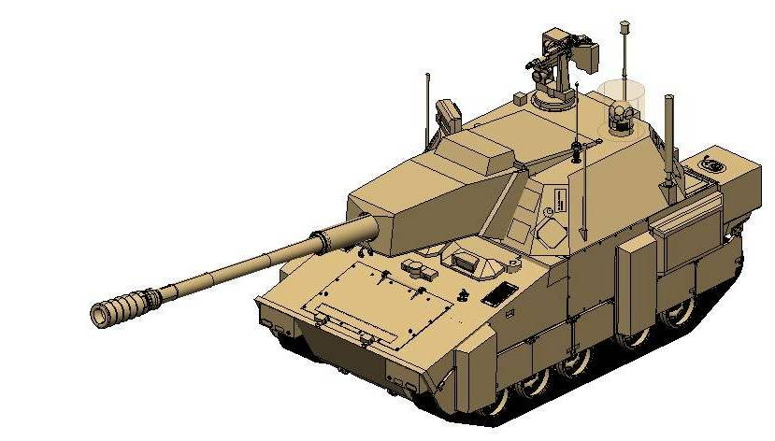

You Know That Old Math Problem….
As students, we learned about the “Two trains that left different cities heading toward each other at different speeds” then calculated when and where they would meet?
As Engineers, we took that lesson to the next level to solve a real world high stakes problem.
  Protect our troops by detecting/destroying threats (Rocket Propelled Grenades)
    Calculate location of threat vs. time
    Launch countermunition to intercept threat at a safe distance
    Do it all in the blink of an eye
  Keys to developing a solution are
    Logical approach (analysis, plan)
    Multi-discipline team
    (collaboration, communication)
    Continually evaluating and
    justifying the solution to stakeholders.
The Engineering Process and Process Standards are both Keys to Problem Solving

Slide 4

The Environment
Workers with STEM skills much needed in today’s global economy.
Technological innovation improves the competitive position of U.S. industries (drives export growth, supports high-quality jobs)
Demand for STEM-capable workers has increased even in traditionally non-STEM fields due to the diffusion of technology- 1,000,000 more by end 2020 (Bureau of Labor Statistics)
Technological progress can improve all workers’ quality of life by improving working conditions and increasing wages- but only if they have STEM skills
Improving access to quality STEM education will strengthen the caliber of the U.S. workforce, drive economic growth, and keep the U.S. competitive.
Source: U S Dept. of Education, National Center for Education Statistics, STEM Attrition: College Students’ Paths Into and Out of STEM Fields 2014

Slide 5
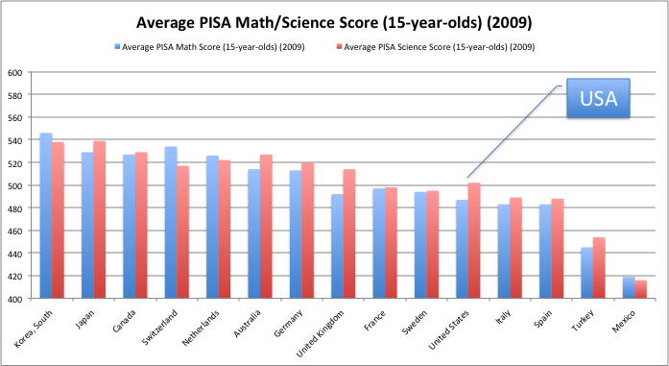
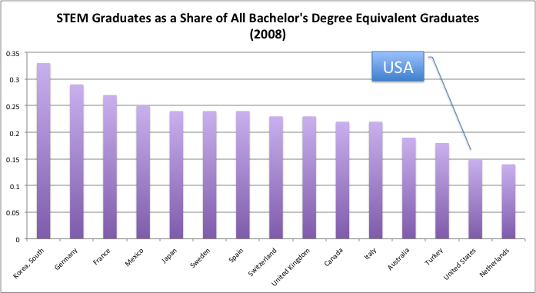
The Challenges
Math/science scores of U.S. students lags behind other nations (Fleischman et al. 2010; Gonzales et al. 2008; Provasnik et al. 2012);
The U.S. has one of the lowest ratios of STEM/non-STEM bachelor’s degrees in the world (National Science Board 2012)
U.S. students, who have great potential to become future science and technology innovators, are eschewing careers in STEM fields (Bettinger 2010; Lowell et al. 2009; Zumeta and Raveling 2002).
Girls and young women do not see engineering as a pathway to multiple career choices (Wang et al. 2013).
Source: US Congress Joint Economic Committee, STEM Education Preparing for the Jobs of the Future April 2012

Slide 6
The Linchpin
“Traditional instruction methods in algebra are failing miserably”
- National Academy of Engineering
Algebra- a simple way to express a repetitive process
  Describes patterns and relationships
  Uses symbols
Why is it different
  First course in abstract reasoning and problem solving
  Use of mathematical symbols and the rules of arithmetic operations
  Structural characteristics can be subtle
If we lose them here….we’re likely going to lose them forever
Source: National Academy of Engineering, The Bridge Linking Engineering and Society Summer 2013

Slide 7
What Do We Do About It?
Improve the students experience BEFORE Algebra !!!
  Make the material less abstract and more real life
  Incorporate technology todays “tech savvy” kids are used to
  Help the teachers--- SMU RME 2015 !
  Introduce competition
  Use collaboration
Connect the dots
  Introduce concepts early and build over time
    (Elementary + Middle + High) School
Discuss the incentive
  Start early dialog about future careers
Even children not bound for STEM careers can benefit from a better grasp of math concepts & problem solving skills
Process Standards
Source: National Academy of Engineering, The Bridge Linking Engineering and Society Summer 2013

Slide 8
Use the Process Standards
apply mathematics to problems arising in everyday life
use a problem-solving model that incorporates:
- analyzing given information
- formulating a plan or strategy
- determining a solution
- justifying the solution
- evaluating the reasonableness of the solution
select tools, including real objects, manipulatives and technology
communicate mathematical ideas and their implications using multiple representations
create and use representations to organize, record, and communicate mathematical ideas
analyze mathematical relationships to connect and communicate mathematical ideas
display, explain, and justify mathematical ideas and arguments using precise mathematical language
Very Similar to the Engineering Process !

Slide 9
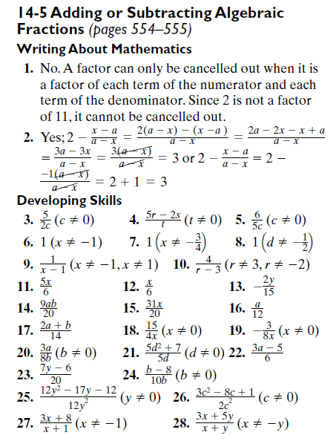
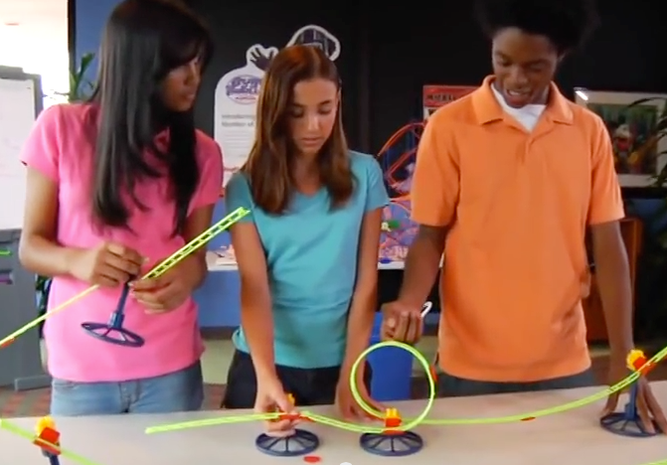
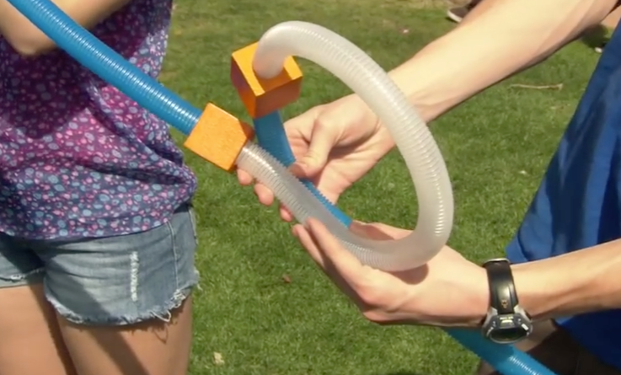
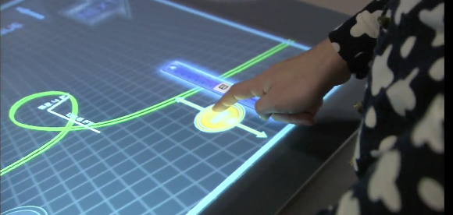
Which Way Would You Rather Learn ?
Everyday Life, representations, problem solving model,
Mathematical implications
Manipulative tools, representations
Relationships, Technology tools

Slide 10

You Know That Old Math Problem….
Don’t Blink

