Slide 1


Mastering the Contract Flow

Slide 2


Welcome & Housekeeping
Sign-Sheet
Recorded Session
Available 24-48 hours after the session, on the website
Q&A session following the presentation. Please hold all questions until the end.
Survey QR Code at the end of session.

Slide 3







Who?

Slide 4
Parts
Preamble – parties, effective date
Recitals – background (whereas…)
Consideration – in consideration of
Body – promises, rights, conditions, reps and warranties, authorizations
Testimonium – (in witness whereof…)
Signatures
Attachments

Slide 5
Non-Disclourse Agreements

Slide 6
Recitals
… Confidential Information pertaining to …
… for the sole purpose of …
Agreements
4. d. Advise each such employee or agent… of the obligations of Receiving Party under this Agreement, and require each such employee or agent to agree in writing or otherwise…;
6. This Agreement imposes no obligation … unless … :
(a) disclosed in a written document or machine readable media marked “CONFIDENTIAL” at the time of disclosure, or
(b) disclosed in any other manner and summarized in a memorandum mailed to Receiving Party within thirty (30) days of the disclosure.

Slide 7

Data Transfer and Use Agreements

Slide 8



Data: what data, whose data, and for what use?
Data from Human Subjects?
Data from Animal Subjects?
Controlled Unclassified Information?
RESEARCH COMPLIANCE (Informed consent, IRB, etc.)
FERPA
HIPAA
CCPA
GDPR
Export Control
Regs
DFARS
and more
Notes:
PHI LDS Infographic FINAL 6.15.17
dtua_guidance_chart.pdf

Slide 9
Provider Assistance needed?
Data Security?
What happens to the Data upon termination of the Agreement?
Permitted Third Parties?
Transfer already governed by other agreements?
Notes:
PHI LDS Infographic FINAL 6.15.17
dtua_guidance_chart.pdf

Slide 10






My research, my data, my equipment, my materials…

Slide 11
Subawards

Slide 12
2 CFR 200.1 Definitions.
…
Subaward means an award provided by a pass-through entity to a subrecipient for the subrecipient to contribute to the goals and objectives of the project by carrying out part of a Federal award received by the pass-through entity…
Subrecipient means an entity that receives a subaward from a pass-through entity to carry out part of a Federal award…
…

Slide 13
§ 200.331 Subrecipient and contractor determinations.
... The pass-through entity is responsible for making case-by-case determinations to determine whether the entity receiving Federal funds is a subrecipient or a contractor.

Slide 14
§ 200.331 Subrecipient and contractor determinations. (Cont.)
… All of the characteristics listed below may not be present in all cases, and some characteristics from both categories may be present at the same time. No single factor or any combination of factors is necessarily determinative. The pass-through entity must use judgment in classifying each agreement as a subaward or a procurement contract… In making this determination, the substance of the relationship is more important than the form of the agreement.

Slide 15
§ 200.331 Subrecipient and contractor determinations. (Cont.)
(a) Subrecipients. … Characteristics that support the classification of the entity as a subrecipient include, but are not limited to, when the entity:
(1) Determines who is eligible to receive what Federal assistance;
(2) Has its performance measured in relation to whether the objectives of a Federal program were met;
(3) Has responsibility for programmatic decision-making;
(4) Is responsible for adherence to applicable Federal program requirements specified in the Federal award; and
(5) Implements a program for a public purpose specified in authorizing statute, as opposed to providing goods or services for the benefit of the pass-through entity.

Slide 16
§ 200.331 Subrecipient and contractor determinations. (Cont.)
(b) Contractors. A contract is for the purpose of obtaining goods and services for the recipient's or subrecipient's use and creates a procurement relationship with a contractor...
Characteristics that support a procurement relationship between the recipient or subrecipient and a contractor include, but are not limited to, when the contractor:
(1) Provides the goods and services within normal business operations;
(2) Provides similar goods or services to many different purchasers;
(3) Normally operates in a competitive environment;
(4) Provides goods or services that are ancillary to the implementation of a Federal program; and
(5) Is not subject to compliance requirements of a Federal program as a result of the agreement. However, similar requirements may apply for other reasons

Slide 17

T

Slide 18
NoA
FDP Cost Reimbursement Template
Subaward
Subrecipient Package
Sponsor T&Cs
2 CFR Part 200

Slide 19


Slide 20
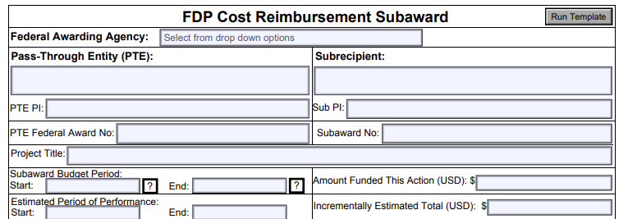

Slide 21
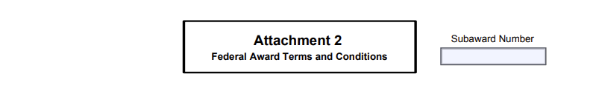
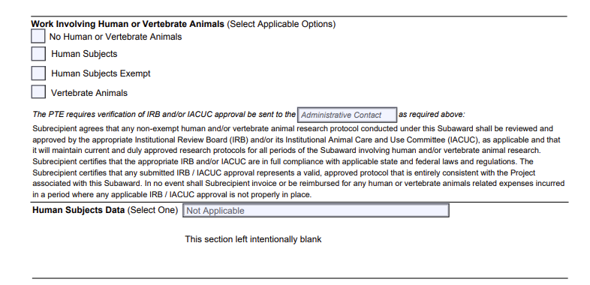

Slide 22
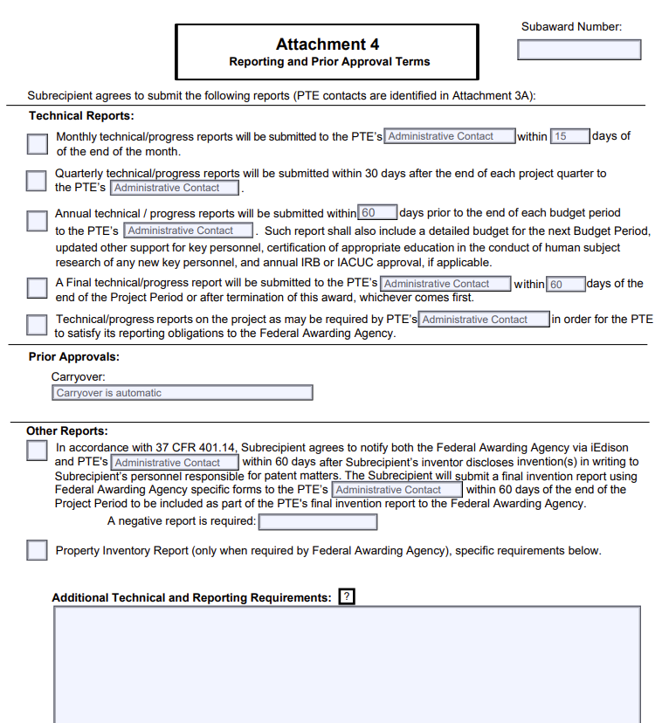

Slide 23
Subcontracts

Slide 24
FAR 52.224.2
Subcontract means any contract, as defined in FAR subpart 2.1, entered into by a subcontractor to furnish supplies or services for performance of the prime contract or a subcontract. It includes, but is not limited to, purchase orders, and changes and modifications to purchase orders.

Slide 25
FAR
DFARS
DEAR
NASA
FLOW
DOWNS
Penn State FAR Matrix Negotiation Tool

Slide 26
Other Agreements/Documents

Slide 27
Sponsored Research Agreements
Teaming Agreements
Research Services Agreements
Consultant Agreement
Equipment Transfer
Material Transfer
Memorandum of Understanding
Etc.

Slide 28
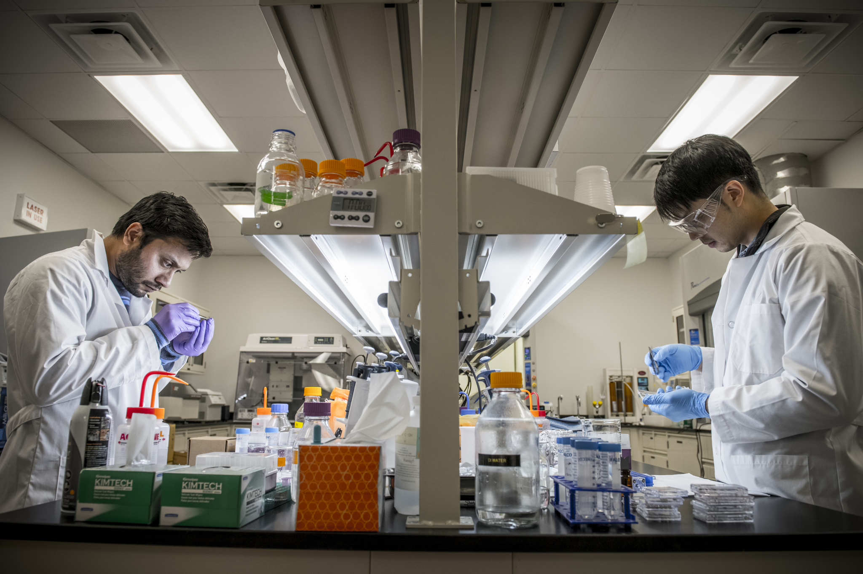

Research Updates & News
Research Integrity & Compliance
If you are conducting research, you may need to complete training that is required by your sponsor.
Online training programs offered through CITI Program have recently been updated for the SMU research community. Enrollment questions have been created to assist the researcher (faculty, staff, & students) select the right training courses. Depending on the type of research to be conducted, new questions will guide you through a process based on your role on a project and from your responses, your training curriculum will be automatically created.
Accessing the CITI Program is completed through Single Sign On (SSO) using your SMU ID at citiprogram.org. For assistance or questions, please contact Research Integrity & Compliance at researchcompliance@smu.edu
Sponsored Projects Administration
The Department of Energy announced a new policy capping "financial support of “indirect costs” of DOE research funding to 15%." This new policy is initially only applicable to institutions of higher education.
The new policy appears to apply to all new grants and "the Department is undertaking action to terminate all grant awards to IHEs that do not conform with this updated policy. See 2 C.F.R. 200.340(a), (b). Recipients subject to termination will receive separate notice and guidance."

Slide 29
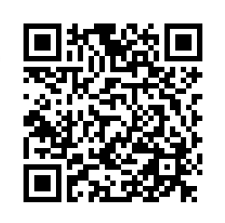

Thank you for attending! Please provide us with feedback by scanning the QR code provided.
Questions?

