Slide 1

2025 ICUT Title IX Training

Slide 2
Session 1
Foundations and Investigative Process

Slide 3
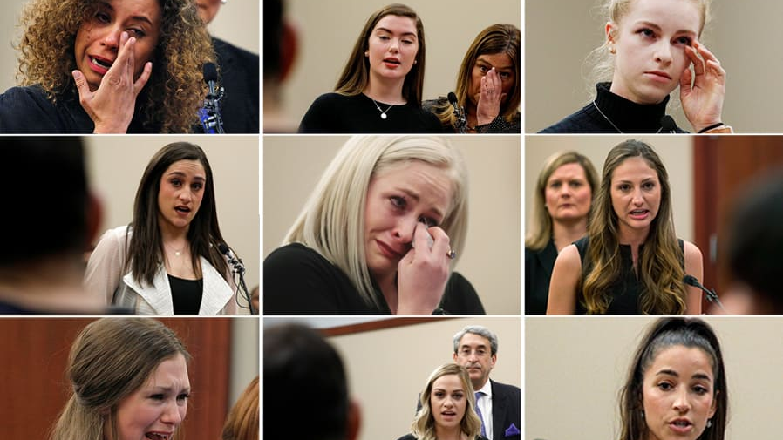

Slide 4
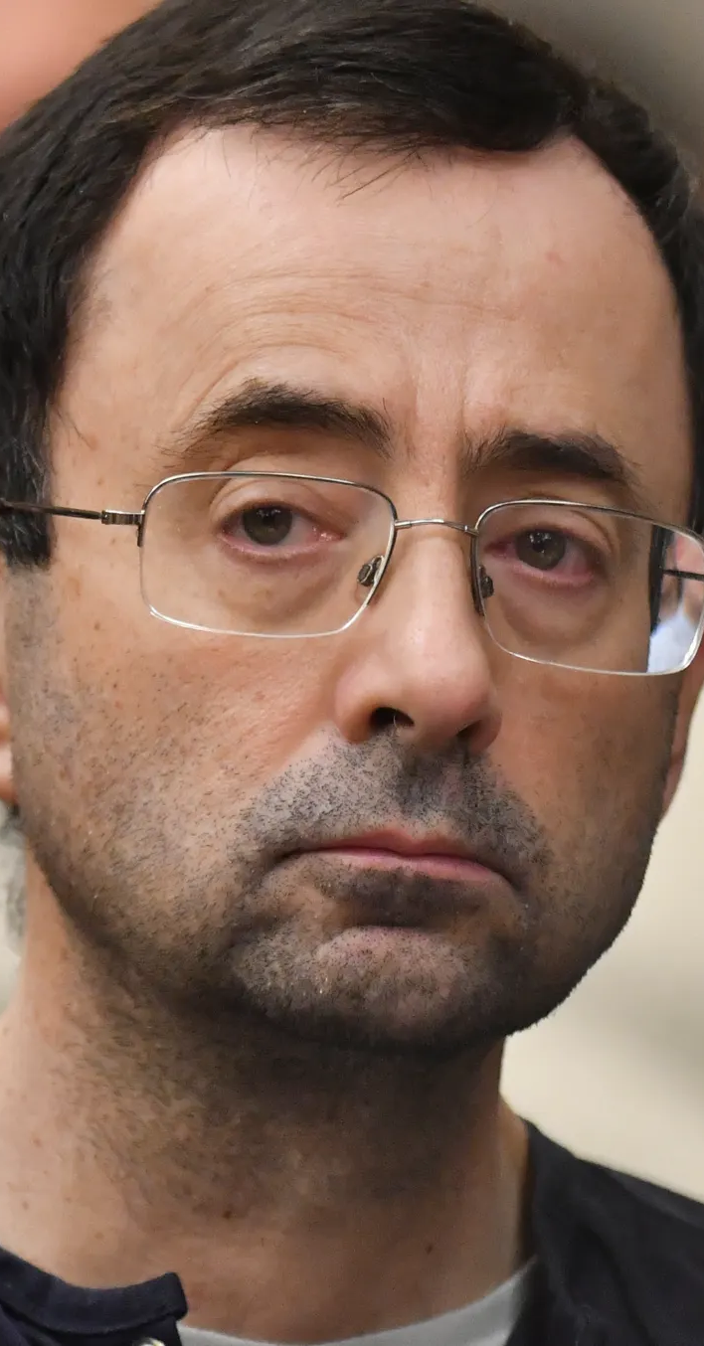
What’s At Stake?
Human cost: 300+ survivors, many students; years of trauma, withdrawals from classes, ongoing mental‑health treatment
Institutional cost: $500 million global settlement with survivors
President, athletic director, and multiple trustees forced to resign

Slide 5


Slide 6

Why We’re Here
When a Title IX report is made, it marks a dark and difficult moment—for everyone involved.
These are stories of harm, fear, and uncertainty. The stakes are personal. Often permanent.
Our role is not just to follow the law—but to meet this moment with care, clarity, and deep humanity.
How we respond can build trust… or deepen the wound.

Slide 7
And if we get it wrong…
We may retraumatize someone who needed help.
We may destroy a reputation without cause.
We may allow someone to continue hurting people.

Slide 8
The Legal Part

Slide 9


Slide 10

Does the alleged conduct meet the definition of “sexual harassment”?
Under §106.30, sexual harassment includes:
Quid pro quo harassment by an employee,
Unwelcome conduct on the basis of sex that is so severe, pervasive, and objectively offensive that it effectively denies a person equal access to the education program or activity, or
Sexual assault, dating violence, domestic violence, or stalking as defined under the Clery Act/VAWA.
⚠️ If the conduct does not meet this definition, the formal Title IX grievance process does not apply (but other institutional policies should).

Slide 11
Did the conduct occur in the school’s “education program or activity”?
Includes locations, events, or circumstances where the school exercises substantial control over both the respondent and the context.
Also includes any building owned or controlled by a student organization officially recognized by a postsecondary institution (e.g., fraternities, sororities).
But…

Slide 12
Did the conduct occur in the United States?
The 2020 regulations exclude conduct that occurred outside the U.S. from the Title IX process (e.g., study abroad).
⚠️ Even if not covered by Title IX, the school may/should address such conduct under a different policy.

Slide 13
Is the complainant participating in or attempting to participate in the education program or activity?
The complainant must be a current or prospective participant (e.g., student, employee, applicant).This is critical for determining whether supportive measures and Title IX grievance procedures apply.
But again …

Slide 14
Has a formal complaint been filed by the complainant or signed by the Title IX Coordinator?
A formal complaint is required to initiate the grievance process.
The Title IX Coordinator may sign a complaint even if the complainant chooses not to, based on safety or institutional concerns.

Slide 15
Is the respondent under the school’s disciplinary authority?
If the respondent is not affiliated (e.g., no longer a student or employee), the grievance process may not be available, though supportive measures may still be provided.

Slide 16
Has the school received “actual knowledge”?
An institution must respond when it has actual knowledge—defined as notice to the Title IX Coordinator or any official with authority to institute corrective measures.

Slide 17


Slide 18
Initial Meetings

Slide 19
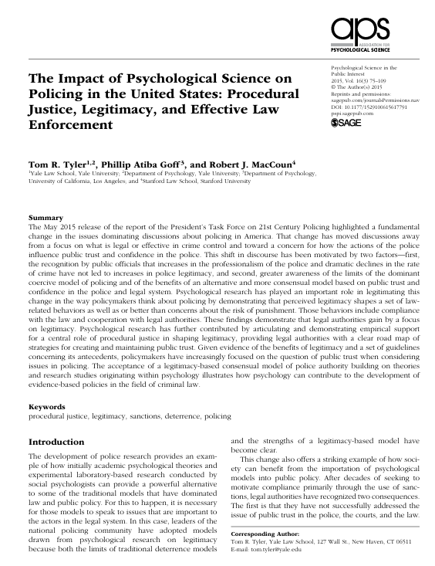
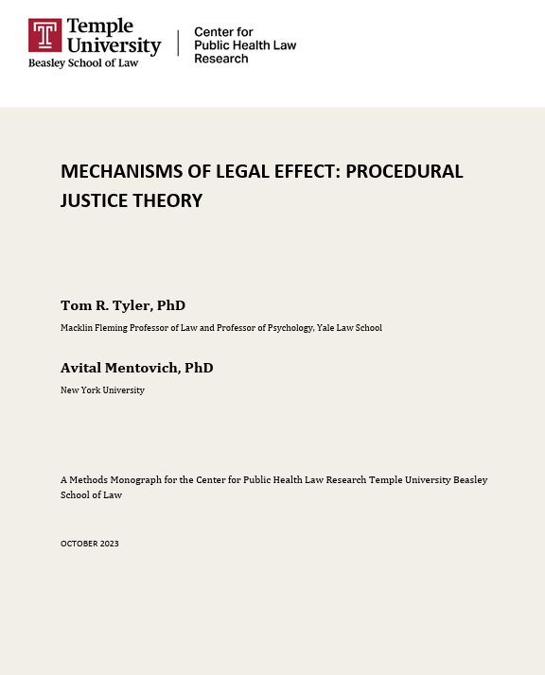

Slide 20
When people believe a process is fair, respectful, and transparent, they are more likely to accept the outcome—even if it's unfavorable.

Slide 21



You're meeting with a student who looks visibly distressed. What’s the first thing you say after introducing yourself?

Slide 22
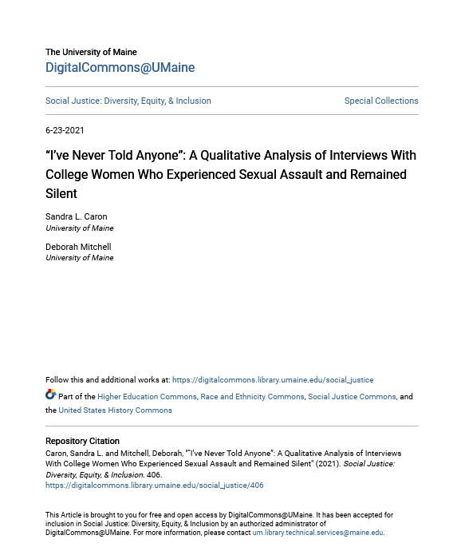
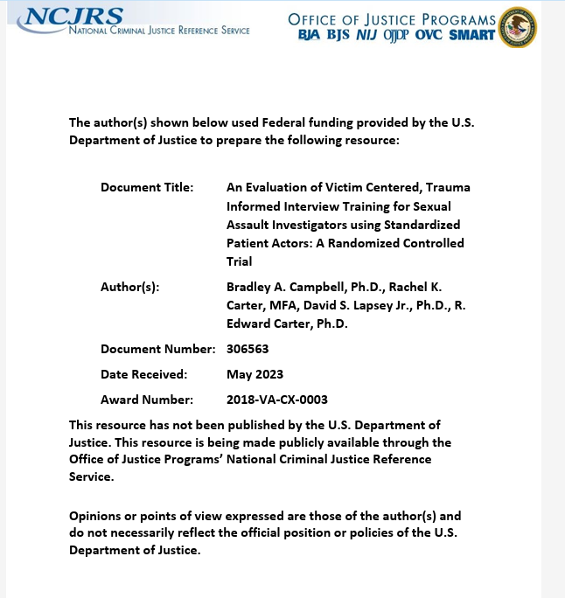

Slide 23
Beginning with Care
Start with Empathy
“Thank you for meeting with me. I understand this may not be easy.”
Introduce yourself and your role.
Outline what you can offer & what to expect—no surprises.
Build Safety & Control
“You have the right to decide how much you share today.”
Emphasize that supportive measures are available now.

Slide 24
Beginning with Care
Acknowledge Emotional Weight
“We understand this can be overwhelming. You don’t have to navigate this alone.”
Offer written materials, contact info, and time to reflect.
Let them know there will be follow-up opportunities.

Slide 25
Beginning with Care
Empower Through Information
Walk through their rights, options, and available resources (on and off campus).
Speak in plain, compassionate language. Avoid legal or bureaucratic jargon.
“You are in control of what comes next.”

Slide 26
What might a student accused of misconduct be feeling in their first meeting?

Slide 27
Your First Conversation with the Respondent
Lead with Fairness and Neutrality. “We’re here to ensure a fair, respectful process for everyone involved.”
Emphasize the presumption of non-responsibility. Approach without judgment or assumptions.
Normalize the Emotions Involved. “It’s completely natural to feel anxious or uncertain in this moment.”
Acknowledge stress without minimizing it.
Allow space for reactions, questions, and pauses.
“This can be an overwhelming time—I’m here to explain what to expect.”

Slide 28
Your First Conversation with the Respondent
Clarify Scope and Next Steps
Outline the process – No decisions have been made– This is not a hearing.
Reassure them of confidentiality and available supportive measures.
Information overload can overwhelm respondents—especially students unfamiliar with legal frameworks. Use simple, structured explanations.

Slide 29
Your First Conversation with the Respondent
Set Ground Rules Compassionately. “You will have an advisor/support person. You’re not alone in this.”
Reinforce expectations around non-retaliation and mutual respect.
Encourage questions about process and role clarity.

Slide 30
Your First Conversation with the Respondent
Commit to Communication
“We’ll keep you informed every step of the way.”
Reiterate timelines, next points of contact, and options for follow-up.
Provide written materials and remind them they can return with questions.

Slide 31
The Importance of Supportive Measures
Must be non-disciplinary, non-punitive, and designed to restore or preserve equal access to education
Victims/survivors are more likely to report incidents when they perceive the institution will offer real, practical support, not just compliance jargon (Campbell, 2006; Holland & Cortina, 2017).
Timely supportive measures—like no-contact orders and housing reassignments—decrease the likelihood of retaliatory contact and prevent emotionally charged confrontations that derail investigations (Edwards et al., 2011).

Slide 32
The Importance of Supportive Measures
When institutions provide concrete, visible, and neutral support early in the process, both parties are more likely to view the process as fair—even when outcomes are adverse (Tyler, 2006; Murphy, 2017).
Failure to provide supportive measures can lead to findings of deliberate indifference under Title IX.

Slide 33


Slide 34
Investigation

Slide 35
What Is “Bias”?
Favoring or disfavoring a party based on status or identity (e.g., complainant, respondent, gender, role)
Prejudging credibility (“Complainants always lie” or “Respondents are usually guilty”)
Prior statements, conduct, or relationships suggesting predisposition

Slide 36
What Is A “Conflict of Interest”?
A personal or professional relationship with a party or witness
A role in the underlying incident (e.g., prior advisor, mentor, or supervisor)
Financial or reputational interest in the outcome

Slide 37
What does coordinator provide investigator to initiate investigation?

Slide 38
Something I’ve Learned from 25 Years of Doing This
Investigators who demonstrate mastery of the definitions are more likely to conduct focused and efficient interviews and avoid evidentiary drift.
How: Before you begin, review:
The relevant Title IX policy
Definitions of prohibited conduct at issue

Slide 39
Create a Structured Investigative Plan
List allegations mapped to specific policies.
Identify parties, witnesses, timelines, and likely evidence (e.g., text messages, keycards, medical records).
Consider the "who, what, when, where, how" of each allegation.
Decide the order of interviews strategically (often complainant, witnesses, then respondent).
Start building a timeline

Slide 40
Hypothetical
Complainant: Jordan, a sophomore
Respondent: Alex, a junior and member of a student organization
Jordan alleges that after a party hosted by Alex’s fraternity on September 16, 2024, Alex walked her back to her residence hall and sexually assaulted her in her room. Jordan reports that she was intoxicated and doesn’t remember all the details clearly but recalls saying “no” and trying to push Alex away.
A roommate entered the room partway through the night and may have seen something. Jordan reported the incident to the Title IX Office on September 20.
There is no formal police report.

Slide 41
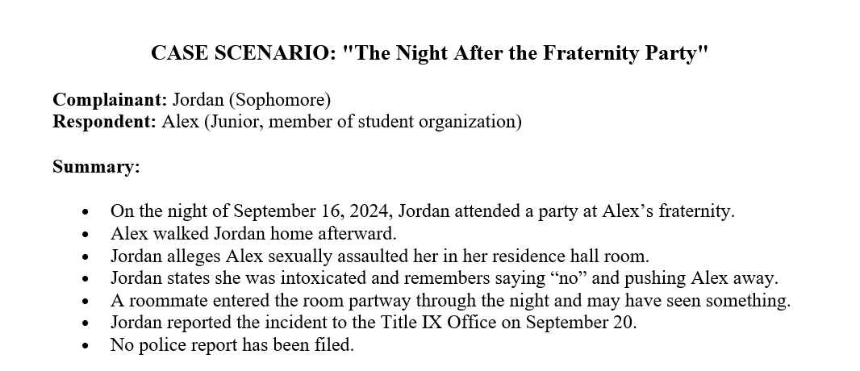
“You’re the Investigator” – A Live Case Simulation

Slide 42
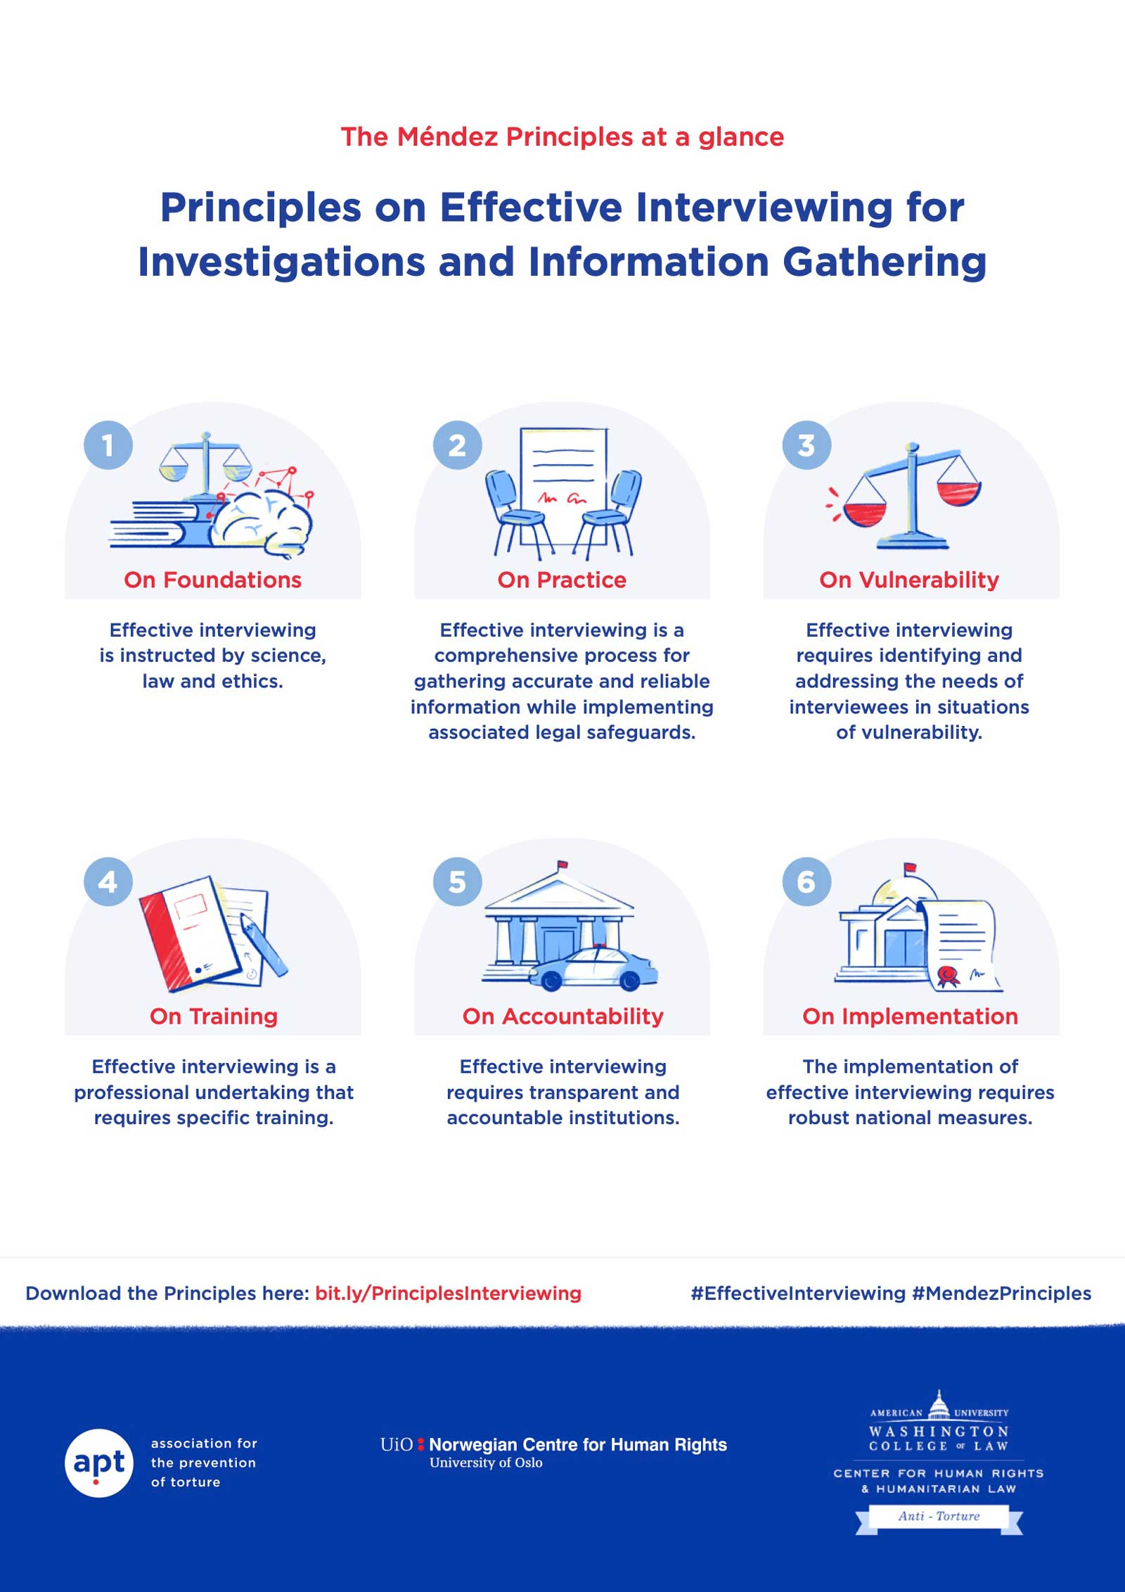

Slide 43
Méndez Principles on Effective Interviewing
Four Foundational Principles
Ground Interviewing in Science and Law
Presume Vulnerability, Promote Dignity
Build Rapport and Trust
Professionalize the Interview Process

Slide 44
1. Preparation
Understand the case context and potential vulnerabilities of the interviewee.
Prepare a non-leading, open-ended question plan.
Choose a setting that prioritizes privacy, comfort, and safety.
Anticipate and accommodate language or accessibility needs.

Slide 45
2. Rapport-Building
Begin with neutral, friendly conversation to reduce anxiety.
Clearly explain your role, the voluntary nature of the conversation, the process, and what will happen next.
Reinforce that the interviewee has control over what they choose to share.

Slide 46
3. Free Narrative
Ask: “Can you tell me everything you remember about…”
Do not interrupt. Let the narrative unfold.
Use nonverbal encouragement (nodding, eye contact, open body language).

Slide 47
4. Clarification and Expansion
Once the free narrative ends, follow up with neutral clarifying questions, such as:
“You mentioned X—can you tell me more about that?”
“Do you remember what happened after that?”
Asking what the interviewee heard, smelled, or saw before/during/after the incident helps bridge trauma‑gapped timelines without leading them
“Help me understand….”

Slide 48
5. Closure
Offer the interviewee a chance to add anything.
Explain next steps and timelines.
Thank them sincerely.

Slide 49
What the Méndez Principles Reject
Coercion, deception, or leading questions
Accusatory or adversarial approaches
Presumptions of guilt or dishonesty
Interrogation-style pressure
Ignoring trauma, stress, or power dynamics
Punitive tone or emotional manipulation

Slide 50
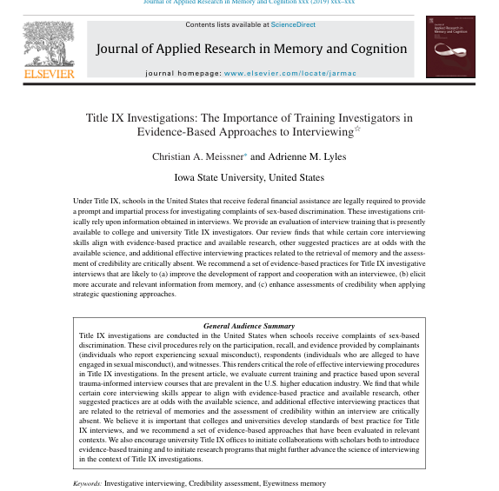

Slide 51
Cognitive Interview Techniques in Practice
Rapport First Establish trust before diving into questioning.
Free Narrative Begin with a neutral prompt (“tell me everything you remember”), then pause and listen.
Context Reinstatement Encourage interviewees to mentally re-enter the scene of the event to trigger richer recall.
Detail-Focused Prompts Ask gentle open-ended questions about specifics without introducing bias.
Strategic Use of Evidence Present evidence later to test consistency, not to lead.

Slide 52
Memorializing Interview
Decide in advance whether you will audio‑record, video‑record, or stenograph
Schedule verification meetings: send transcript or summary to each witness for accuracy confirmation.

Slide 53
Common Sources of Evidence
Text Messages & iMessages
Social Media
Emails
Dating Apps & Messaging Platforms
Surveillance Footage
Photos
Keycard Swipes / Building Access Logs
Uber/Lyft Receipts or Ride History
Medical or Counseling Records (only with voluntary release)
Institutional Records

Slide 54
Text & Social Media Evidence
Common Issues:
Incomplete screenshots
Edited or cropped threads
Best Practice Tips:
Ask for full conversation context (not just snippets)
Review metadata if available (timestamp, sender)
Cross-check with phone records if in doubt

Slide 55
Report Structure
Introduction & Scope
Allegations & Policy Provisions
Procedural History
Summary of Evidence
Applicable Law & Definitions
Disputed Issues of Material Fact
Exhibits & Appendices

Slide 56
Other Thoughts
Neutral Voice, No Spin – Summarize all relevant evidence, even what you think is weak.
Sidebar Notes – Flag any outstanding tasks (“Snapchat record request pending”).
No Findings, No Credibility Labels Delivery Checklist (per 34 C.F.R. § 106.45(b)(5)(vi)):
Send electronically or hard copy to each party and advisor.
Include the entire evidence file, even exculpatory items you may not rely on.
Provide clear instructions: 10 calendar days to submit written response; how to label new exhibits.

Slide 57
Tough Investigative Scenarios: What Would You Do?
Witness changes their account mid-process
How to document inconsistencies
Ethical follow-up questioning
Advisor tries to control the interview
Reaffirm advisor role under Title IX
Set and enforce clear ground rules
Maintain fairness and investigator control

Slide 58
Tough Investigative Scenarios: What Would You Do?
New screenshots or texts are submitted
Authenticity checks (metadata, context)
Complainant disengages emotionally or stops responding
Trauma-informed re-engagement strategies
Respect for autonomy and procedural discretion
When (and how) to pause or proceed

Slide 59
Title IX Hearings and Adjudication –
Ensuring Fair Resolutions

Slide 60

The Worst Hearing Ever
Describe the most chaotic hearing or adjudication process you’ve observed.
What made it so bad?
What could we have done differently?

Slide 61
Pre-Hearing Conference
Clarify logistics, timing, and technology for the hearing
Review witness lists and anticipated evidence
Address accessibility accommodations or language needs
Ensure parties understand rules of decorum and cross-examination procedures
Emphasize Purpose

Slide 62
Best Practices
Hold at least 3–5 days before hearing
Include all parties, advisors, and hearing chair/decision-maker
Provide written summary of agreements and rulings afterward
Document objections raised and resolved
“A well-run pre-hearing conference is the scaffolding of a respectful and lawful adjudication process.”

Slide 63
Kicking Off the Hearing
Opening Remarks Should:
Reiterate the purpose of the hearing
Emphasize the institution’s commitment to fairness, neutrality, and respect
Identify all participants (Complainant, Respondent, Advisors, Witnesses)
Outline the order of proceedings
Set Ground Rules: Address expectations for decorum and conduct
Explain how cross-examination will proceed
Remind parties about recording, confidentiality, and procedural boundaries
Reaffirm that retaliation is prohibited
“How the hearing starts often shapes how the hearing goes. Authority, clarity, and empathy matter.”

Slide 64
Cross-Examination
“Questions and evidence about the complainant’s sexual predisposition or prior sexual behavior are not relevant,”— 34 C.F.R. § 106.45(b)(6)(i)
Exceptions: (1) To prove someone else was responsible (2) To show consent re: prior relationship with respondent

Slide 65
Relevance
“The Department acknowledges that determining relevance in real time during a live hearing may be difficult.”— 85 Fed. Reg. 30026, 30331 (May 19, 2020)
My personal rule: When in doubt about relevance, I generally allow the question. Why?
Relevance Is a Low Bar: Most relevance determinations should be quick and deferential. If a question might reasonably help assess credibility, bias, or facts at issue, it should be allowed.

Slide 66
Hypothetical Scenario
Two students, Taylor (Complainant) and Jordan (Respondent), attended a late-night gathering in the campus commons.
Both admit they drank alcohol.
Taylor alleges that Jordan engaged in sexual activity without consent later that night in Jordan’s dorm.
Jordan claims the encounter was consensual.
During the hearing, Taylor has testified about their memory of the evening, including what they drank, who they were with, and the moment they said “no.”
Jordan’s advisor begins cross-examination.

Slide 67
Relevant Or Irrelevant?
Question 1:“You said you had vodka, but isn’t it true you were also doing shots of Fireball before that?”
Question 2:“Didn’t you tell your roommate earlier that week you were into Jordan?”
Question 3:“Isn’t it true you kissed another person at the party before going upstairs with Jordan?”

Slide 68
Relevant Or Irrelevant?
Question 4:“You’ve accused someone of sexual misconduct before, haven’t you?”
Question 5:“You didn’t scream or fight back. Why not?”
Question 6:“You and Jordan were flirting in your group chat earlier that day. Can you explain that?”

Slide 69
Disruptive Advisors
Scenario: You’re conducting a hearing. The respondent’s advisor repeatedly objects mid-answer (“Objection! Hearsay!”) and tries to coach responses.
How do you respond in the moment? Do you stop the hearing? Do you warn them? What’s your tone?

Slide 70
Disruptive Advisors
Scenario: An advisor uses hostile tone and loaded questions during cross-examination (“Why are you lying about what happened?”).
What’s the standard for intervention? How do you balance fairness with decorum?

Slide 71
What Can You Do?
Remind them of ground rules at the outset
Interrupt and redirect when needed
Issue clear, progressive warnings
Document disruptive behavior
Remove an advisor only as a last resort

Slide 72
Report Writing Common Pitfalls
Failure to Adequately Explain Findings
Courts consistently criticize reports that contain conclusory statements with no rationale.
Common issue: Findings of responsibility or non-responsibility are stated without explaining why evidence was credited or discounted.
Example: “The panel found the complainant not credible,” but provided no reasoning, leaving the court unable to assess whether the decision was arbitrary.— Doe v. Univ. of Denver, 952 F.3d 1182 (10th Cir. 2020)

Slide 73
Report Writing Common Pitfalls
Ignoring or Mischaracterizing Evidence
Decision-makers sometimes omit key evidence or misstate what was said or submitted, raising concerns of bias or procedural irregularity.
Common issue: Not addressing documentary or witness evidence that contradicts the conclusion.
Example: In Doe v. Purdue Univ., 928 F.3d 652 (7th Cir. 2019), the university expelled a student without considering his version of events or exculpatory evidence.

Slide 74
Report Writing Common Pitfalls
Insufficient Analysis of Credibility
While credibility is often central, many reports fail to explain why a party or witness was or was not credible.
Common issue: Boilerplate language such as “The panel found the respondent more credible,” without connecting it to specific facts.
Courts expect: Acknowledgement of inconsistencies; evaluation of corroboration, motive, or plausibility; be careful about trauma-informed factors

Slide 75
Some Others
Failure to Address Policy Elements
Disorganized or Unclear Structure
Language Suggesting Bias or Presumption
Failure to Explain Sanctions and Remedies

Slide 76
A Moment On Sanctions
Purpose of Sanctions
Restore or preserve equal access to the education program
Address the harm caused and prevent recurrence
Sanctions are not punishment for punishment’s sake—they serve institutional equity
Considerations When Determining Sanctions
Nature and severity of the misconduct
Impact on the complainant and broader campus community
Whether the respondent poses an ongoing risk
Prior misconduct history (if any)

Slide 77
“Design the Ideal Hearing”
Share creative or unusual ideas that worked for your institution

Slide 78
Challenges
Retaliation
Disabilities and Intersectionality
Bias and Conflict of Interest
Coordinating with Law Enforcement

Slide 79
Informal Resolution

Slide 80


Slide 81
First Principles: Overarching Title IX Duty
Prevent/Remedy Sex Discrimination!
Supportive measures
Equitable treatment
Respond to known acts of sexual harassment in a manner that is not “clearly unreasonable”
Generic Hypo: Your president has asked you to explain to him why the university’s response to a report of sex harassment was not clearly unreasonable.
What facts would you want to be able to cite?

Slide 82

The Regulations In A Nutshell
An optional institutional alternative (should, when, how, & by whom)
Guidance paperwork (how does process work & consequences of participating in the process)
Voluntary for both sides (how to assess & demonstrate)

Slide 83
In The Courts
Very few reported cases analyzing informal resolution practices
Why?
Federal courts have been reluctant to allow deliberate indifference claims based on an institution’s use of an informal resolution process in general
Key issues: voluntariness, timeliness, and remedies/enforcement
Communicate with parties about status (where are we)
If the institution follows policies and procedures, courts appear to be reluctant to second-guess the decision or outcome.

Slide 84
Hypothetical: The Case of the Class Project Pairing
Jordan (they/them), a junior, alleges that Alex (he/him), a senior, made unwelcome sexual advances during a group meeting, including comments and touching. Jordan does not want a hearing but is open to informal resolution with conditions. Alex denies the allegations but is open to “resolving it quietly.” You’re the Title IX Coordinator. Should informal resolution be offered?

Slide 85
Would You Offer Informal Resolution?
Work in small groups or at your table. You’ll have 10 minutes to review the case and decide:
Is this matter eligible for informal resolution under your policy?
Would you offer it?
What would you want to see in the terms?
What concerns might lead you to say no?

Slide 86
Group Discussion Prompts
Is the allegation (unwanted touching, suggestive comments) eligible under your policy?
Are both parties truly engaging voluntarily?
Would informal resolution preserve educational access and safety?
What safeguards or terms would make you more comfortable proceeding?
What are the risks—either of proceeding or declining?

Slide 87
Threshold Question: Should Informal Resolution Even Be An Option?
The Easy “No”: allegations that an employee sexually harassed a student
The Complicated: Are there situations where informal resolution would be not appropriate (or “clearly unreasonable”)?
One potential guidepost: if allegations are true, would it be appropriate for accused to remain on campus (on-going threat to campus community → gravity of the alleged offense, repeat offender, risk of repeating, weapons, minor victim, etc.)

Slide 88
Three Suggested Best Practices
Clear policy language is important -- Make sure the policy reflects (a) who needs to consent to an informal resolution and (b) what factors university officials will consider
Show your work -- document your analysis (sorry)
Monitor for consistent application and implicit bias (i.e., similar fact patterns should be handled consistently)

Slide 89
You Say Yes! Now to Complainant
Discuss options with Complainant
Explain the IR process in writing
Form document that satisfies regulatory requirements → Have a non-lawyer human being read this for clarity
If Complainant says “no,” that’s a wrap
What do you say about IR?
What are pros & cons to mention?
What should you avoid?
Timing?
What are some of the questions you may get from the Complainant?

Slide 90
Complainant Say Yes! Now to Respondent
Discuss options with Respondent
Explain the IR process in writing
Form document that satisfies regulatory requirements → Have a non-lawyer human being read this for clarity
If Respondent says “no,” that’s a wrap
What do you say about IR?
What are pros & cons to mention?
What should you avoid?
Timing?
What are some of the questions you may get from the Respondent?
*** can this be used against me in a subsequent proceeding? Sent to subsequent schools? Part of education record?

Slide 91
How Do We Ensure Voluntary Participation?
Clear communications (can’t stress this enough)
Be timely, but don’t rush
Require parties to sign a clear Participation Agreement
Periodic check-ins and monitoring (Who? How?)
Reiterate where appropriate that either party can stop the process
What would be a red flag about a party’s voluntary participation?
Rule → when in reasonable doubt, put concern on table/stop the process
Show your work (again – sorry)
What if…once you’re done, a party objects that they didn’t, in fact, voluntarily participate?

Slide 92
Types of Informal Resolution
Administrative adjudication
Facilitated conversations
Restorative justice
Mediation

Slide 93


Slide 94
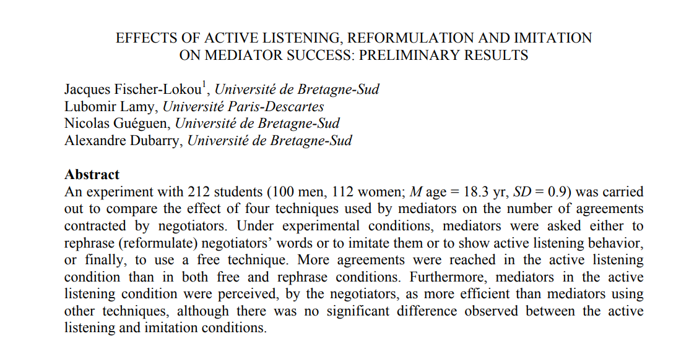
What Makes A Good Mediator?
Reasonable participants
Ability to establish rapport
Listening for Understanding/Establishing trust (what can I share?)
Soliciting what parties want & setting expectations
Creativity

Slide 95
Four Items For Preparation Of Mediator
Reasonable summary of report and status
Background information on parties and advisors
Information for assessment of potential conflicts
Summary of concerns raised (if any) in screening process

Slide 96
My Personal Preference for Process Steps
Send an introductory communication where I discuss process and begin scheduling meetings
Meet with complainant (listen primarily & get a sense of remedies sought)
Meet with respondent (listen primarily & get a sense of willingness to address harm)
Assess and plot next steps

Slide 97
Other Considerations
Some mediations begin with both sides in the room together sharing account – I’m generally not a fan
Is in person preferable for party meetings?
Can advisors be helpful or harmful? How to engage?

Slide 98
Some General Question Possibilities
“I’ve read the materials in this matter and am familiar with the report, is there anything else you think is important to share with me?”
“Can you walk me through what you would like to achieve through this process?”
“Are there things you are willing to do remedy the harm Complainant has expressed?”

Slide 99
How Long Should Process Take?
From regulations: “reasonably prompt” with extensions for “good cause” with written notice to parties
Practical 1: comply with institutional policy
Practical 2: I worry when I’m past 21 days from receiving file
Is there a reasonable basis for resolution?
Is it worth setting a firm deadline for a response?
Ensure parties and IX Coordinator are apprised of where things stand

Slide 100
Some Outcome Examples
Administrative accommodations such as adjusting class schedules, changing sections, etc.
Apologies
Voluntary educational, mentoring, or coaching sessions
Relocation or removal from a residence hall or other on-campus housing
Verbal cautions/warnings
Training
Collaborative agreements on behavioral or institutional changes
No on-going contact
Voluntary withdrawal from university ***

Slide 101
Example Confidentiality Language in Agreements
“I agree that to the extent permitted by law, I will not use information obtained and utilized during informal resolution in any other institutional process (including investigative resolution under the Policy if informal resolution does not result in an agreement) or legal proceeding, though information documented and/or shared during informal resolution could be subpoenaed by law enforcement if a criminal investigation or civil suit is initiated.”

Slide 102
Post-Conference: Monitoring
This is mission critical!
Clarity on who is responsible
Hypo: Respondent becomes non-responsive and does not participate in agreed-to educational activities.
How do we enforce?

Slide 103
Guideposts (One More Time)
Respond to known acts of sexual harassment in a manner that is not “clearly unreasonable”
Complainant: Continue in educational program
Respondent: Continue in educational program so long as there is no harm to campus community
The perspective is peacemaking, supportive, and educational – it’s not confrontational, punishment-oriented, or overly legalistic
Keep the parties posted
Be honest with the parties but stress they control outcome (this is voluntary!)
Be timely

