Slide 1
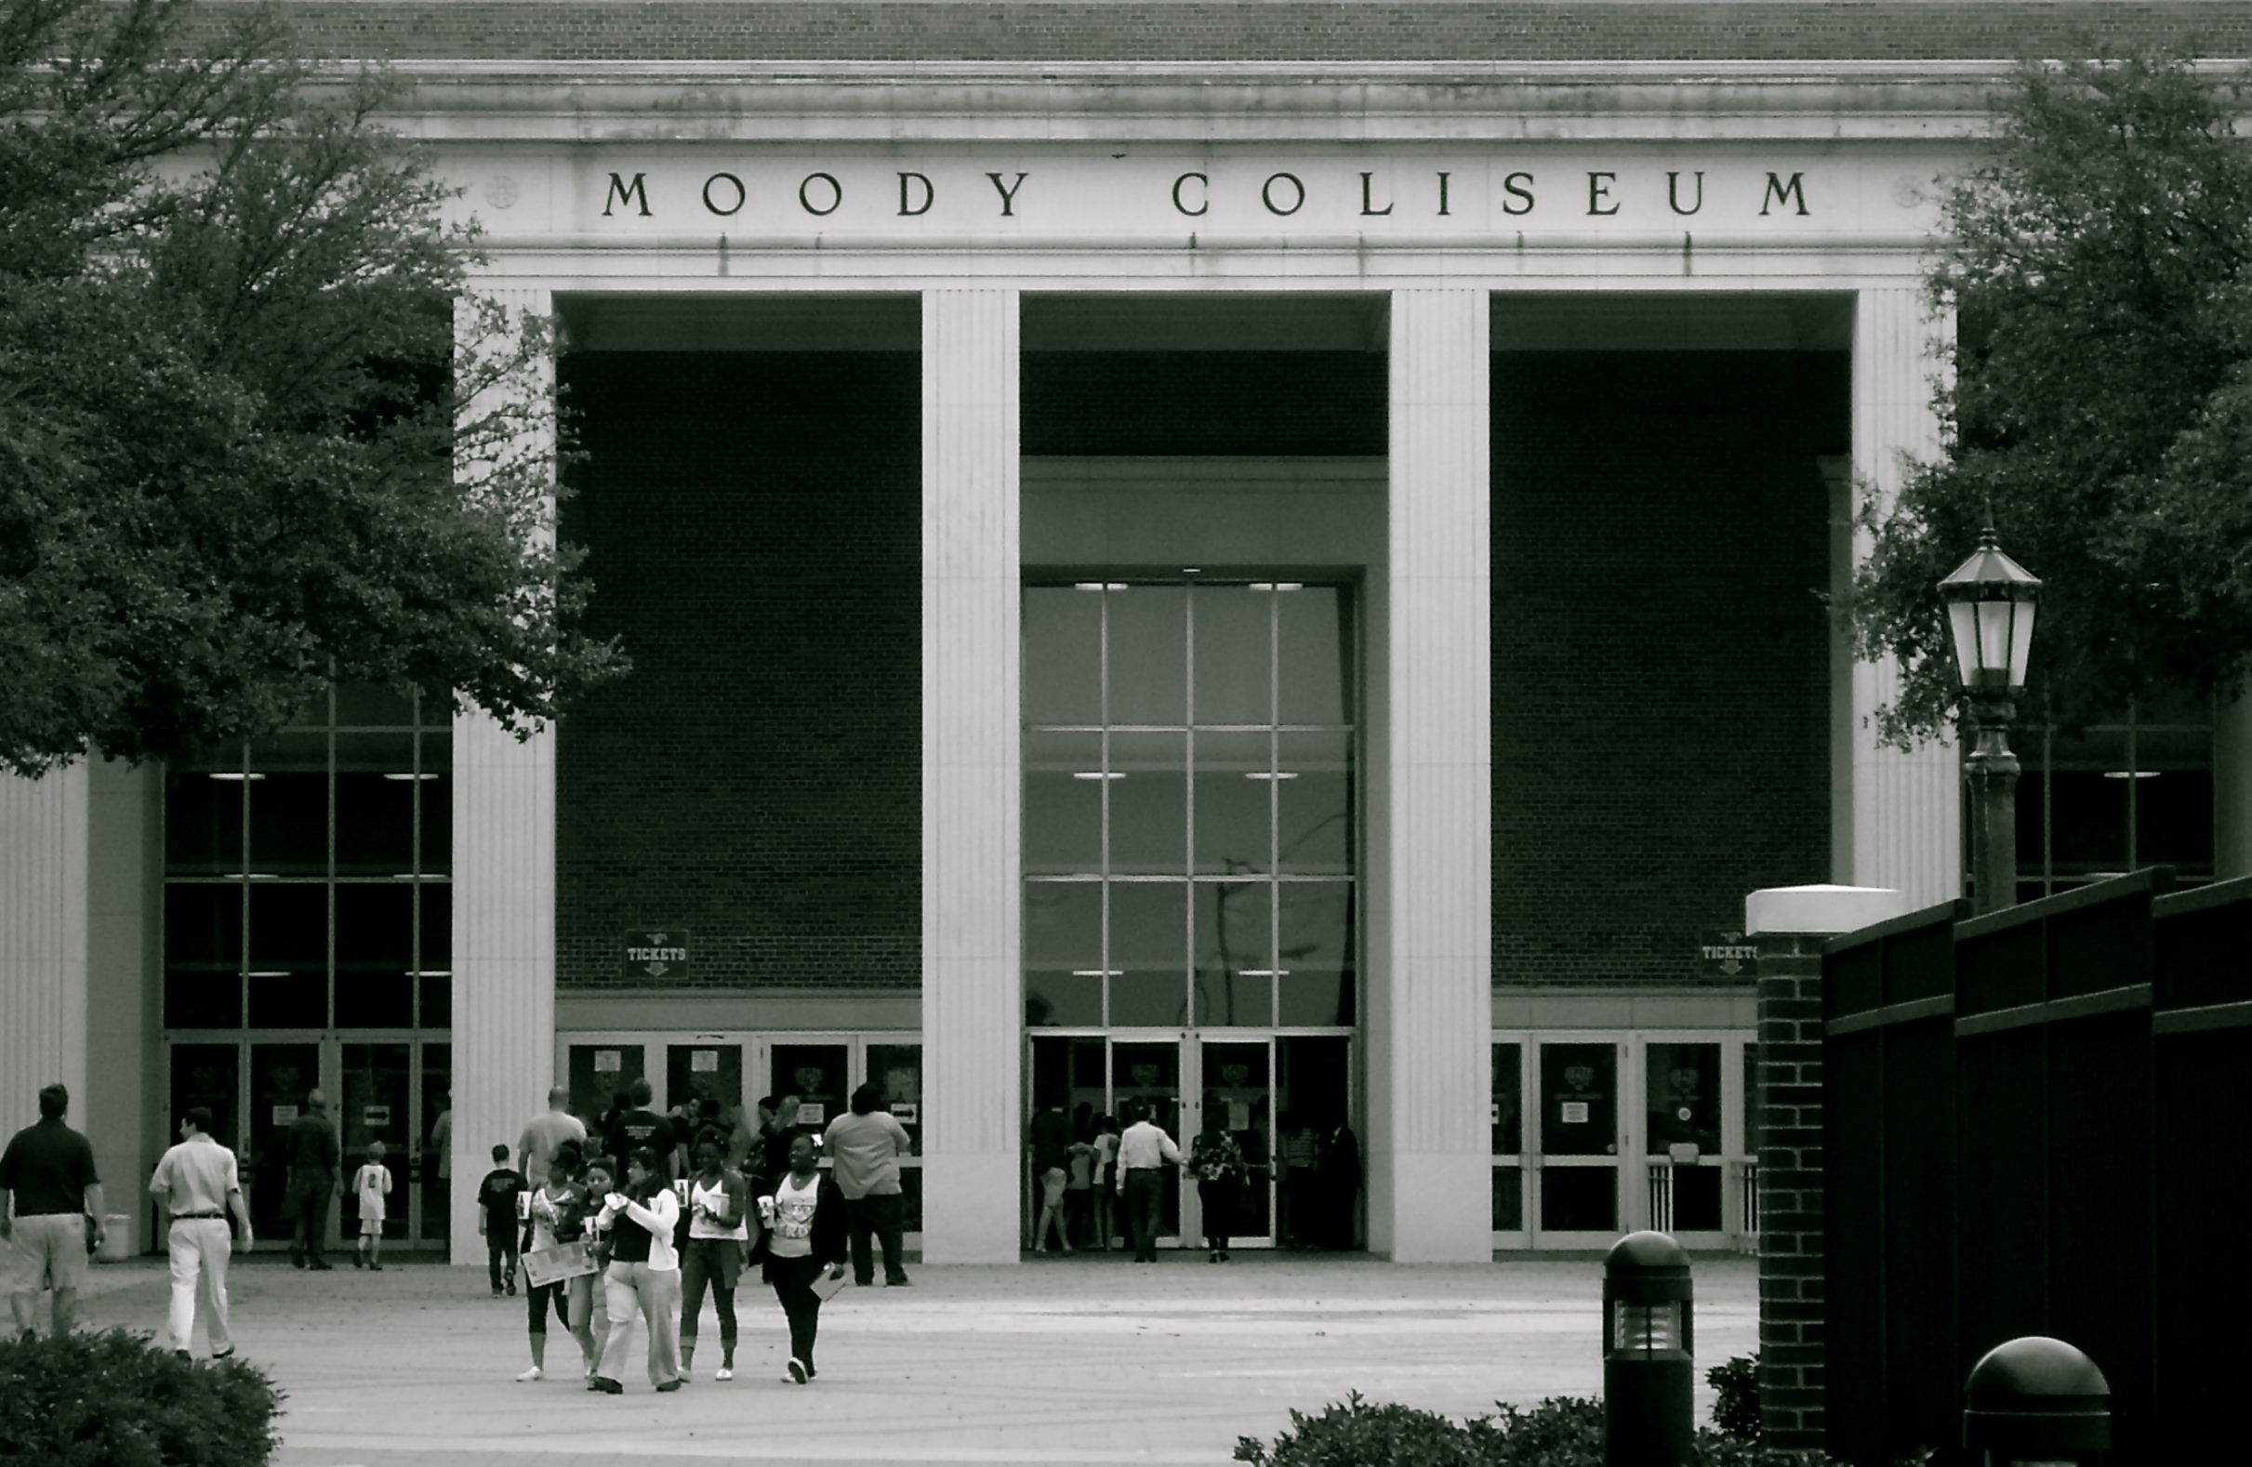
How many basketball games have you attended at SMU? Now, how many women’s basketball games have you attended at SMU?

Slide 2
The following presentation is a documentation of the disparity in fan support, measured by attendance, between male and female basketball games. Jessica Noel

Slide 3
Collegiate Basketball Average Attendance Per Game (2010 season)
School | Men’s Basketball | Women’s Basketball
SMU | 2,688 | 964
Texas Tech | 9,290 | 6,837
TCU | 3,686 | 2,563
University of North Texas | 2,716 | 865
University of Texas at Austin | 14,629 | 4,909

Slide 4
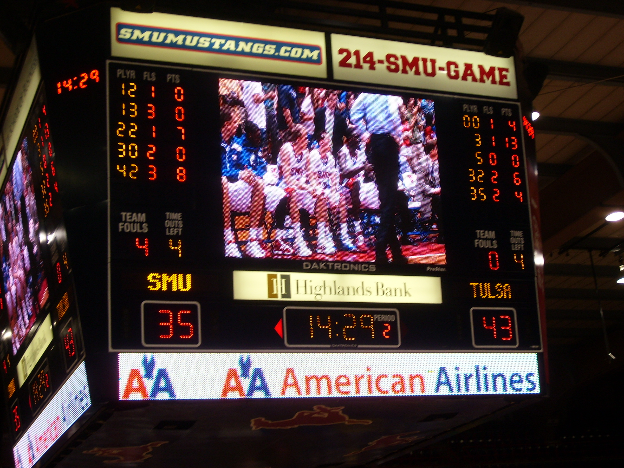
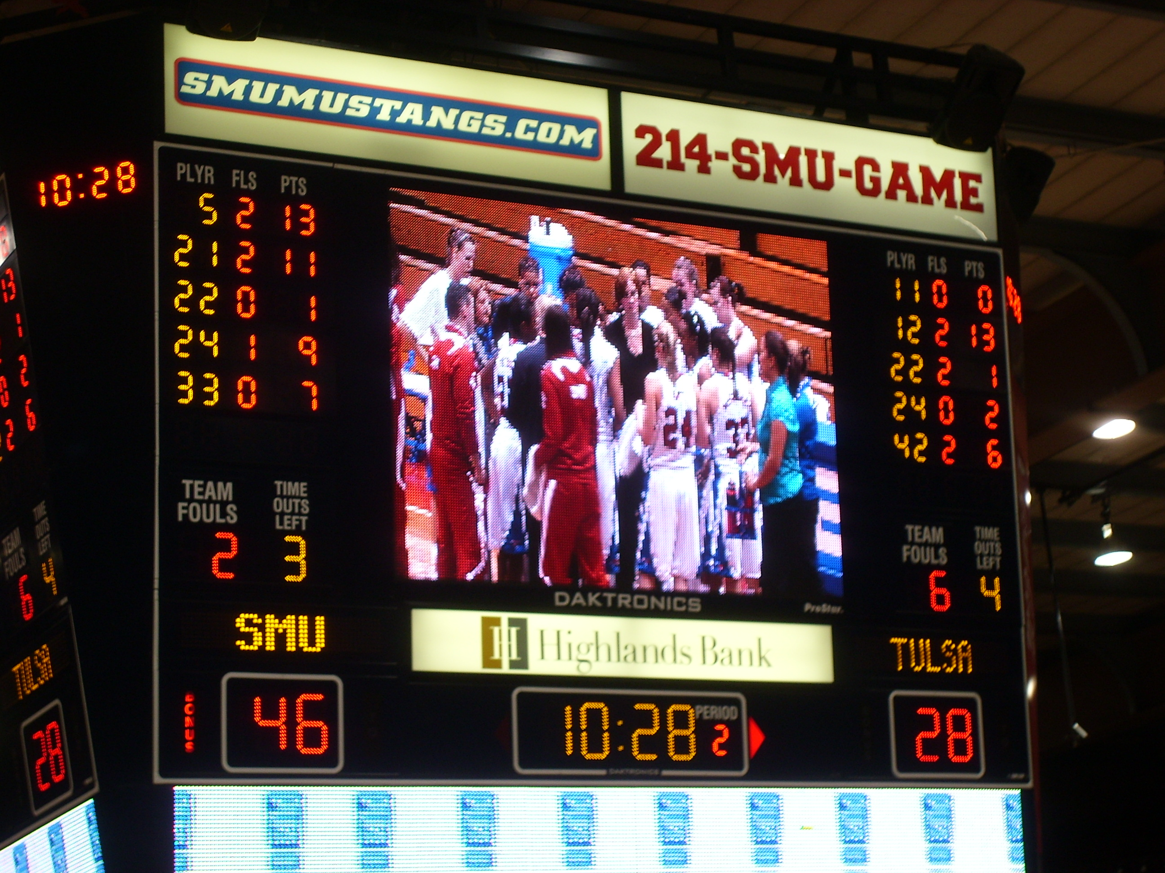
Men’s Final Score: Loss: 74 - 66
Winning games doesn’t translate into fan support for women.
Women’s Final Score:
Win: 66 - 58

Slide 5
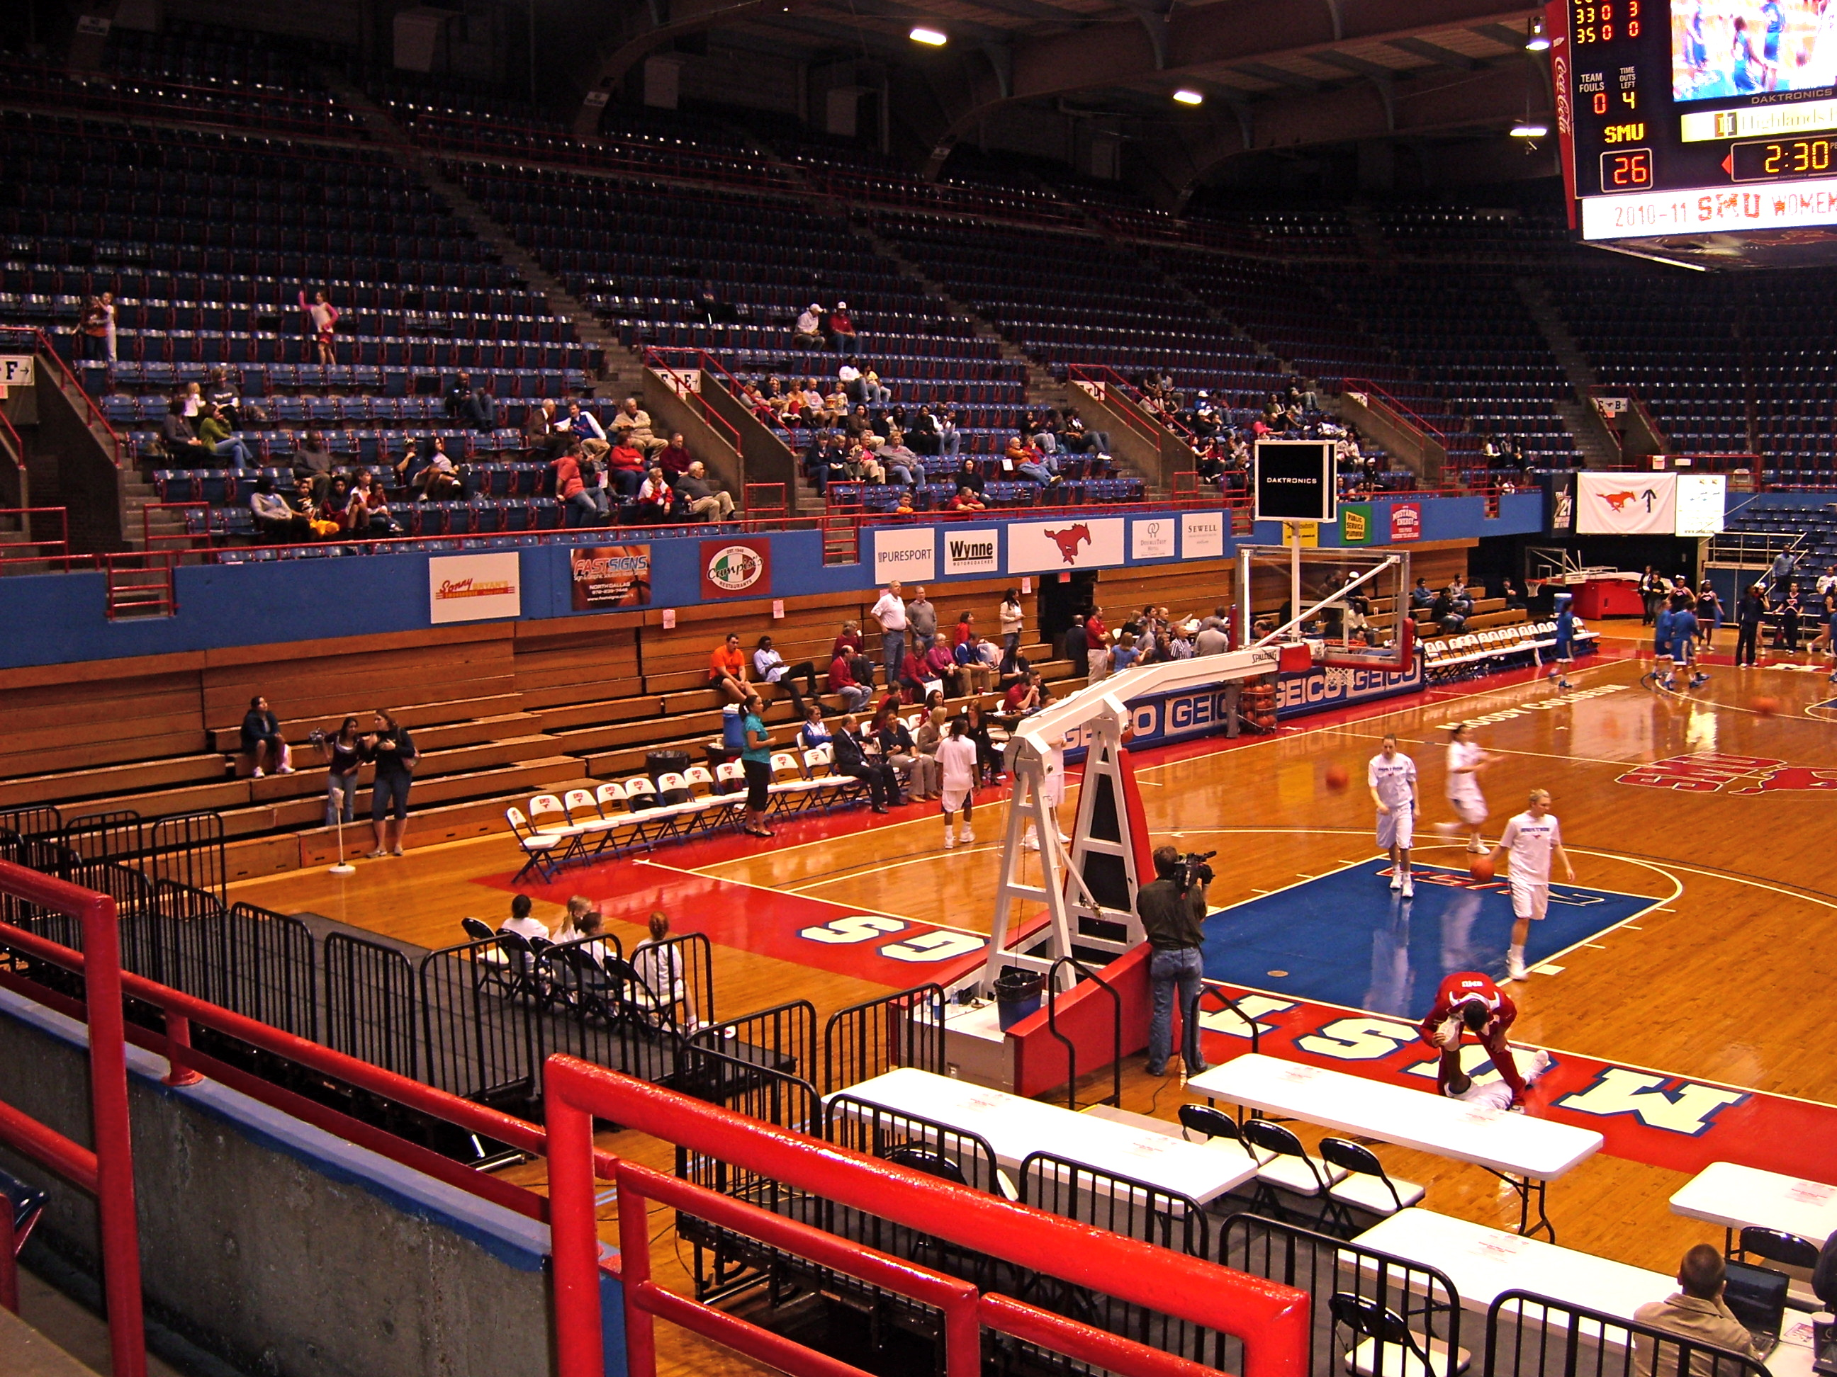
Women’s Game

Slide 6
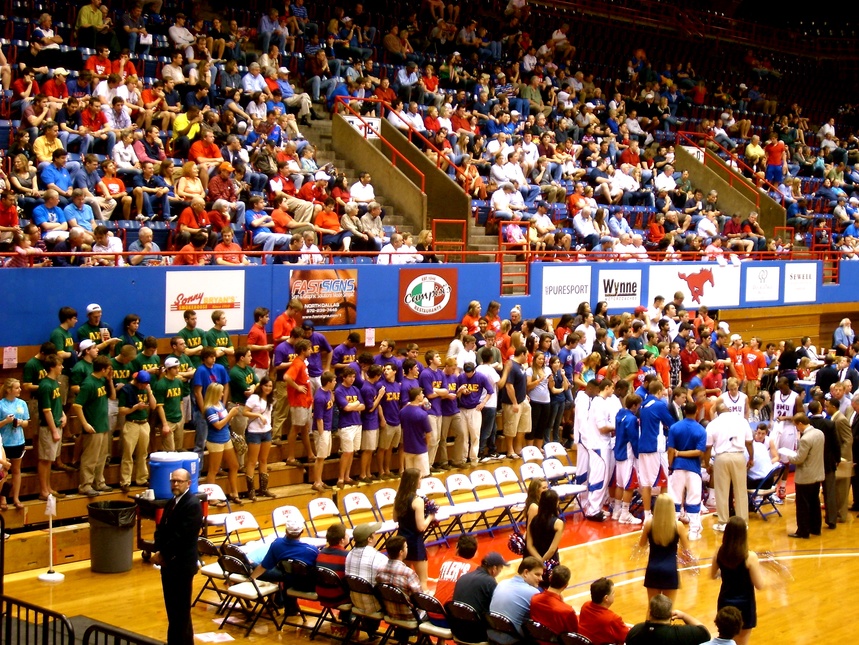
Men’s Game

Slide 7
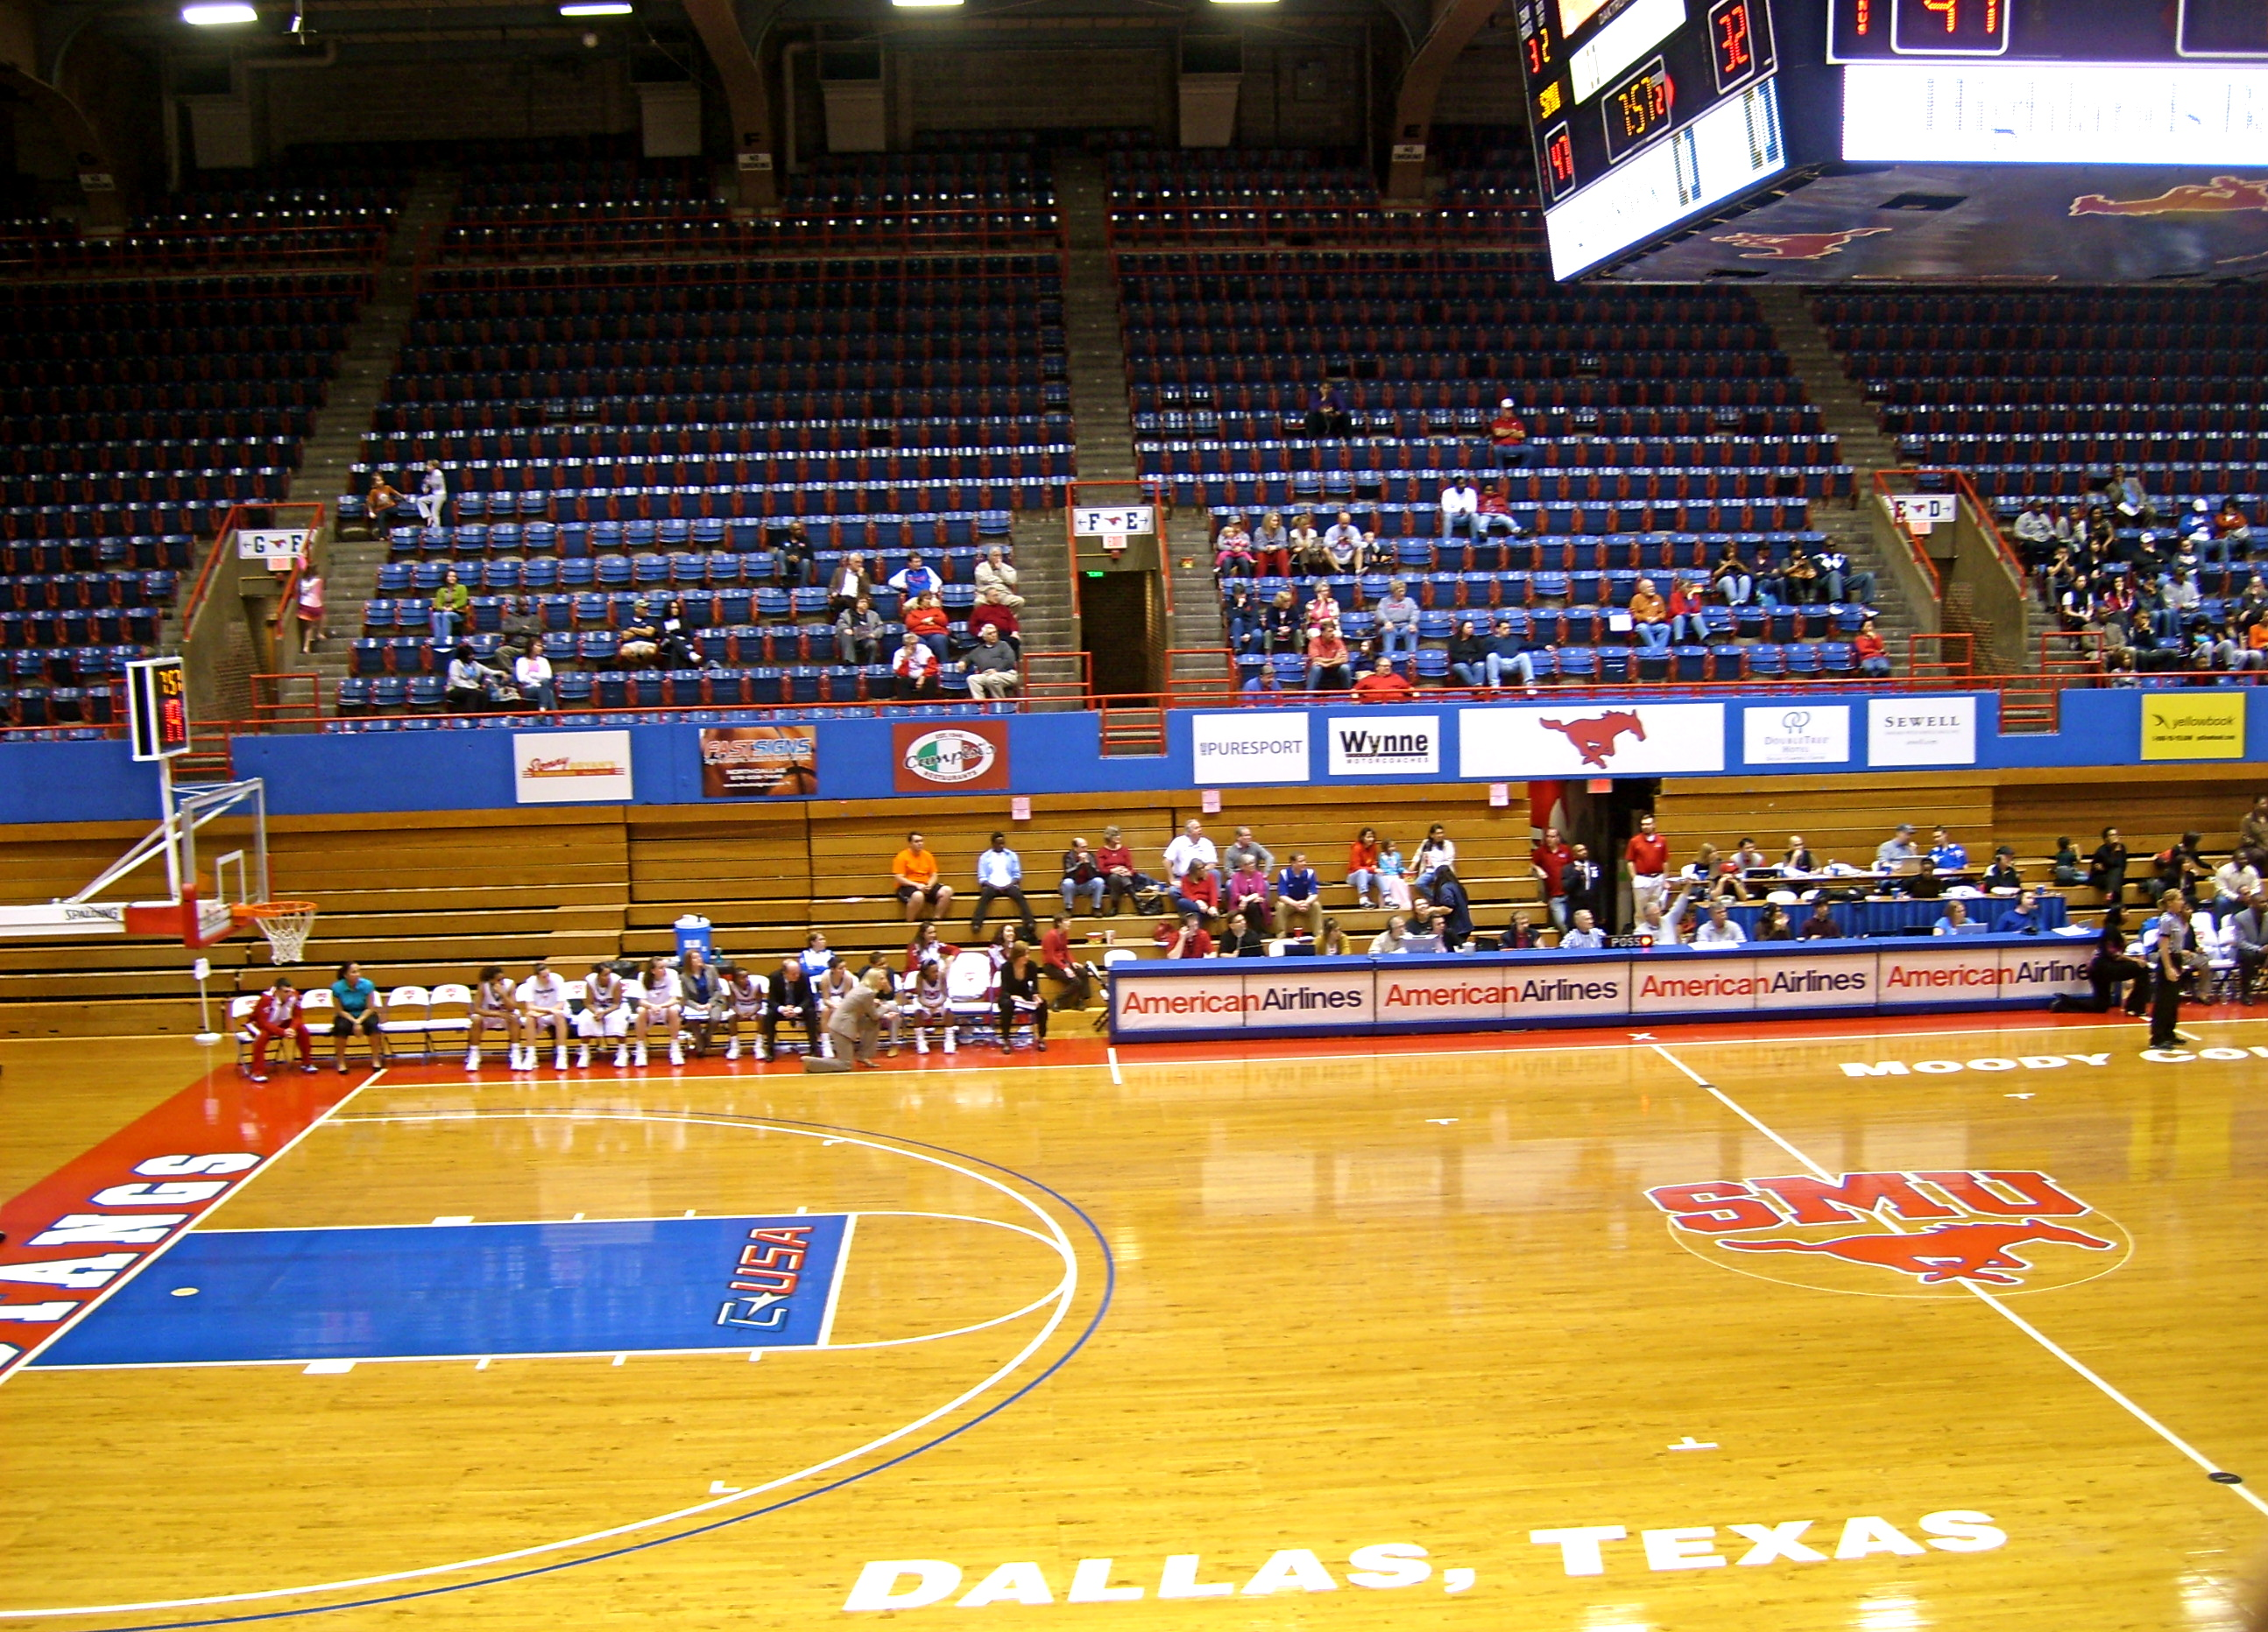
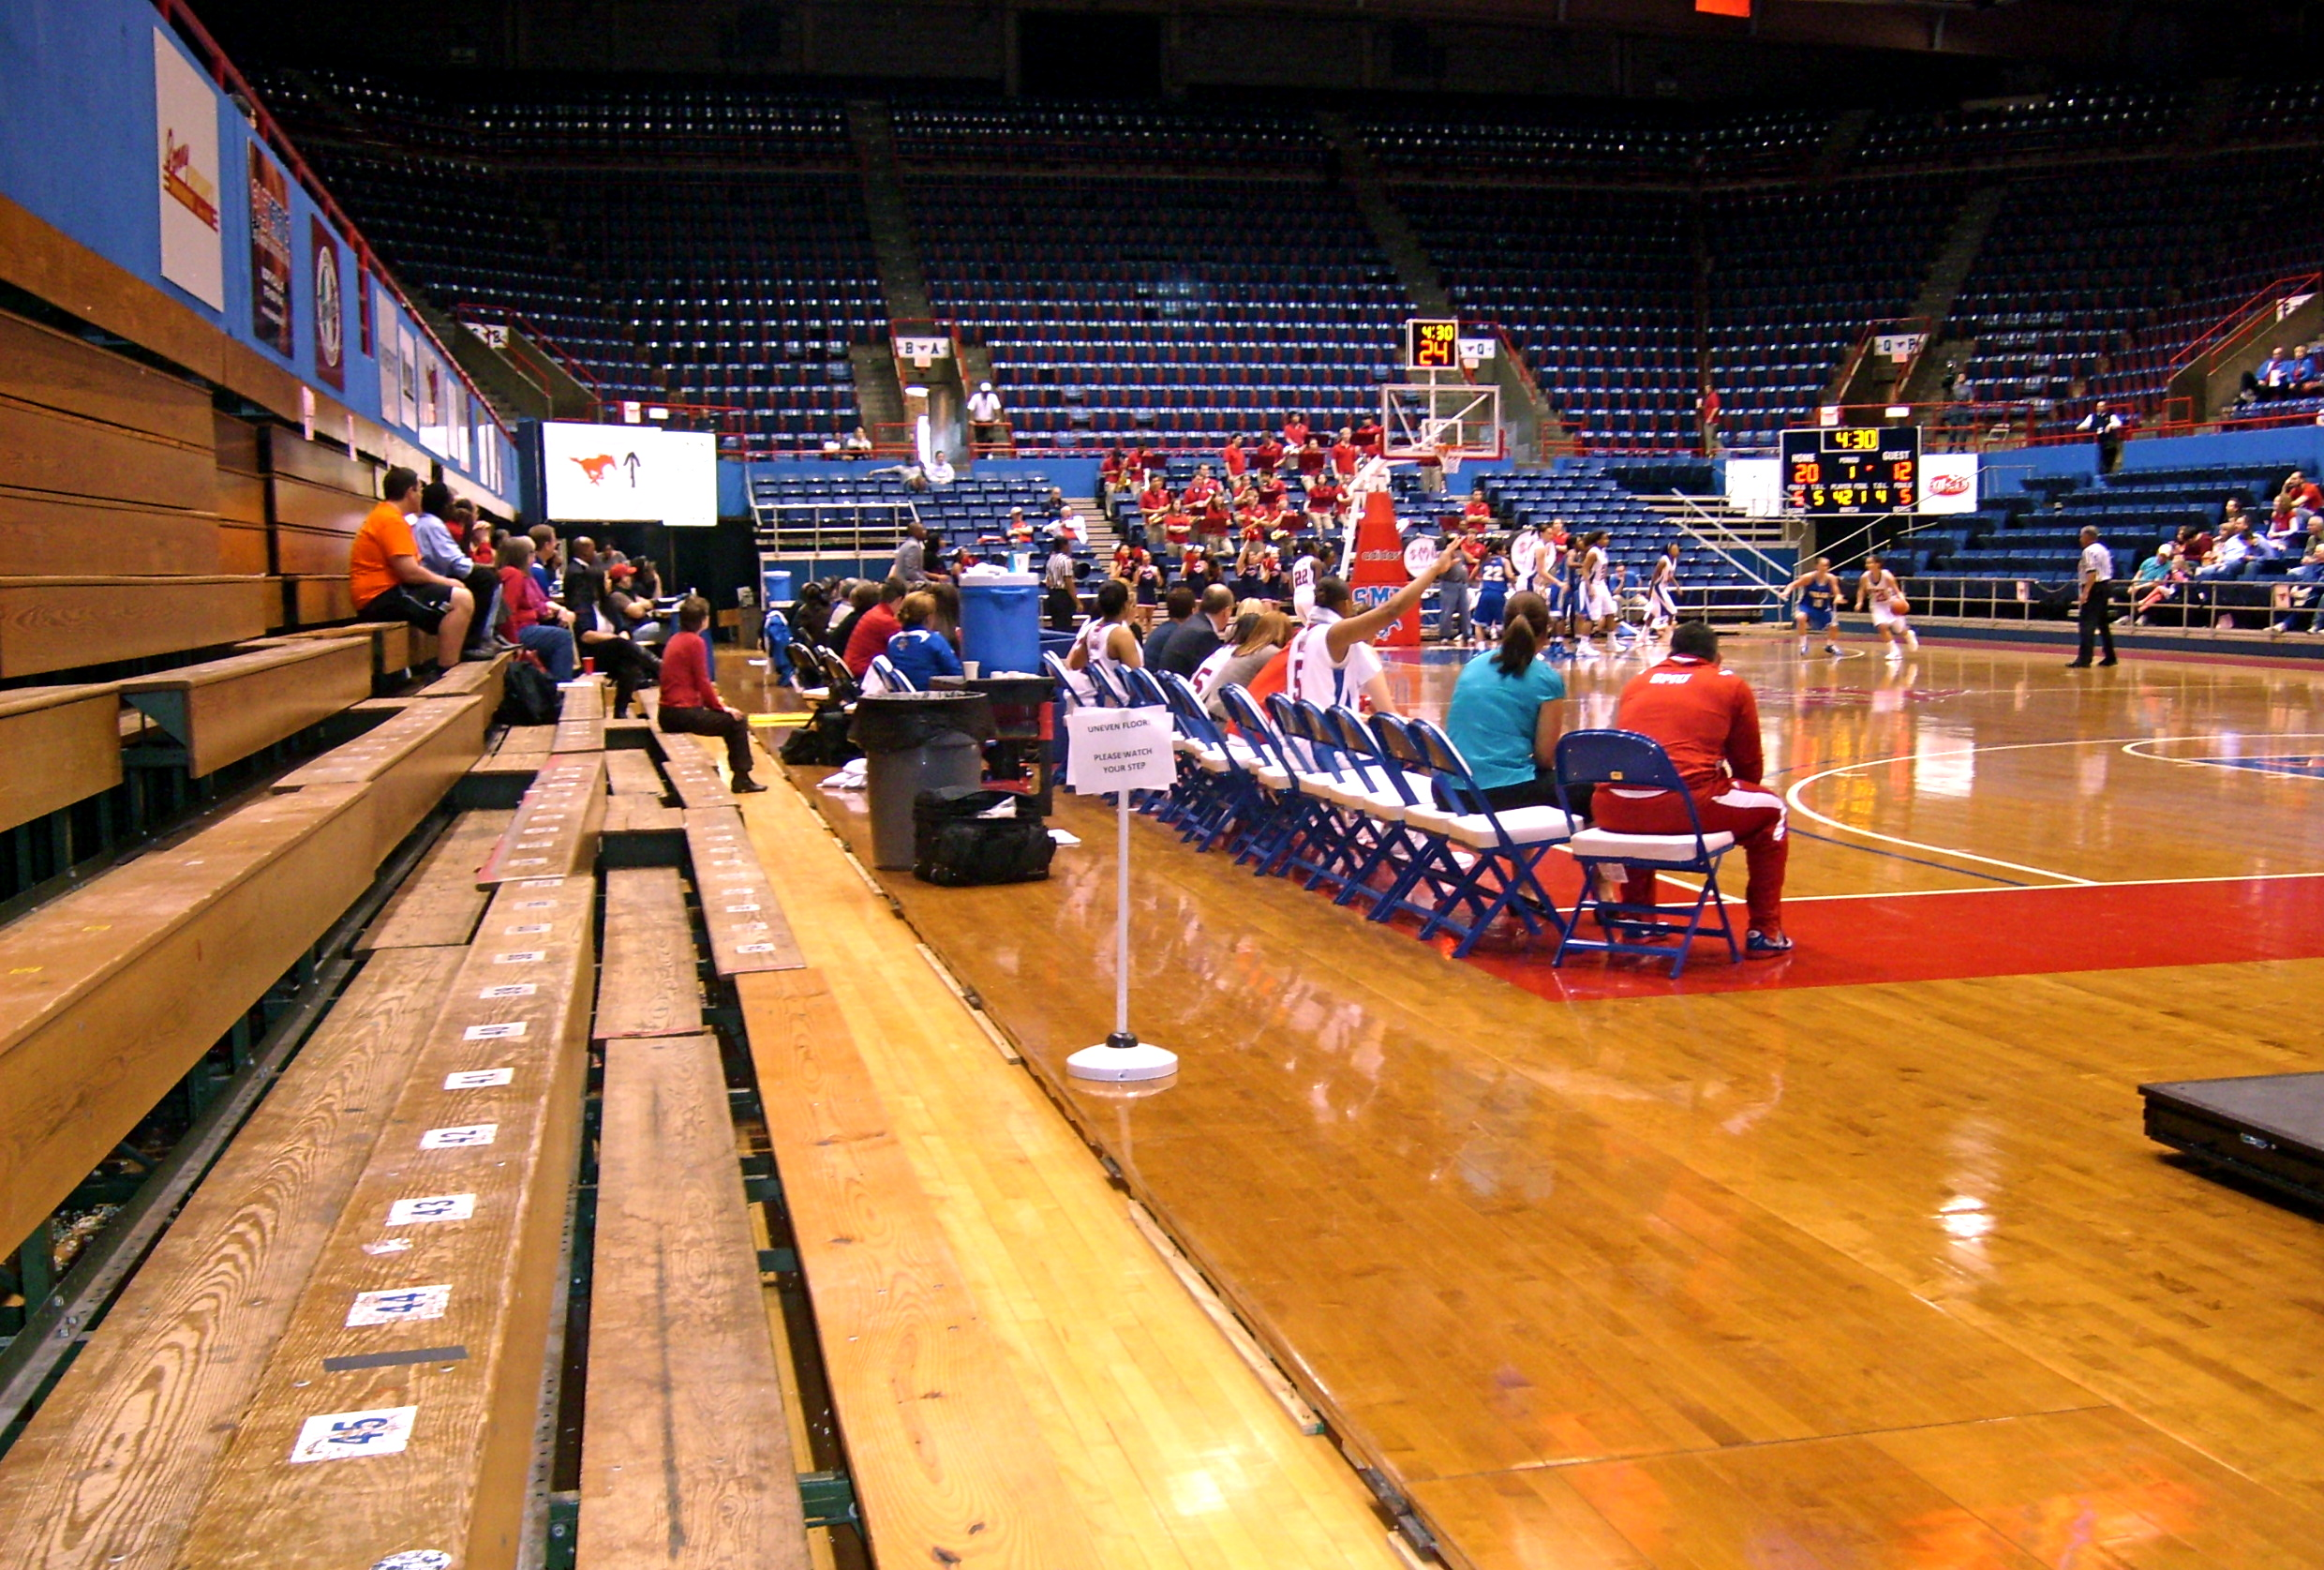

The majority of seating in Moody Coliseum remains empty during a women’s basketball game.

Slide 8
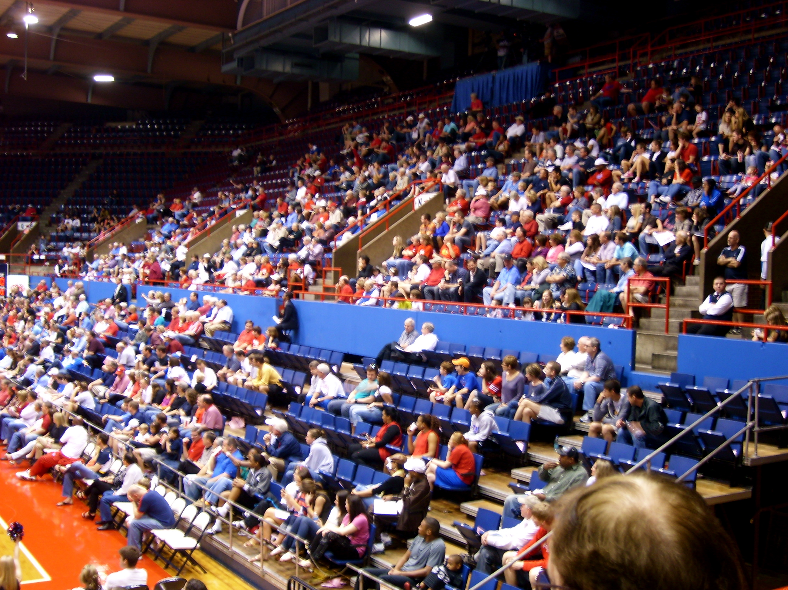
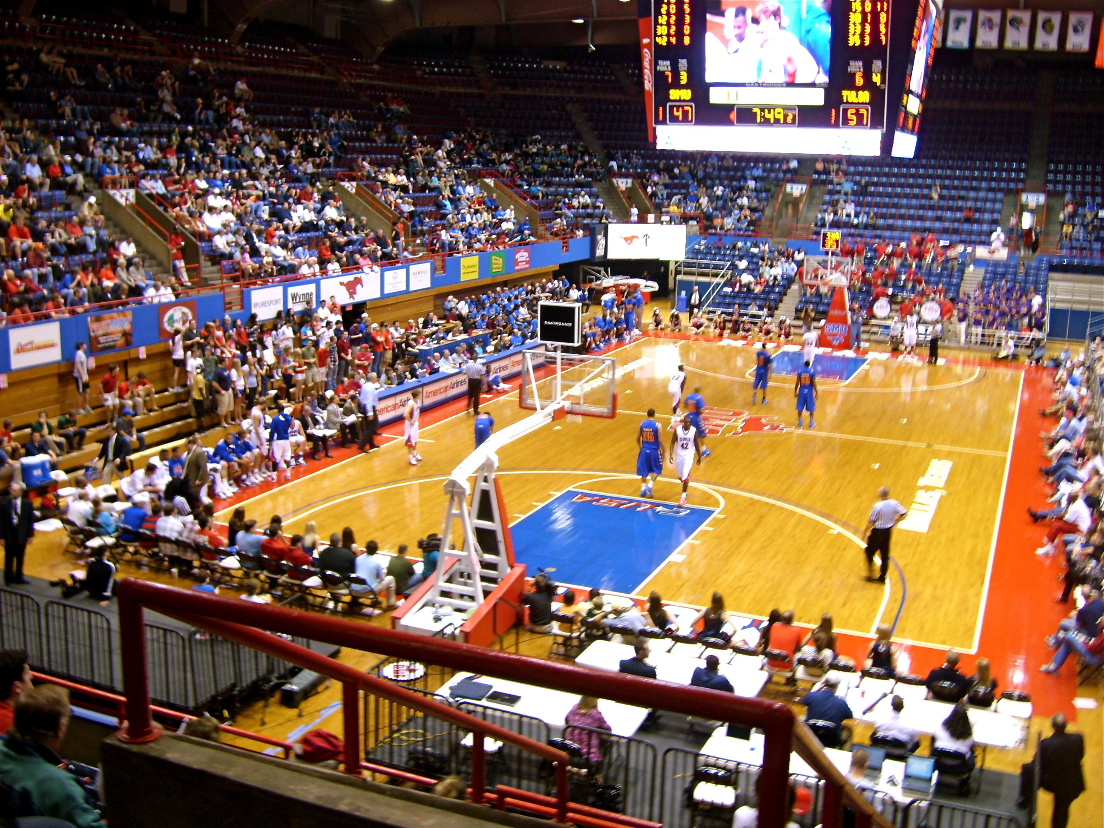
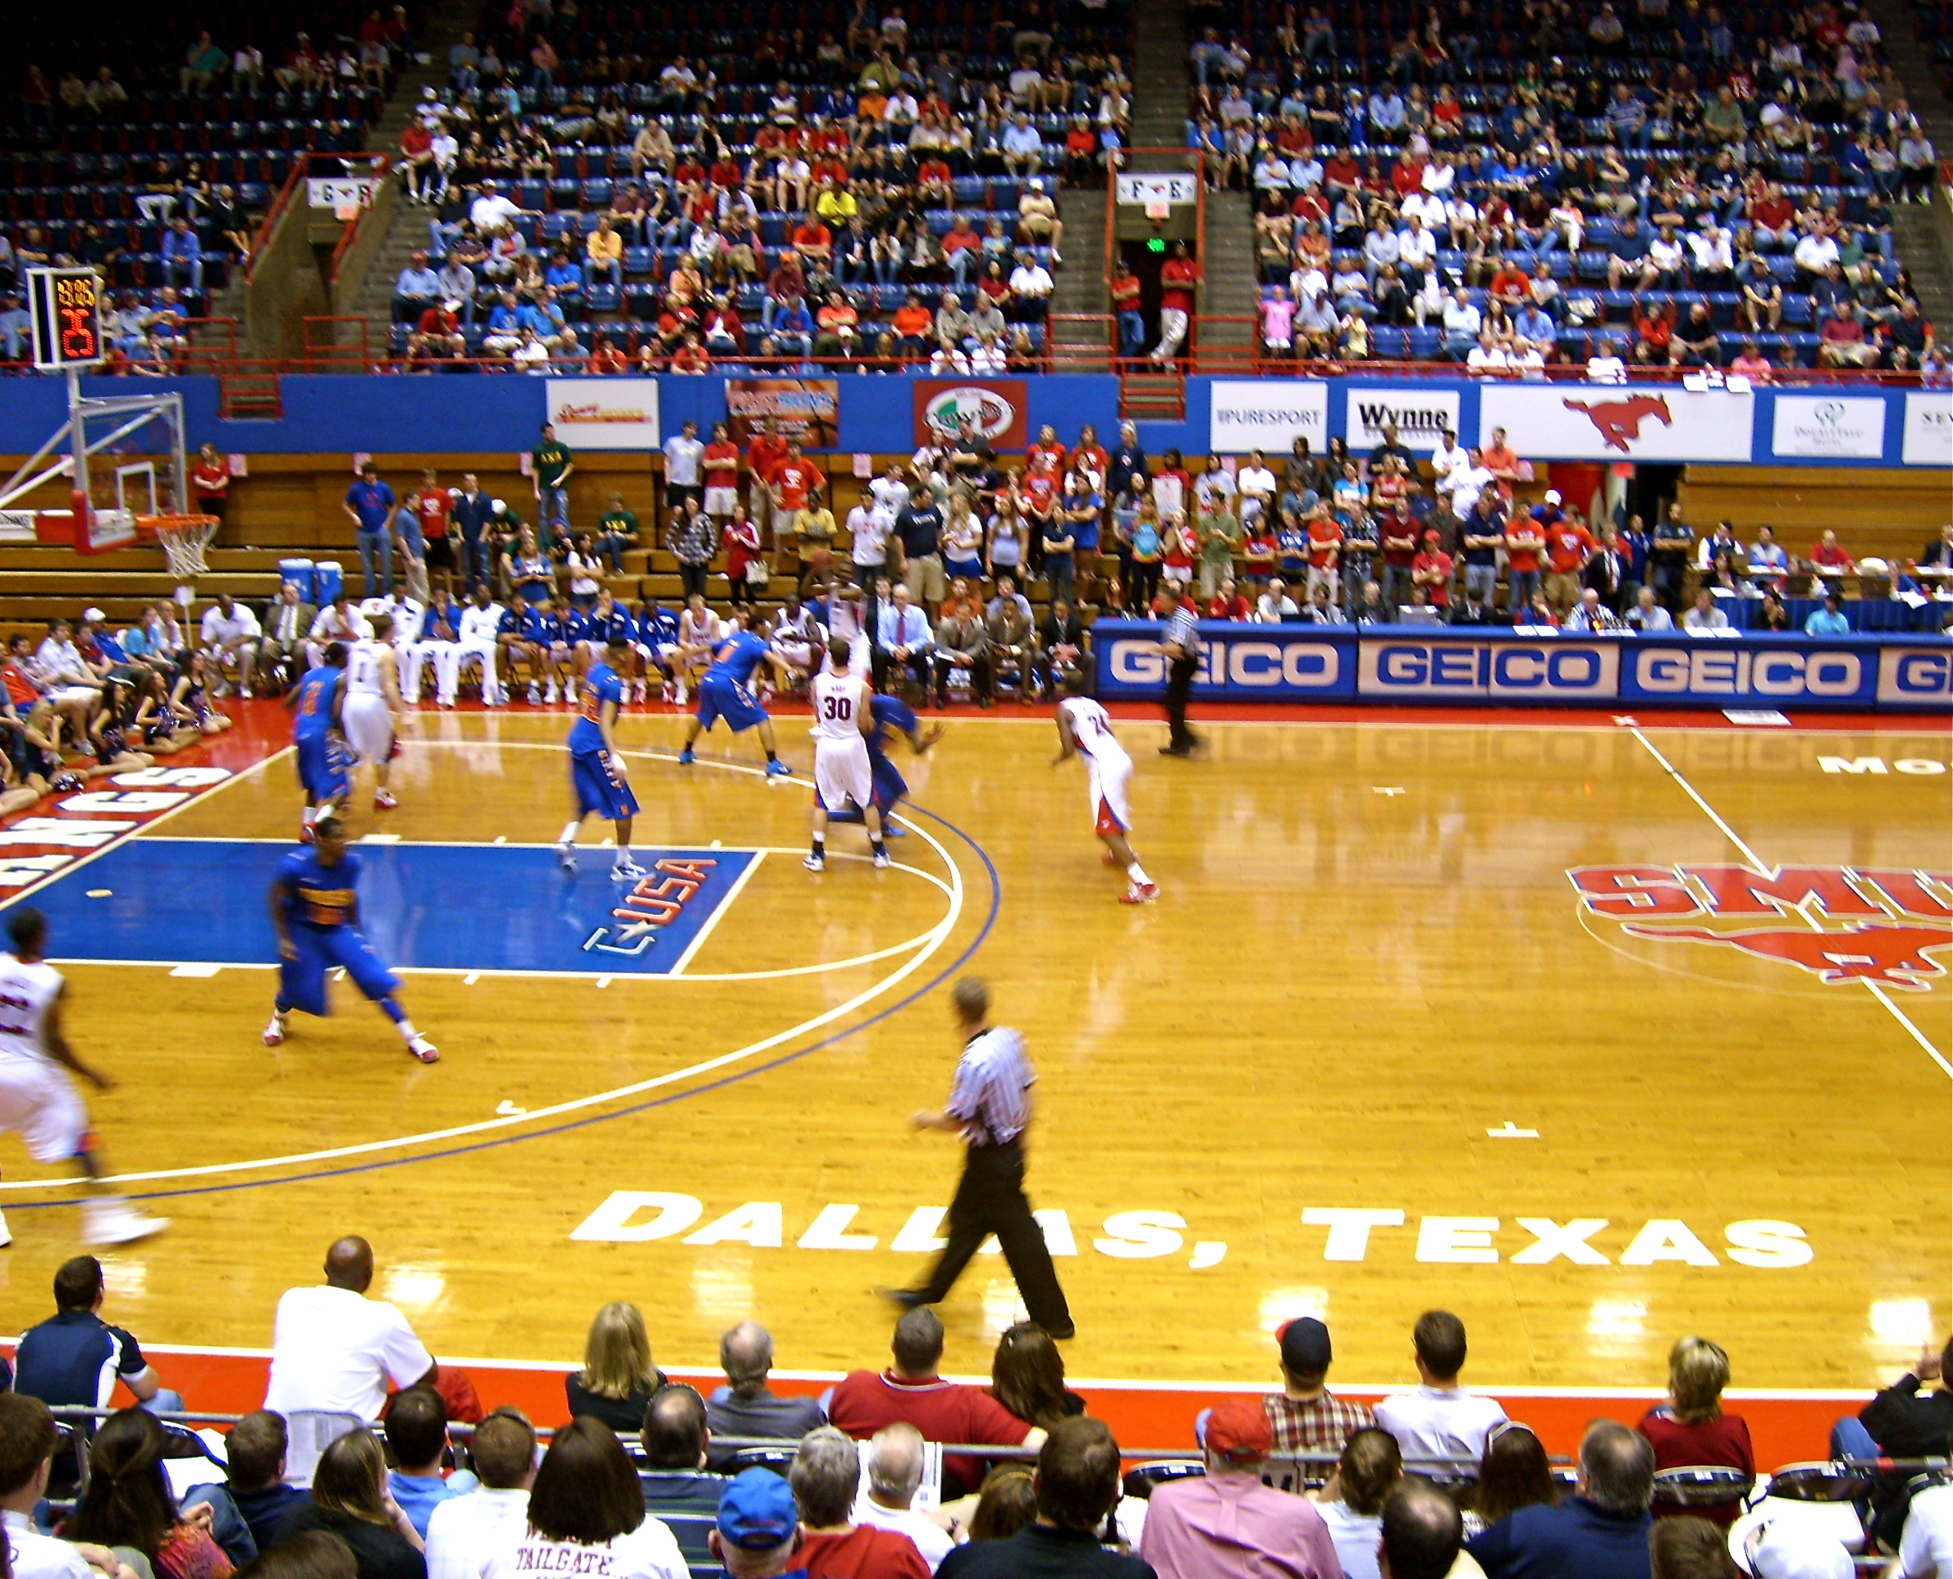
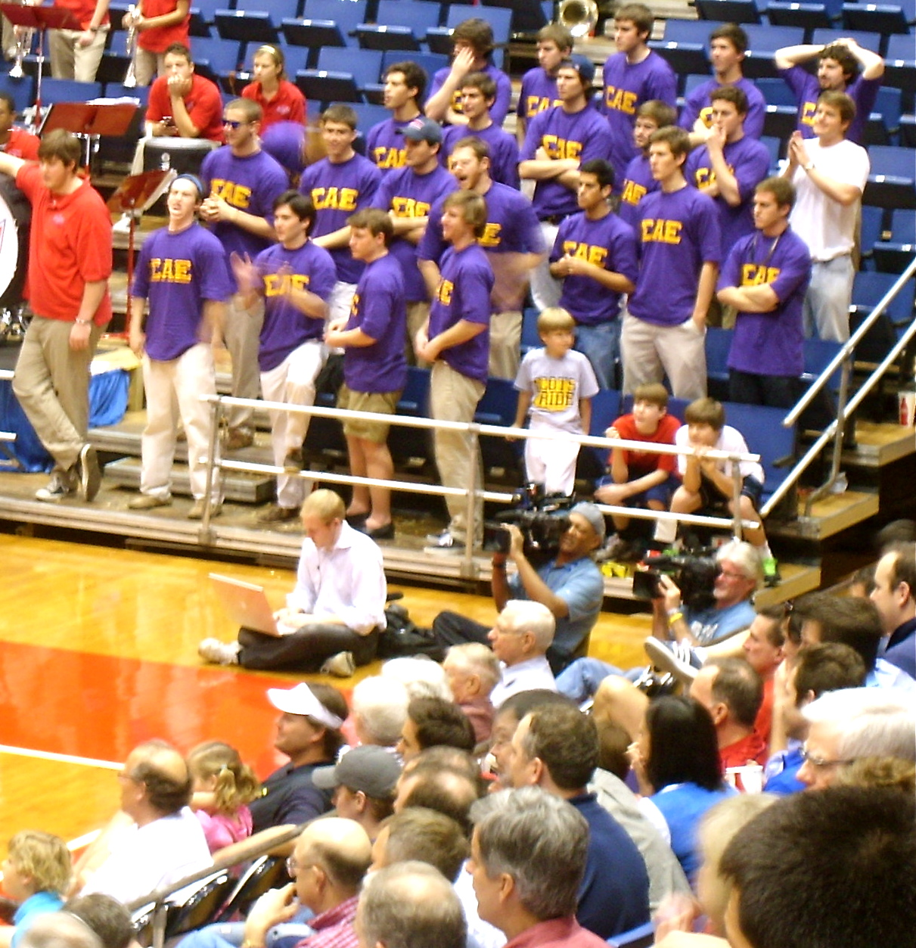
Men’s Game
Nearly three times as many fans come out to support the men’s basketball team, including fraternity and sorority organizations on campus.

Slide 9
No where is this disparity in fan support as evident as it is in the student fan section of Moody Coliseum…

Slide 10
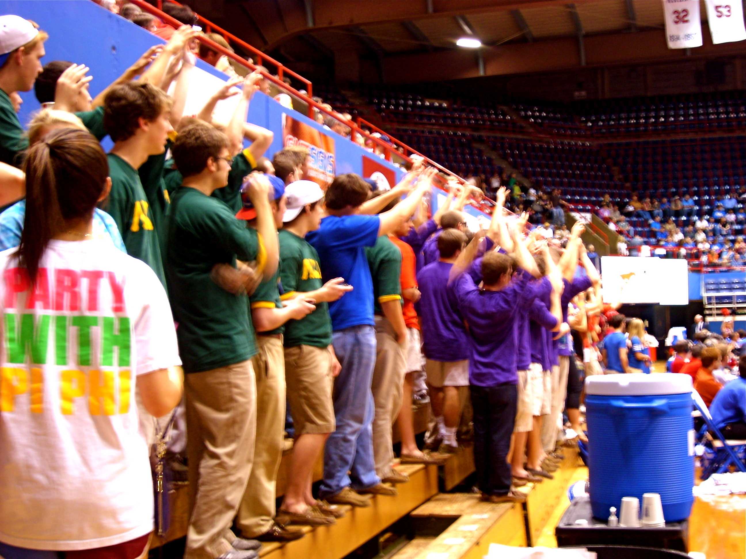
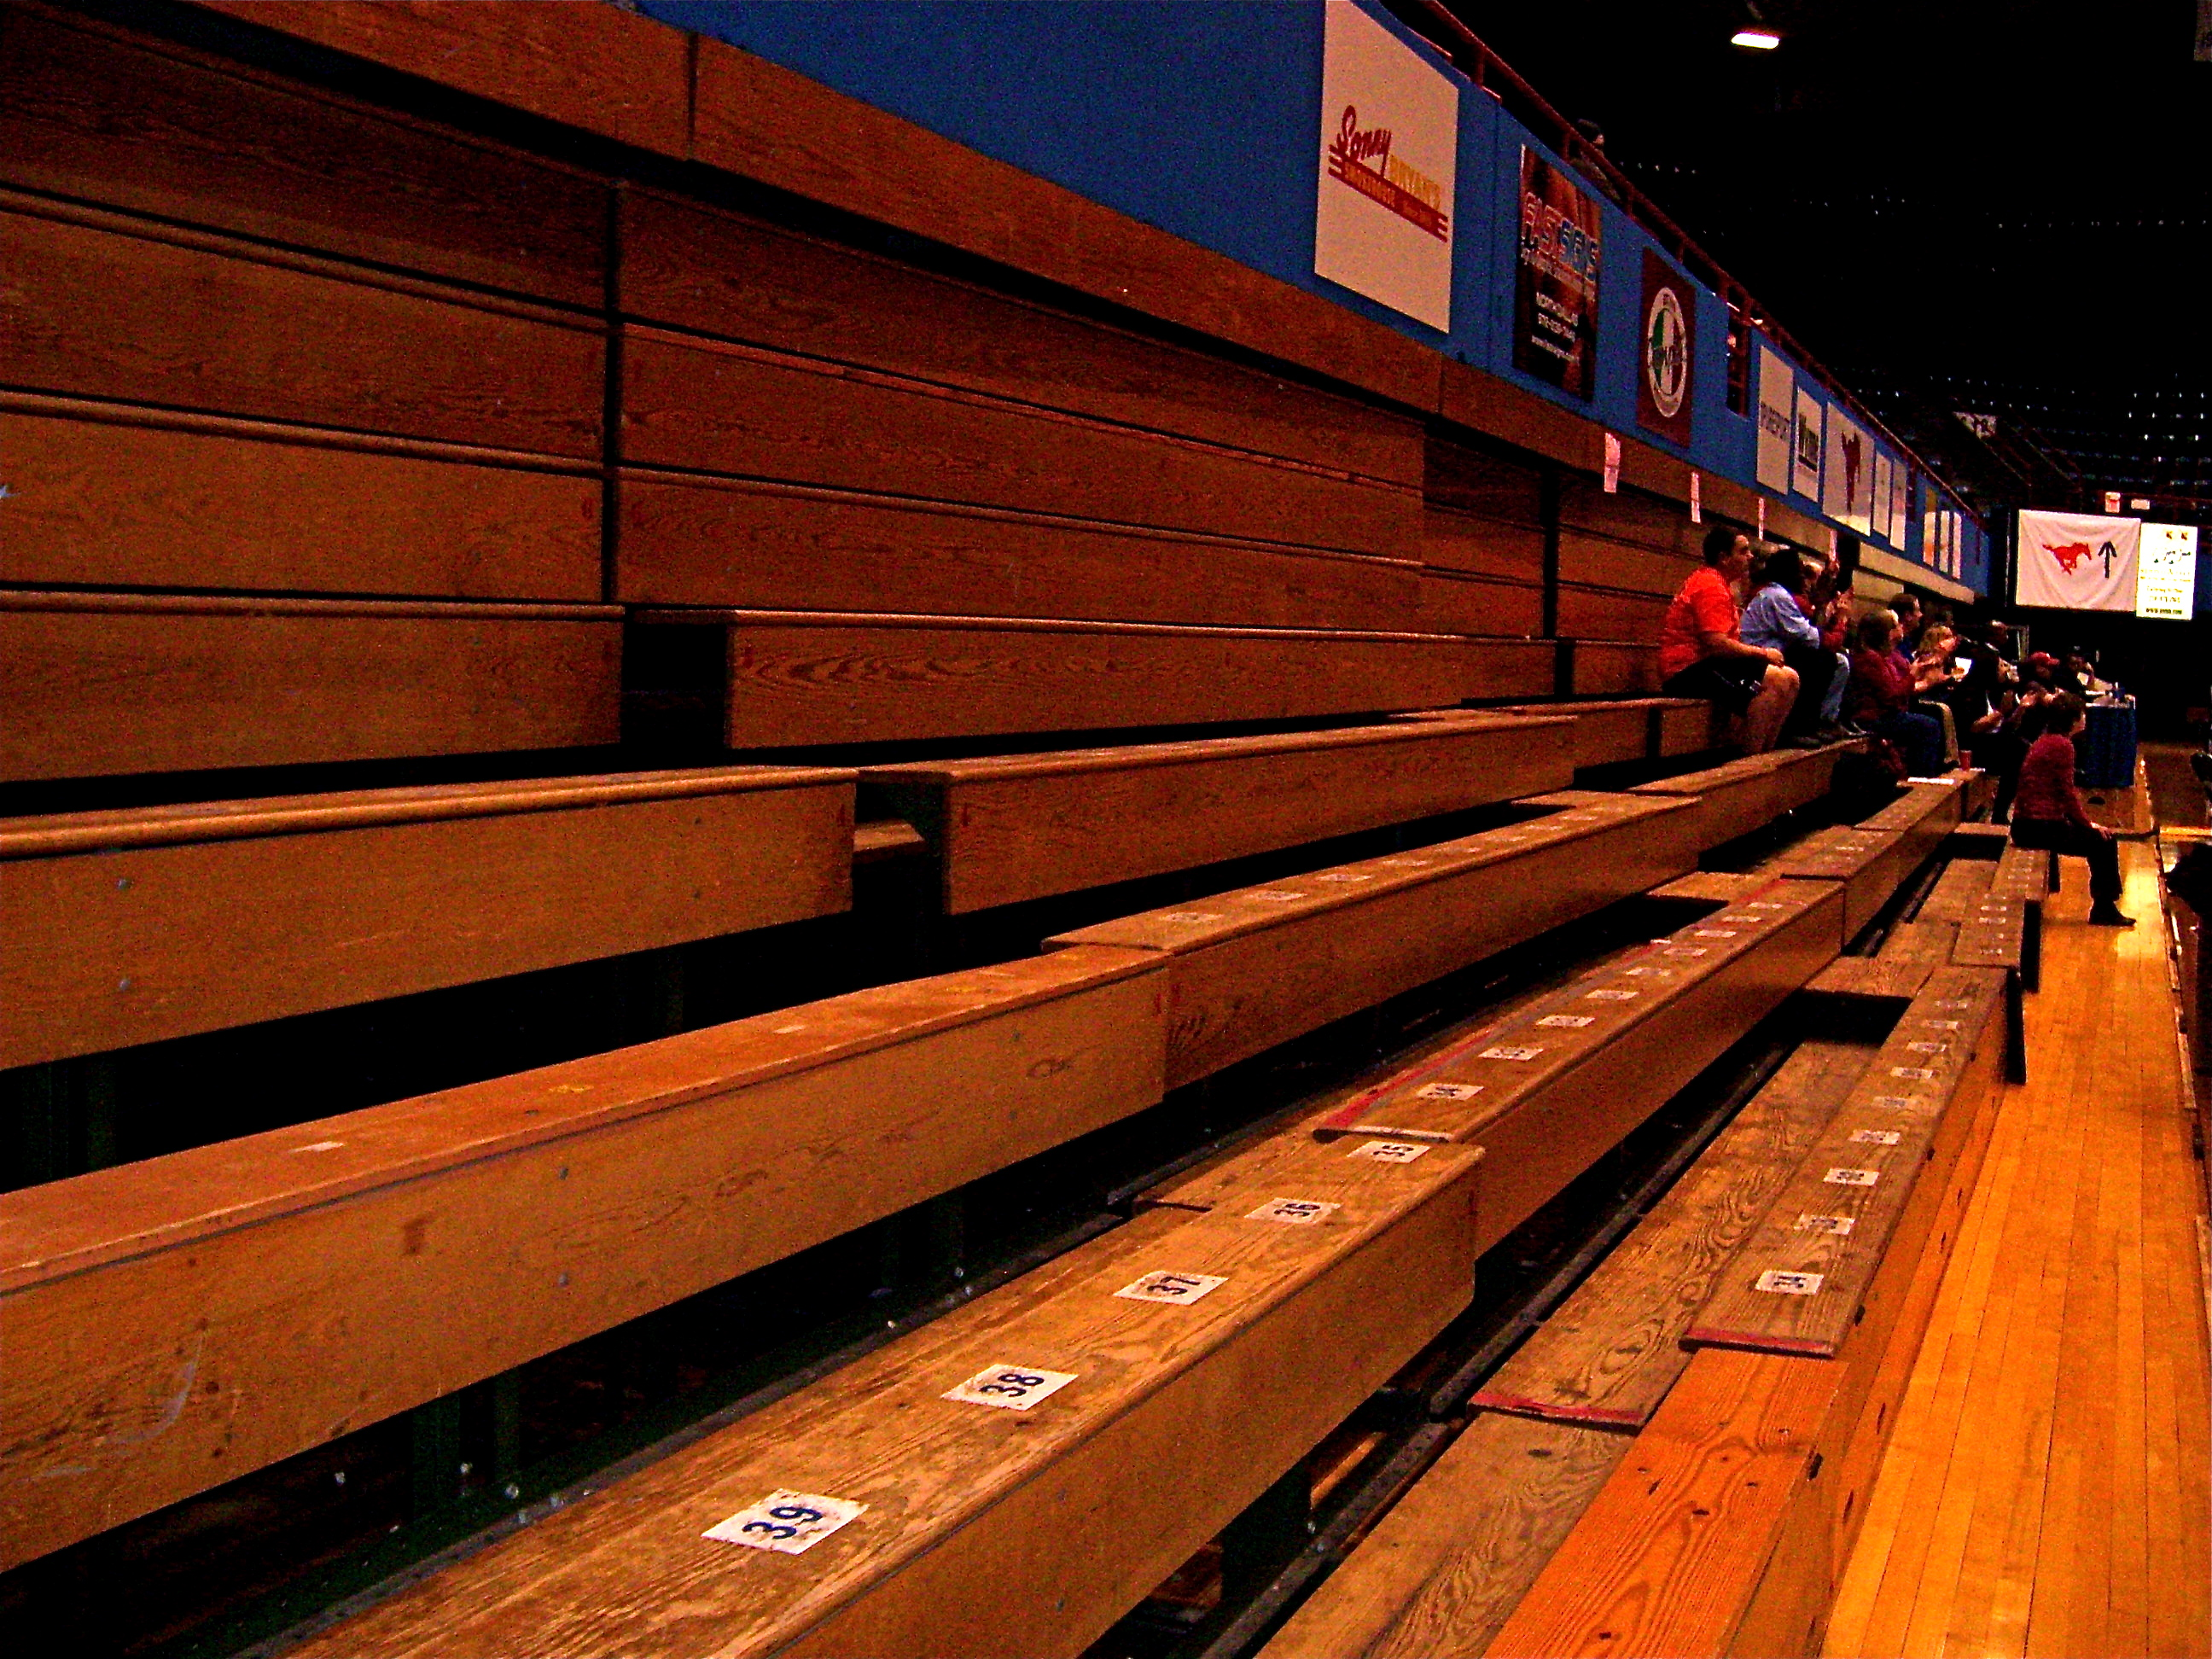
SMU vs. Tulsa
Men’s Basketball
Student Section
Women’s Basketball
Student Section

Slide 11
The SMU men’s basketball team lost to Tulsa 74-66 and the women’s team beat Tulsa 66-58, but it is clear which team won the support of the student body.
Why does this matter?
Please imagine one personal goal you have for your future…

Slide 12
Now, what if your gender limited your ability to reach that goal? What if you were able to attain the highest level of success, but the most successful you could ever become would never be as valuable as it would have been if you were born the opposite sex?

Slide 13
Female athletes face this reality every time they put on their uniforms. Even if you don’t value athletics, hopefully we can all value the importance of gender equality and recognize that in America we still have a long journey ahead of us.

Slide 14
The End

