Slide 1

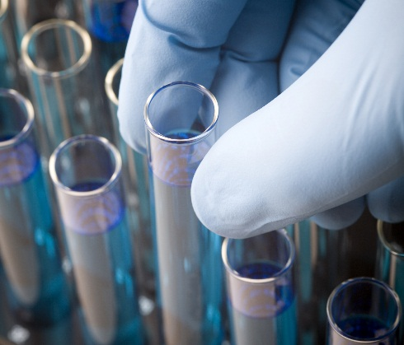

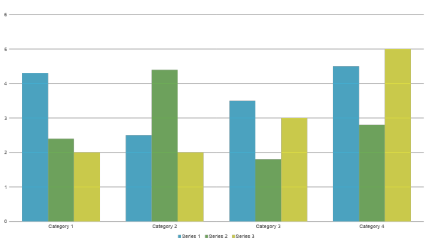
Science Project Title
Scienteer Project #
Problem / Question
Data
Photos
Data Analysis/Statistics
Enter your question here (statement of the problem)
Processed data of your findings. This should not be the raw data
Include results based on your experiments
Result 2
Result 3
Hypothesis
Write hypothesis before you begin the experiment
This should be your best educated guess based on your research
If you are doing an engineering project, this section should be your Engineering Goal
Conclusion
Brief summary of what you discovered based on results
Indicate and explain whether or not the data supports your hypothesis
Use builleted talking points
Charts
Photos
Materials & Methods
Should be in a flow chart format with pictures and captions. Stay clear of using numberd systematic lists if possible.
Applications
How can your discovery be applied to the real world.
Use builleted talking points
Future Research
Observations
Indicate future areas of research or new directions you might be interested in continuing your research.
Use builleted talking points
Background Research
Graphs
Add a brief overview of the background research for your project.
Observation 1
Observation 2
Observation 3
Photo Credit
All photos, images, and graphics were done by the researcher or parent unless otherwise stated.
IF YOU TOOK IMAGES FROM A WEBSITE, GIVE THEM CREDIT ON YOUR BOARD.

Slide 2
Extra Slide
You are allowed one extra slide for any additional data relevant to your project. Make sure to credit any sources of information that are not yours.

Slide 3
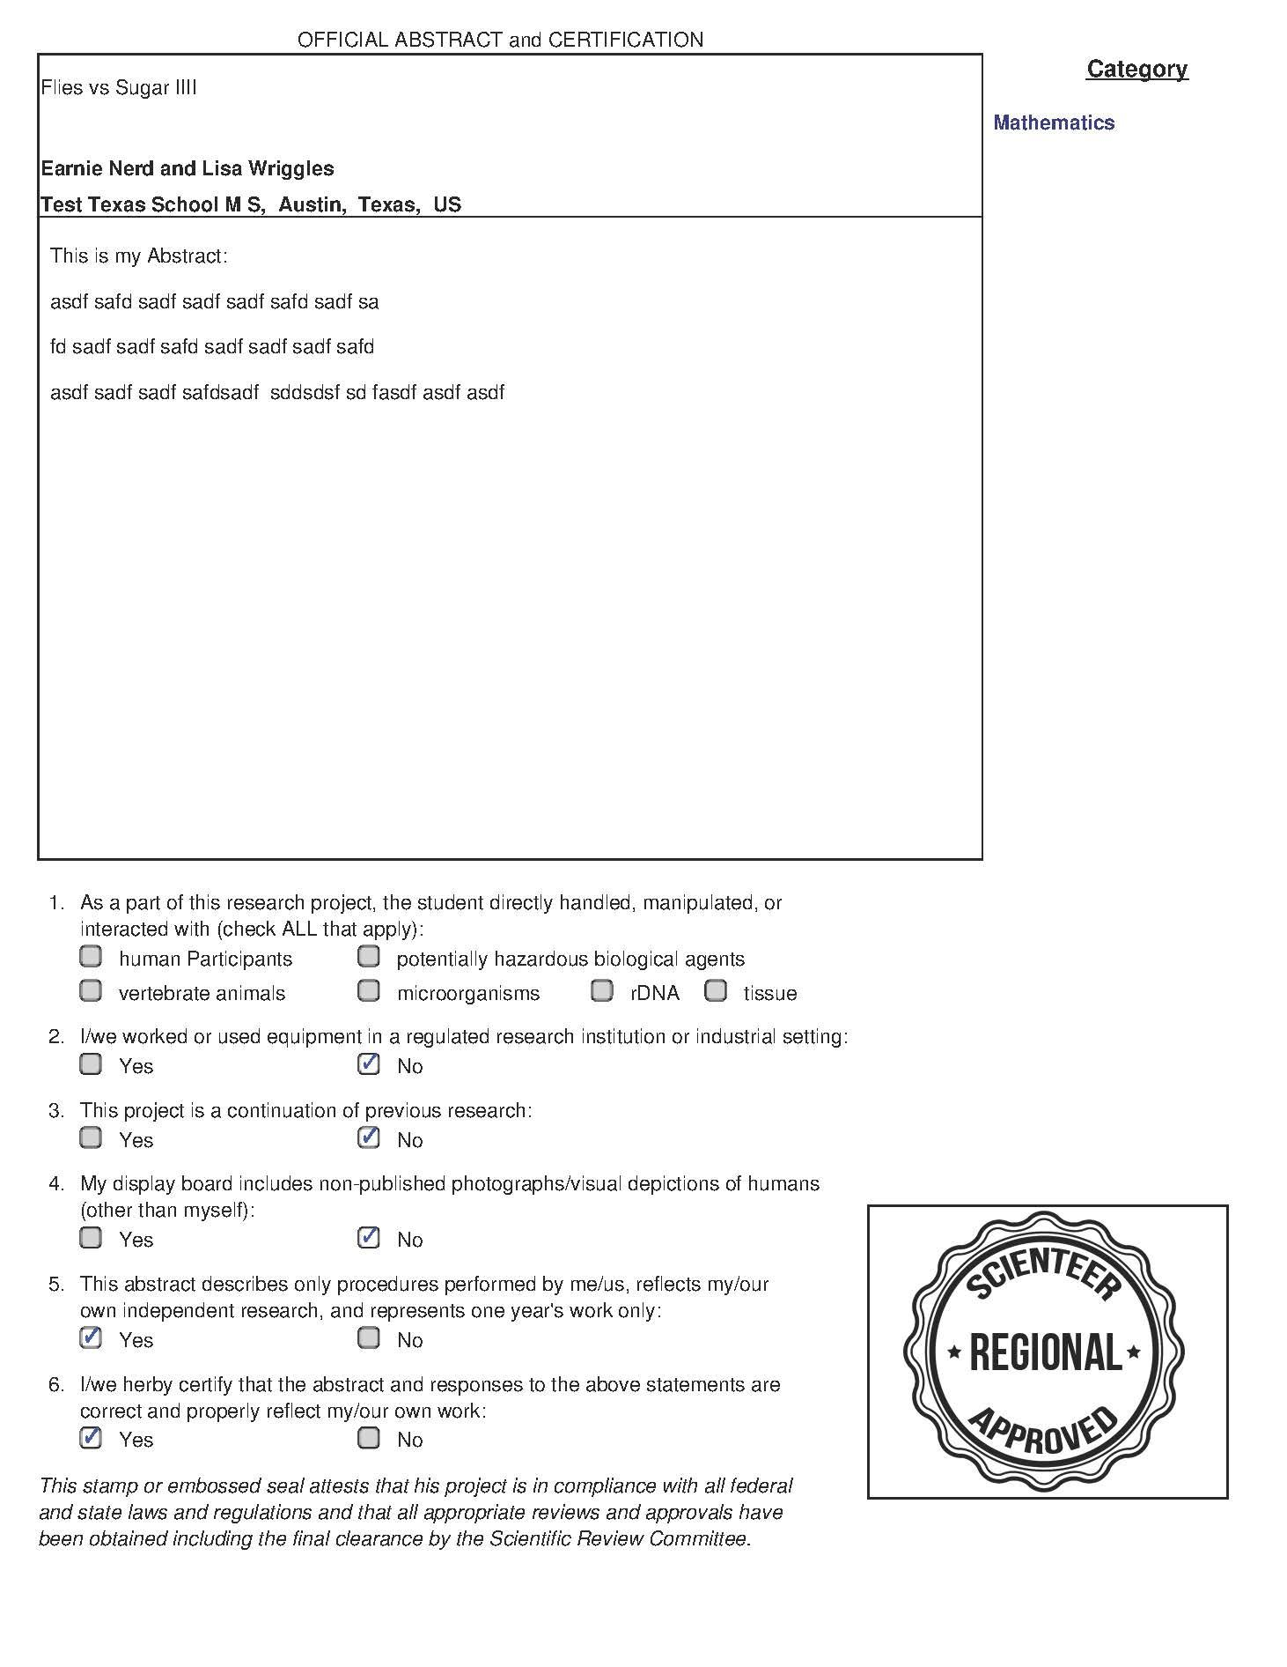
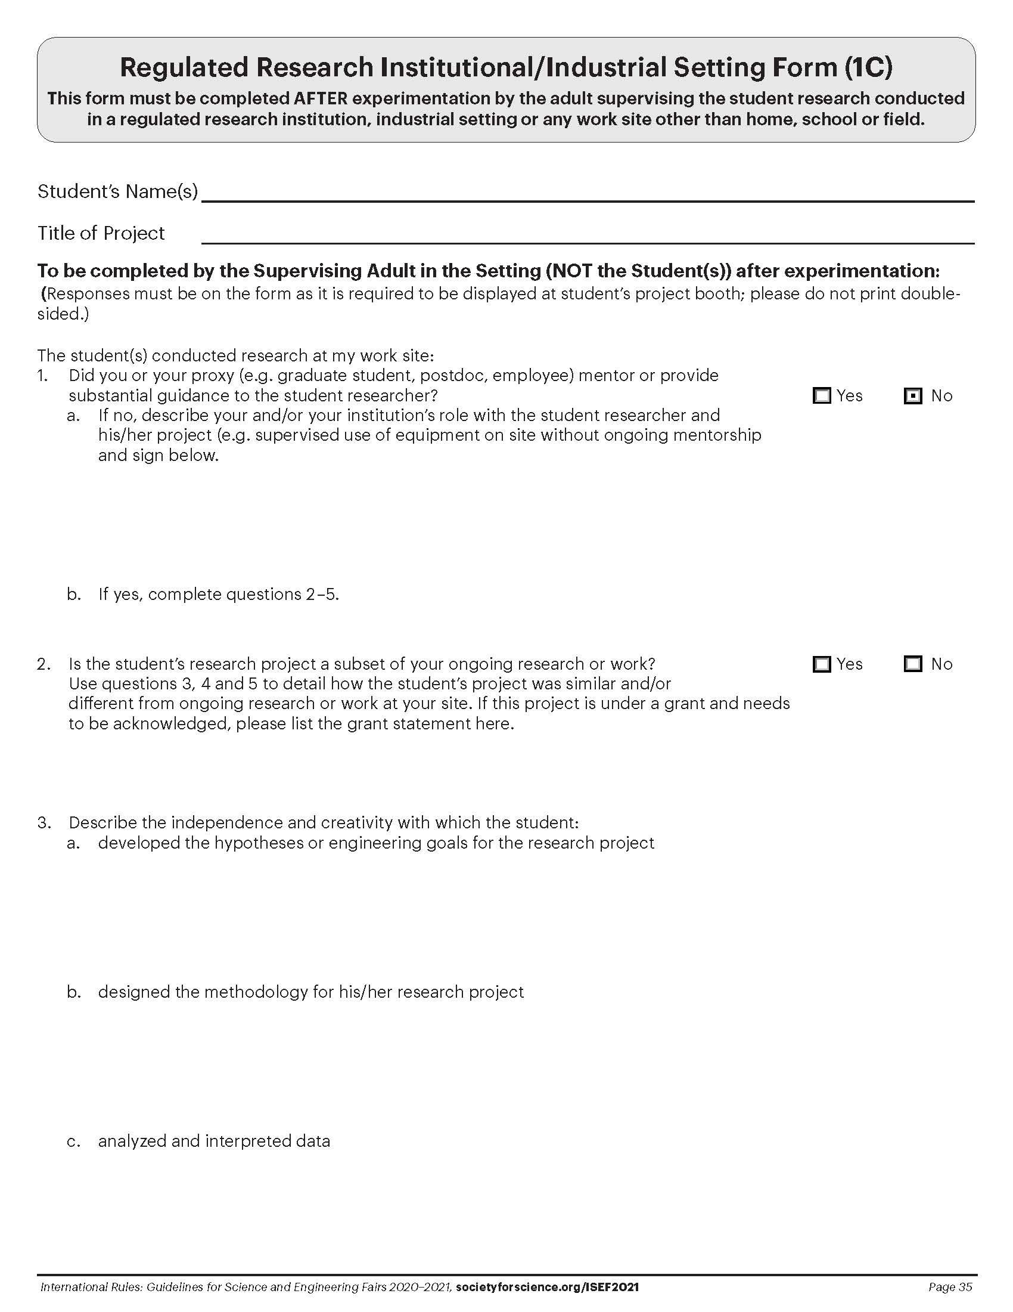
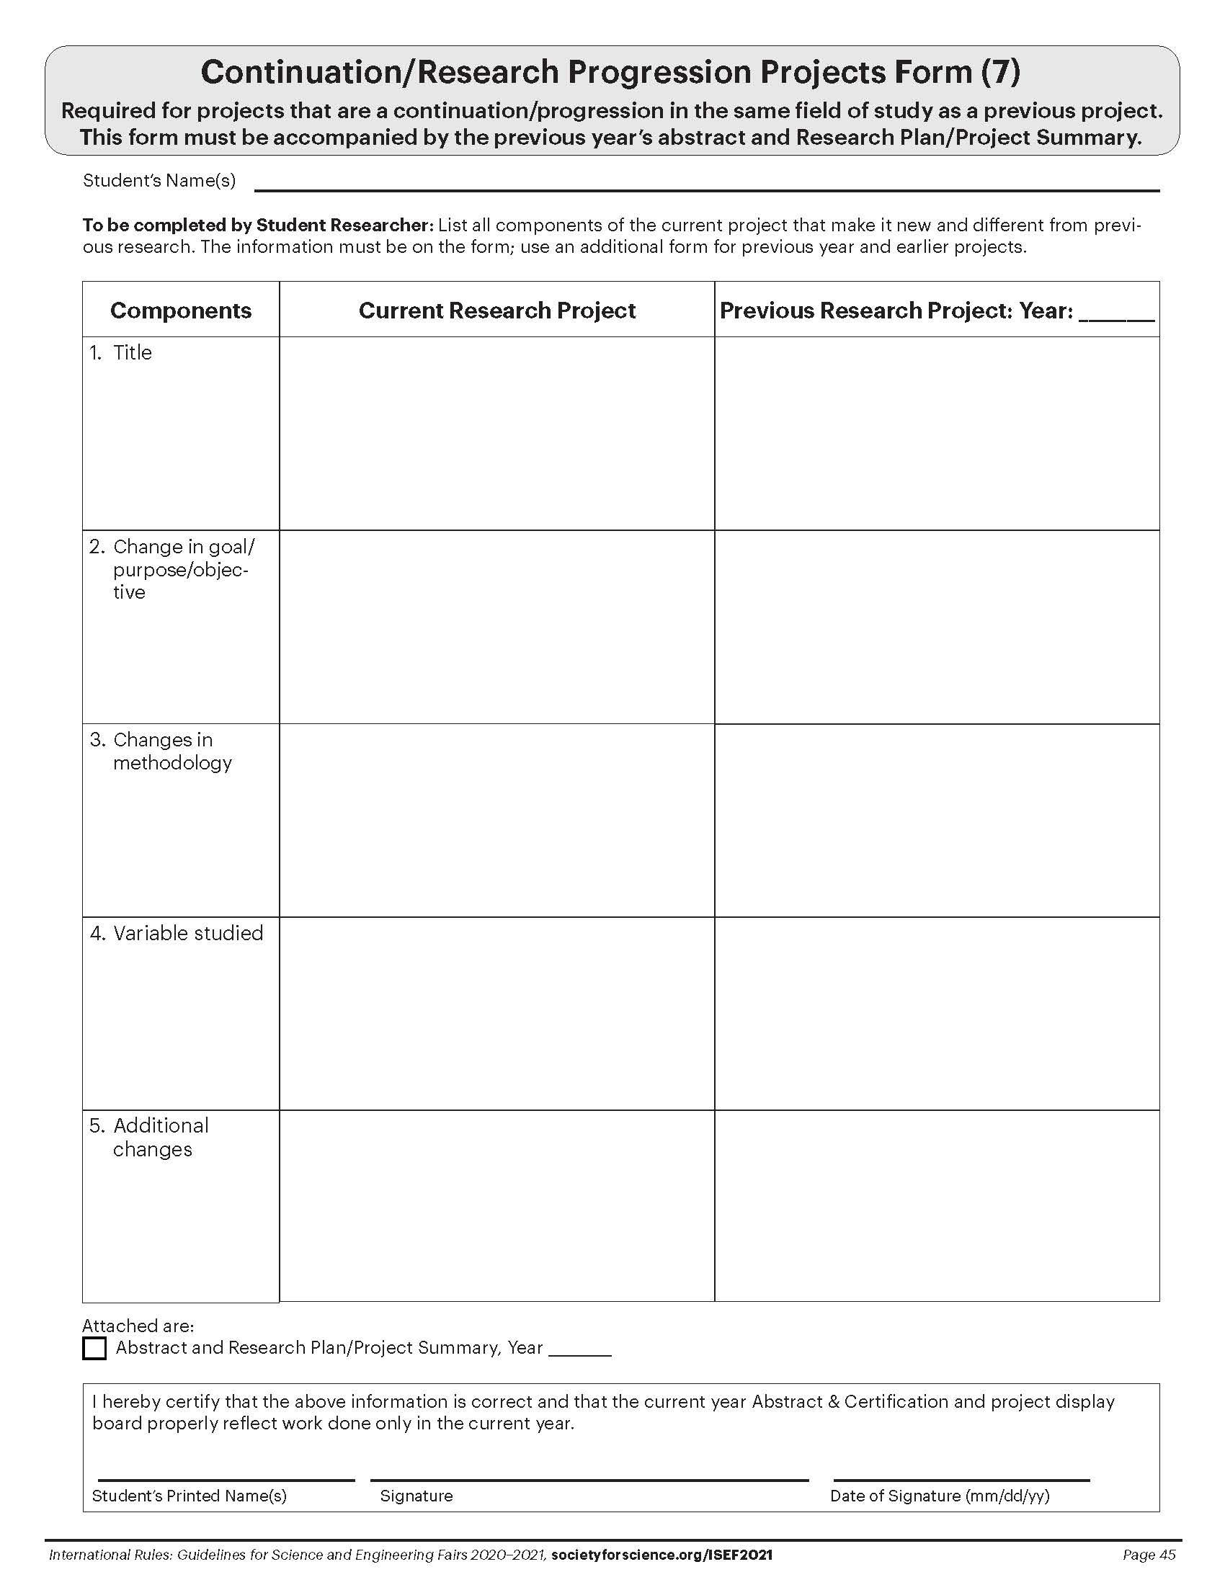
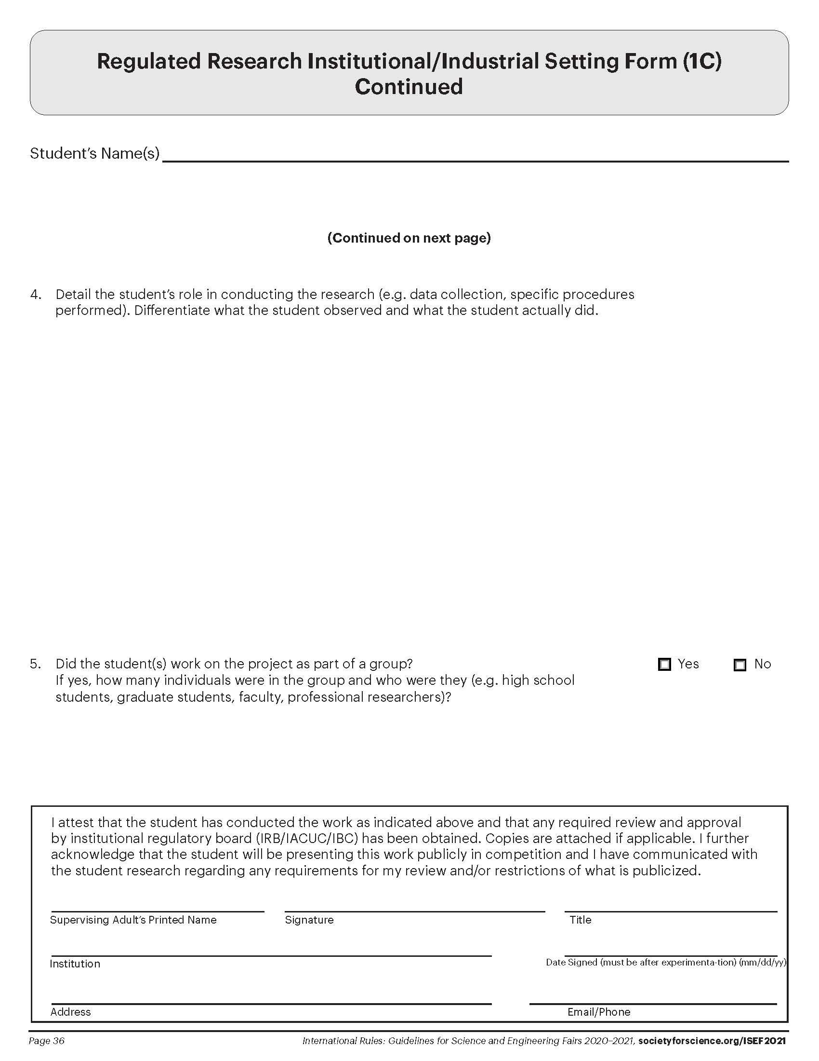
Project Forms
Instructions
Abstract
Form 1C (If Required)
Form 7 (If Required)
ALL Projects must display the Official SRC Approved Abstract from Scienteer as well as Form 1C (Regulated Research Institutional/ Industrial Setting Form) and/or Form 7 (Continuation/ Research Progression Projects Form) if required for your project.
These forms can be found on Scienteer on the Dashboard (left side of the screen).
The documents can be downloaded as pdfs.
In order to insert the documents on this slide, you will have to convert them to jpgs. You can use Adobe Acrobat, the Snip Tool, or any online conversion tool.
After inserting the documents on this slide, make sure that the forms are still clear enough to be read by the judges.
Example
Replace with Your Abstract from Scienteer
with the Official Seal
Example
Replace with Your Form 1C
from Scienteer (If Required)
Example
Replace with Your Form 7
from Scienteer (If Required)
Example
Replace with Your Form 1C
from Scienteer (If Required)

Slide 4
Project Board Rules
A virtual project board must be uploaded prior to the deadline set for the fair.
All ISEF Display and Safety Rules must be followed as well as any additional rules below.
Students are allowed three 48” x 36” slides.
Font on the boards must be 16pt or larger.
If slides contain photographs with people other than the researcher, the researcher must have photo releases available upon request.
The first two slides may NOT include an abstract. Only your official abstract from Scienteer should be included on slide 3.
The slides may NOT include any animations, videos, links, or demonstrations.
The slides may NOT include any offensive or inappropriate images or photographs.
The slides may NOT include any reference to an institution, mentor that supported the work, or any patents pending other than what is displayed on Form 1C on slide 3.
The slides may NOT include any personal information such as email address, home address, phone number, or social media contacts.
Slide 1
Slide 2
Slide 3
The first slide should be modeled after a science fair board (see slide 1 example) and include all key information such as Problem/Question, Hypothesis or Engineering Goal, Background Research, Materials, Procedure, Data, Results, and Conclusion.
The Scienteer Project # must be displayed under the Project Title on slide 1.
The example project board on slide 1 may be used as a guide by students. Formatting to change colors, text box sizes, move panels, etc. is acceptable. We want this to be your board. Just make sure to follow the rules as to what needs to be included.
The first slide must include a Photo Credit that gives credit for all photos, images, and graphics on the slides.
The second slide may include any supporting information for the project such as additional photos, charts, and graphs. Make sure to use image citations as needed.
The third slide must include the Official SRC Approved Abstract from Scienteer as well as Form 1C (Regulated Research Institutional/ Industrial Setting Form) and Form 7 (Continuation/ Research Progression Projects Form) if required for your project.

