Slide 1


Office of Welcoming Communities and Immigrant Affairs
Simmons School of Education and Human Development at Southern Methodist University at George W. Bush Institute
Liz Cedillo-Pereira, Esq., Director,
Welcoming Communities & Immigrant Affairs
Presenting with Theresa O’Donnell, Chief
Office of Resilience
Notes:
Communication and Informed Consent
Providing Diligent Representation within legal bounds
Administration of justice
Competence

Slide 2
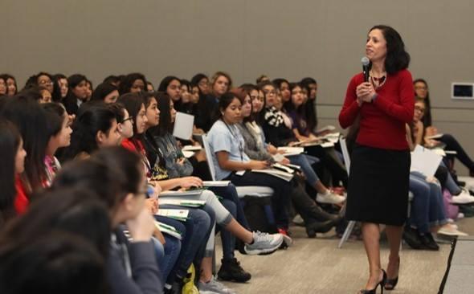
My Educational & Professional Journey

Slide 3
What is a Welcoming Community?

Slide 4
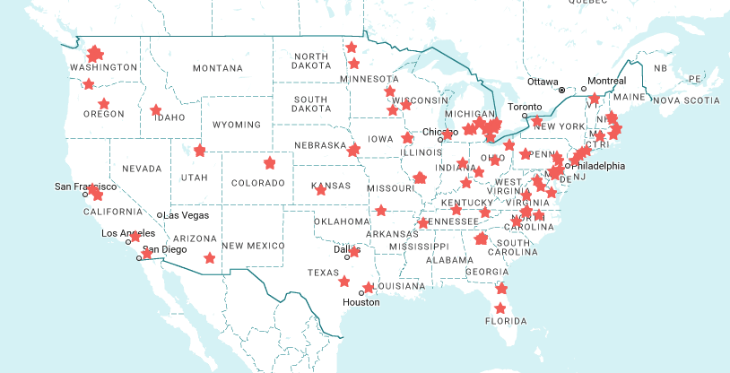
Welcoming America Network
1 in 8
Americans now lives in a community in the Welcoming American network.
From 12 local partners in 2009 to more than 160 Welcoming Communities in 2017

Slide 5

@Dallas_WCIA #MyDallas #WelcomingDallas
A community where diversity is acknowledged, celebrated and harnessed to improve social, economic and cultural opportunities for all residents of our city

Slide 6

Who We Are
City of Dallas Office of Welcoming Communities & Immigrant Affairs started in 2017.

Slide 7
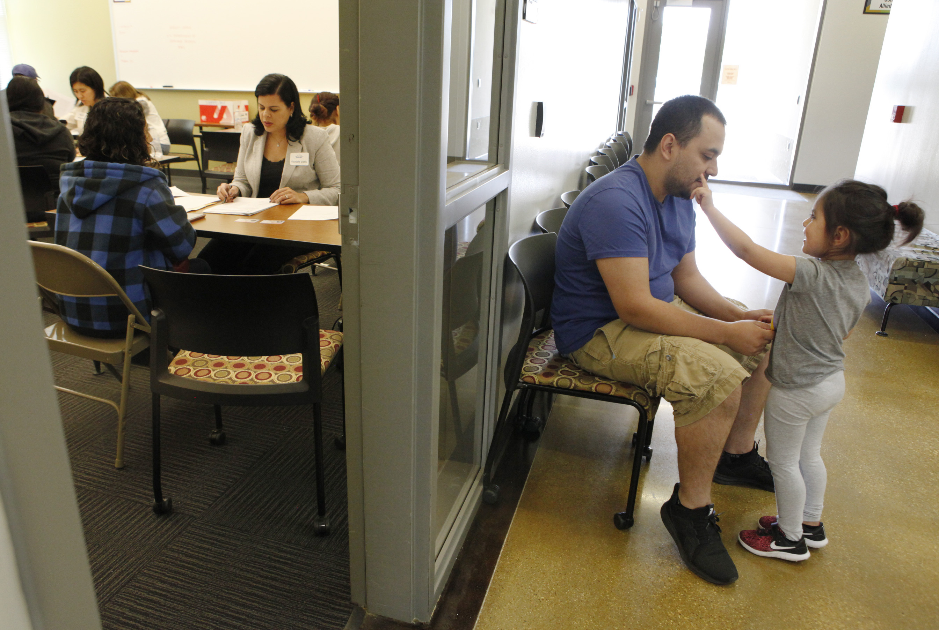
Photos by Kael Alford, Micro-resident with WCIA via Office of Cultural Affairs
Notes:
DACA Renewal workshop – photography can help alleviate fear through communication of events and safe spaces

Slide 8
Dallas Taskforce on Welcoming Communities

Slide 9
Welcoming Plan
Leadership and Communications
Equitable Delivery of Services
Civic Engagement
Economic & Educational Opportunity
Safe, Healthy and Connected Communities

Slide 10
Immigrants in the Dallas Economy

Slide 11
Immigrants in the Dallas Economy

Slide 12
Immigrants in the Dallas Economy

Slide 13
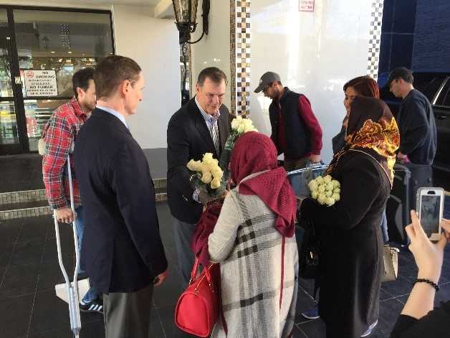
Accelerating Change
Creating an Immigrant Integration Office
Implementing Change
Creating a Strategic Welcoming Plan

Slide 14
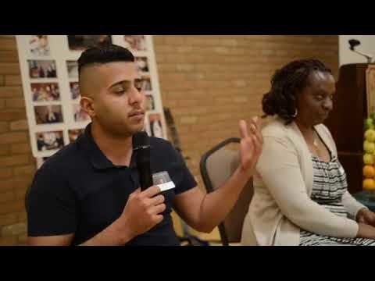
Moving Across the Welcoming Spectrum

Slide 15
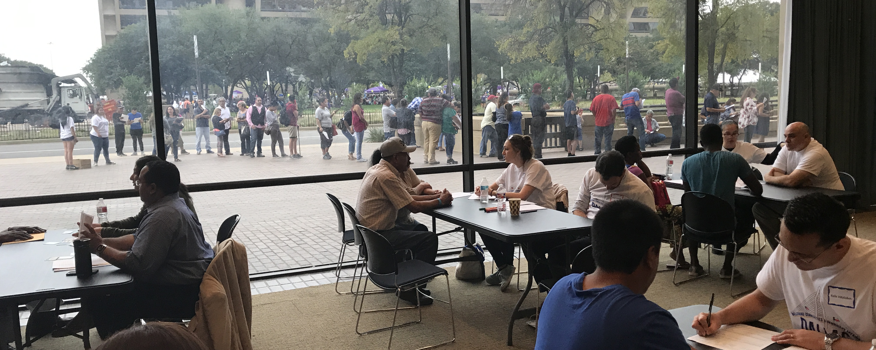

#MyDallas – A City Of Neighbors
Follow us @Dallas_WCIA

