Slide 1
Using Verbal Protocols to Develop Assessments of Algebra Readiness
CEC 2013 Annual Convention
April 6, 2013
Deni Basaraba, Leanne Ketterlin-Geller, Sharri Zachary, & Savannah Hill

Slide 2

Research in Mathematics Education
Staff Supporting These Efforts
Dr. Leanne Ketterlin Geller
Mathematics Coordinators
  Dawn Woods (Elementary)
  Beth Richardson (Middle/Secondary)
  Sharri Zachary
Assessment Coordinators
  Dr. Deni Basaraba
  Cassandra Hatfield
Technology
  Jason Bell
Item Review
  Saler Axel
  Savannah Hill
  Dr. Yetunde Zannou
Logistics
  Toni Buttner
  Marilea Jungman
Graphics
  Mike Moore

Slide 3
Objectives for this presentation
Provide theoretical rationale for verbal protocols
  What they are and what the are not
Discuss how verbal protocols can be used to inform assessment development and instruction
Share some examples of students’ thinking regarding items we developed and discuss efforts to revise the items
Practice revising items based on students’ feedback
Develop “Item Writing Do’s and Don’ts” list to take back to the classroom

Slide 4
What are Verbal Protocols?
Process of having students “think-aloud” while completing a task
Students are asked to say what they are looking at, thinking, and doing (including strategies they are using) while completing a task
Goal: To see first-hand the process of task completion, rather than just the final product
I am going to ask you to solve some math problems and to talk about how you solved the problems, just like you do in class. We are interested in understanding the thinking you use while solving math problems. Today, I want you to say all of your thoughts about how you came to your answer, rather than thinking them in your head.
Notes:
Note that verbalization as an indicator of cognition is a widely-recognized technique in social sciences research, beginning with Duncker in 1945 when think alouds were introduced as “productive thinking” and a way to understand the development of thought

Slide 5
Overview of Verbal Protocols
Can be useful during the test development process because having students “think-aloud” while solving problems can provide information about
  Cognitive processes students were engaged in while solving the problem (Ericsson & Simon, 1993)
  Students’ understanding (or misunderstanding) of the content and constructs being assessed (Almond et al., 2009)
  Whether items are of comparable difficulty or understood similarly for students from different demographic subgroups (Ercikan et al., 2010)

Slide 6
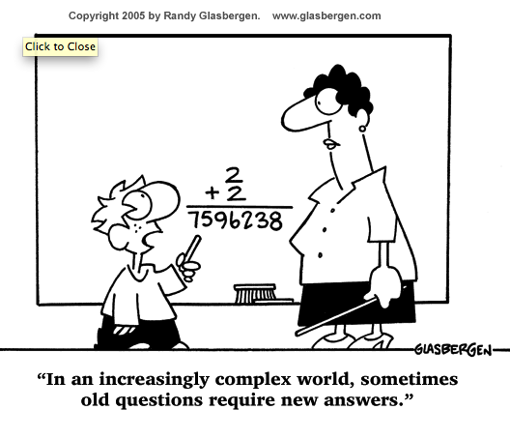

Slide 7
Multiple Types of Verbal Protocols
Concurrent Think-Alouds
Students think aloud while they complete the task (Talk about what they are doing as they are doing it)
Likely to contain disjointed sequence of thoughts, lack coherence and not provide detailed insights about how student generated his/her response
Intent is to unveil cognitive processing steps
Students do not explain what they are doing or why they are doing it
Guided by general, neutral prompts (e.g., Keep talking)
Notes:
Important to note that students are NOT asked to describe or explain what they are doing as part of the think-aloud – asking students to do this while simultaneously engaged in the task is thought to distort or misrepresent the accurate portrayal of the students’ thinking while they are engaged in the task.

Slide 8
Multiple Types of Verbal Protocols
Retrospective Think-Alouds
Student describes cognitive processes he/she engaged in after solving the problem
Opportunity to describe any meta-cognitive (e.g., planning, organizing information, etc.) or higher-level problem-solving processes used to solve the problem
Can be designed to include specific questions that will provide more information about processes or perceptions you are interested in (e.g., What strategies and steps did you take to solve the problem? What did you do first? What did you do second?)
Designed to verify that the content of the concurrent think-aloud is accurate

Slide 9
Verbal Protocols
What They Are
What They Are Not
Opportunities for students to think aloud while solving problems
Students can think all of their thoughts aloud without interference from the interviewer (e.g., concurrent)
Interviewer can ask the student to ask more specific, targeted questions after the student has solved the problem (e.g., retrospective)
Focus on students’ current level of understanding
Do not involve active and directed teaching to prompt changes in students thinking
Do not include the interviewer asking a series of clarifying questions while the student is solving the problem
Do not include a sequence of hints to help lead the student to selecting or determining the correct response
Focus on students’ learning potential

Slide 10
How do Verbal Protocols differ from Dynamic Assessment?
Dynamic assessment examines learning ability as a function of what a student can do as he/she is being taught during instruction. Verbal protocols can provide insights about a students’ thinking during and after problem solution that can inform future instruction
During dynamic assessment the interviewer intervenes during the assessment to provide feedback and determine how the student can profit from that feedback. During verbal protocols the interviewer probes students’ thinking and specific cognitive processes after the task has been completed

Slide 11
Verbal protocols and assessment development
Can be used in rule-based, problem solving context – such as mathematics and science – to examine how students solve problems (Leighton & Gierl, 2007)
  Used to illustrate the content knowledge and skills elicited in students’ responses to different item features (e.g., language, vocabulary, graphics, etc) and item formats (e.g., multiple-choice items, fill-in-the-blank, etc.) (Leighton, 2004)
  Used to shed light on problems or ambiguities with the item content that may contribute to students’ difficulty comprehending the item (Almond et al., 2009; Leighton et al., 2011)

Slide 12
Verbal protocols and assessment development
Can help validate whether students’ use the higher knowledge and skills hypothesized to be necessary to solve the item (Leighton, 2012)
Can provide data about the knowledge successful students have mastered in relation to the knowledge and skills of less successful students (Leighton, 2012)
Can provide valuable information about potential sources of construct irrelevant variance associated with the item
  Specific features of the item that are extraneous to the intended construct and may systematically influence students’ ability to access the targeted content of the item (AERA, APA, NCME, 1999)

Slide 13
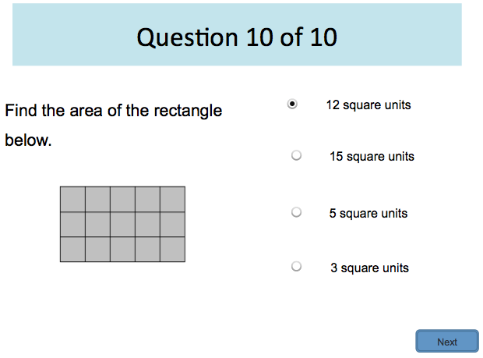
Using Verbal Protocols to Identify Sources of Construct Irrelevant Variance
Do you see anything in the wording or graphic for this item that may cause confusion for a 2nd grade student?

Slide 14
Using Verbal Protocols to Identify Sources of Construct Irrelevant Variance
How hard was this question for you?
I thought it would be hard.
You thought it would be hard? But why did you change your mind? Why did you think it was very easy?
Because you just have to count the bottom.
Why did you just have to count the bottom?
Because it says below – rectangle below.
What was this problem asking you to do?
To count like part of the rectangle below

Slide 15
Using Verbal Protocols to Identify Sources of Construct Irrelevant Variance
This example illustrates how even one word can influence a student’s understanding of what the question is asking and, subsequently, influence his/her ability to select the correct response
In addition to non-mathematical vocabulary, other potential sources of CIV for students may include their decoding skills, reading fluency, and/or reading comprehension
It is important to note that something that makes a problem challenging for one student may not create challenges for other student!
Notes:
There are a couple of points I was thinking we could make (but I’m not adamant that they be included in the presentation)
Reading as a source of CIV – including the decodability of words (particularly for younger students still learning to read, as well as older, struggling learners), vocabulary (not mathematics vocabulary that is associated with the intended construct or content), and reading comprehension (the degree to which students’ ability to understand an item influences or interferes with their ability to correctly solve the problem). Presumably, fluency could be an issue too because if students’ aren’t fluent readers that may interfere with their ability to hold information important to solving the problem in their working memory as they read and try to solve
Interesting study conducted by Ercikan, Arim, Law, Domene, & Lacroix (2010) in which they report the results of think-aloud protocols as additional evidence of differential item functioning for two groups – one English-speaking and one French-speaking of 7th and 8th grade students – as they solved math and science items
Want to note somewhere about the possibility of group CIV (example in the Ercikan et al., 2010 study) but also need to consider that sources of CIV may be different for different students

Slide 16
When should verbal protocols be conducted?
To inform assessment development and instruction, verbal protocols ought to be conducted before assessments have been finalized and will be used with multiple students
  For the development of the MSTAR and ESTAR assessments, we collected verbal protocol data before item writing workshops so that information collected during the VPs could be used to inform the drafting of items that would be pilot-tested with large numbers of students
Information collected during verbal protocols should not be used to modify existing assessments

Slide 17
Verbal Protocols
Examining Students’ Responses
to Algebra Readiness Items

Slide 18
Verbal Protocol Data Collection:
Our Process
Developed 10 sample questions assessing content from the blueprint for each grade level
Asked 10 students in each grade level from a local school to solve the problems
  Had them “think aloud” while solving the problems (concurrent think-aloud)
  Asked a series of targeted, follow-up questions after they solved the problems:
    What is this problem asking you to do?
    What strategies and steps did you take to solve the problem?
    Was there any part of the question that was confusing or hard to understand?
    Explain why you did not choose the other answer options

Slide 19
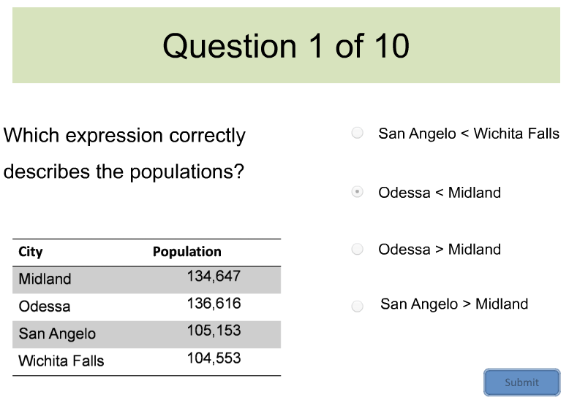
Verbal Protocol Data Collection:
Grade 4 Example
Notes:
This is one sample item that we asked fourth grade students to solve during our verbal protocol study. The item was written to assess this content standard in the Texas Response to the Curriculum Focal Points, Revised (2013):
4.1.1: Apply place value knowledge up to millions to compare and order whole numbers, using mathematical symbols (>,<,=), in contextual problems (situations connected to students lives) and on a number line.
Take a minute and discuss with your neighbor (1) How you think students might approach solving a problem of this type, and (2) Are there any features or components of the item that may pose challenges for some students and/or influence their ability to select the correct response?

Slide 20
Grade 4 Example: Data
# Who Selected Correct Response | 7
Average Response Time | 4:32
Minimum Response Time | 3:00
Maximum Response Time | 7:00
What is this problem asking you to do?
“Eaten or protected”
Why didn’t you select Response D?
“Because its pointing at this one, saying that this one would get eaten but this one’s supposed to get eaten, not that one”
Notes:
(I included these sample student responses to questions because they kind of reflect the lack of mathematical thinking going on here…All of the student’s language is about “eaten” and “protected,” not so much about math and comparing numbers

Slide 21
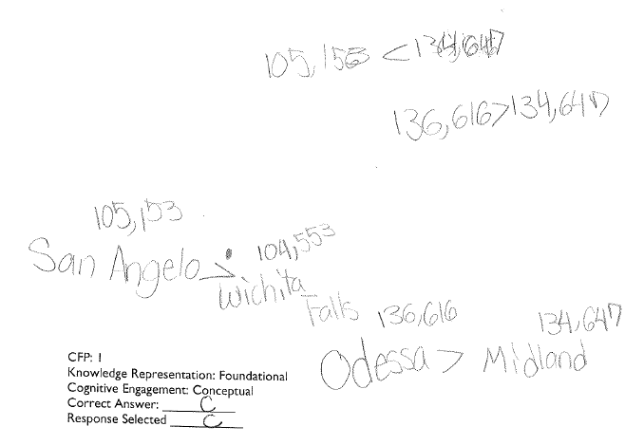
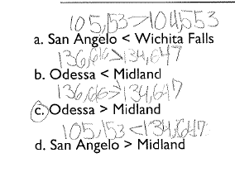
Grade 4 Example: Students’ Work
Notes:
It took this student about 7 minutes to solve the problem because of the painstaking time it took to write out all of the city names to begin thinking about the comparisons and then to re-write the numbers above the city names by the responses provided because she was not sure how to approach a comparison problem in which the names of the items were being compared instead of the actual values.

Slide 22
Grade 4 Example: Suggestions for Revision
Consider using names/items for comparison that are easily decodable and/or familiar to students
Depending on the target level of difficulty, consider including 3 options for comparison instead of 4
Notes:
If concerned about the accuracy of the numbers being compared and the ease with which students can work through the comparisons (these numbers are recent population values for the four cities), consider making up city names that are easy for students to read (e.g., Oak, Maple, Beech, Pine)
Ask participants if they have any other suggestions for how we might revise/improve the item

Slide 23
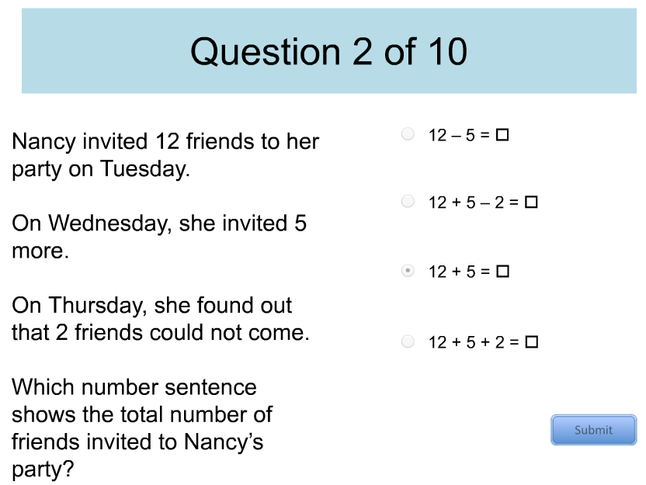
ESTAR
Grade 2 Example
Notes:
Not sure if for this next set of Activity slides we want to include “placeholder” slides for essentially a “think-pair-share” activity (e.g., Think about possible source of CIV or features of the item that may make it challenging for students to solve
Find a partner
Share your thoughts about potentially confusing features of the item and brainstorm possible solutions to address the potential sources of confusion
Large-group share

Slide 24
ESTAR
Grade 2 Example: Data
# Who Selected Correct Response | 0
# Who Selected Distractor B | 9
Average Response Time | 1:25
Students’ rationale for their answer choice:
“ [I knew B was the correct response] because it has all of the numbers that is on the question.”
“[The problem is asking] what is like the – like what total of it is how many friends is gonna come?”
90% of students appear to have selected the incorrect response based on an understanding or expectation they were being asked to figure out the number of friends that were coming to the party.

Slide 25
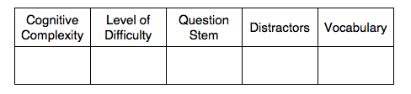
Grade 2 Item Activity
How do you think students’ responses may have changed the intended construct of the item?

Slide 26
ESTAR
Grade 2: Data Decisions
Item | Cognitive Complexity | Verified | Difficulty | Verified
2 | Strategic | Yes | Difficult | Yes
For this item, the think-aloud verified that students did not understand they were being asked to write an equation to represent the problem. Based on the average response time and student responses to level of difficulty, our item construct was verified.
DECISION: Clarify the question stem.

Slide 27
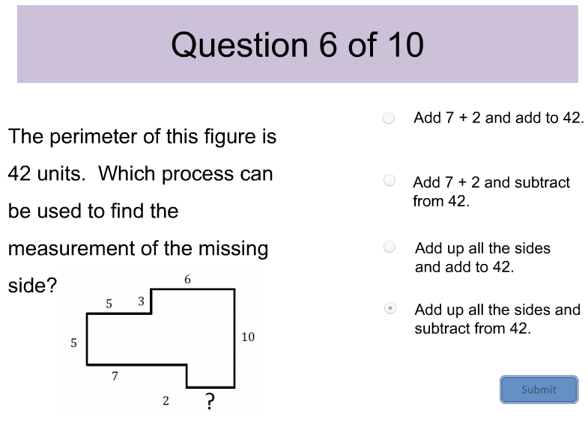
ESTAR
Grade 3 Example

Slide 28
ESTAR
Grade 3 Example: Data
# Who Selected Correct Response | 2
Average Response Time | 2:20
Minimum Response Time | 0:54
Maximum Response Time | 6:00
Student’s rationale for their answer choice:
[I did not choose C] “because you’re going to add it to 42, not subtract.”
“If you added all the sides and added it to 42, it would be 70 something.”
“I’m counting 10 plus 6, 16 plus 3, 19 plus 5…That there’s 38 and I’m trying to find 42.
80% of the students appear to have selected an incorrect response based on the understanding that this problem only called for a single operation.

Slide 29
Grade 3 Item Activity
How do you think students’ responses may have changed the intended construct of the item?

Slide 30
ESTAR
Grade 3: Data Decisions
Item | Cognitive Complexity | Verified | Difficulty | Verified
6 | Strategic | Yes | Difficult | Yes
For this item, the think-aloud verified that students did not understand they were being asked to find the missing side and struggled with the word “perimeter.”
DECISION: Grade 3 students are expected to know perimeter. Item remains “as is” and will be used to inform item-writing.

Slide 31
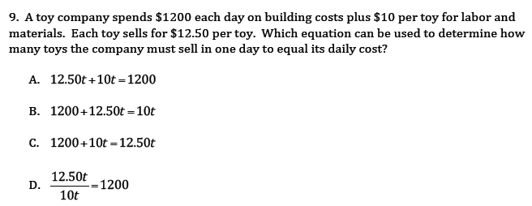
MSTAR
Grades 5-8 Example

Slide 32
MSTAR
Grades 5-8: Data
Student’s rationale for their answer choice:
I chose A because they were saying $1200 each day on the building cost plus $10 per day for the labor, so that they want to see, they want you to find out how many toys the company must sell in 1 day to equal it’s daily cost. It’s daily cost is $1200, so $1200 would have to be behind the equals sign...”
“The daily cost is 1200 dollars. So to start the equation, I would be = 1200 dollars.”
# Who Selected Correct Response | 2
Average Response Time | 2:16
Minimum Response Time | 1:16
Maximum Response Time | 4:33
50% of the students appear to have selected an incorrect response based on the understanding that the constant should appear to the right of the equal sign.

Slide 33
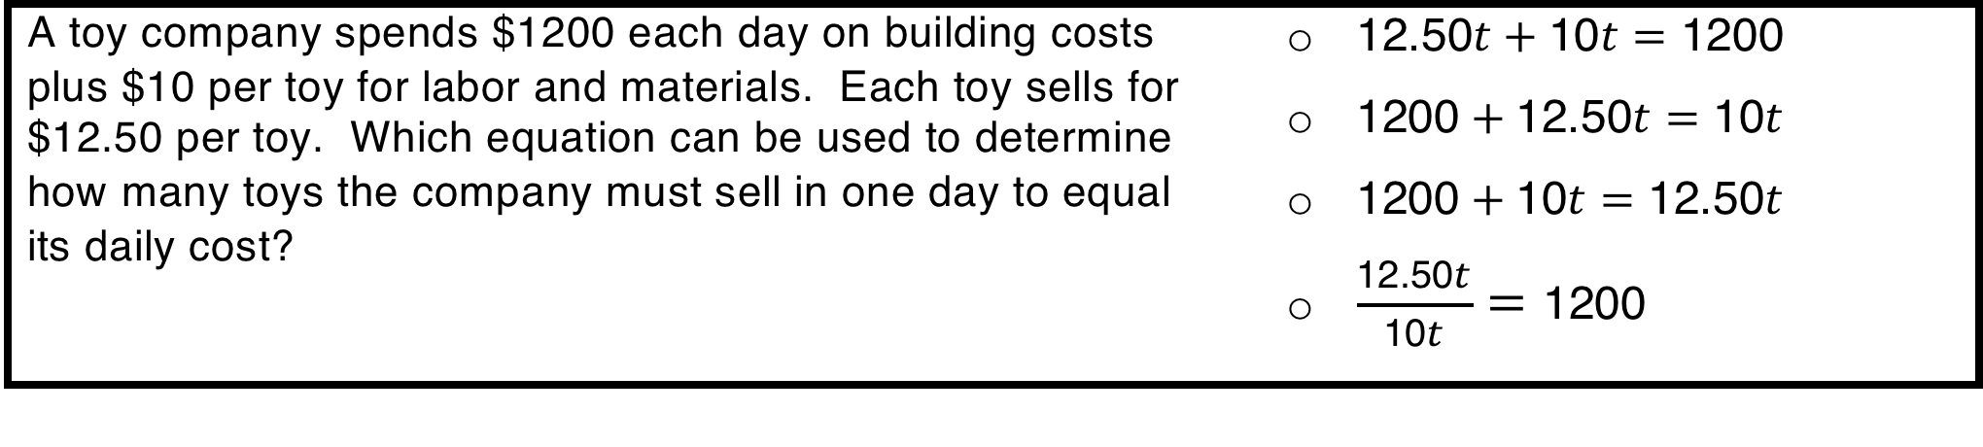
Grades 5-8 Item Activity
How do you think students’ responses may have changed the intended construct of the item?

Slide 34
MSTAR
Grades 5-8: Data Decisions
Item Standard | Description | Misconceptions
25.4.ii | The student will be able to write and solve multi-step equations generated from word problems. The student can generate algebraic solutions to word problems (as opposed to reasoning arithmetically). | Given a simple context, the student cannot always determine if a variable should be used Can only solve problems one way; does not see that there may be multiple ways to solve the problem
For this item, the think-aloud verified that students understood they were being asked to write an equation to represent the situation. However, the misconceptions were not verified based on student responses.
DECISION: Add a misconception to the learning progression that accounts for students thinking a constant can only be to the right of the equal sign in an equation.

Slide 35
What can we do with this information?
Generalizing findings for
item writing

Slide 36
Lessons Learned and to Consider During Item Writing
Do’s
Include nouns and proper nouns that are easy for students to decode and they are likely to be familiar with (e.g., roses vs. petunias)
Use explicit language in the stem with verbs that communicate the precise action you want students to complete
If appropriate, define words for students in the stem (e.g., ¼ is equivalent (or equal to) which fraction?)
Double- and triple-check all response options to make sure there is only one correct answer and that distractors are plausible
For comparison problems, consider including fewer numbers of items to be compared
Avoid repetition of wording in the stem and response options to minimize cognitive load
Notes:
Not sure if we want to share all of these immediately following the activity items or if we want to do the activity items, collectively brainstorm Item Writing Do’s and Don’ts, and then share the lists that we came up with

Slide 37
Lessons Learned and to Consider During Item Writing
Don’ts
Include response options that clue students to the correct response and/or can be easily eliminated without “working” the problem
Use vague verbs and language that allow for multiple interpretations
  Describe the fraction
  At the circus, one person rode on the back of every one horse. There were 7 horses. How many total legs could you count?
Introduce unnecessary complexity by including extraneous information

Slide 38
Final thoughts…
Verbal protocols can be used to inform assessment development and instruction
Using data from verbal protocols, guidelines for item writing can be established
Future research is needed to verify results from verbal protocols and to develop general guidelines for writing items

Slide 39
References
Almond, et al. (2009). White paper: Cognitive interview methods in reading test design and development for alternate assessments based on modified academic achievement standards (AA-MAS). Dover, NH: Measured Progress.
Ercikan et al. (2010). Application of think aloud protocols for examining and confirming sources of differential item functioning identified by expert reviews. Educational Measurement: Issues and Practice, 29(2), 24-35.
Ericsson, K. A., & Simon, H. A. (1993). Protocol analysis: Verbal reports as Data. Cambridge, MA: MIT Press.
Leighton, J. P. (2004). Avoiding misconception, misuse, and missed opportunities: The collection of verbal reports in educational achievement testing. Educational Measurement: Issues and Practice, XX, 6-15.
Leighton, J. P. & Gierl, M. J. (2007). Verbal reports as data for cognitive diagnostic assessment In J. P. Leighton & M. J. Gierl (Eds.) Cognitive diagnostic assessment for education: Theory and application (pp. 146-172). New York, NY: Cambridge University.
Leighton et al. (2011). An experimental test of student verbal reports and teacher evaluation as a source of validity evidence for test development. Applied Measurement in Education, 24, 324-348.

Slide 40
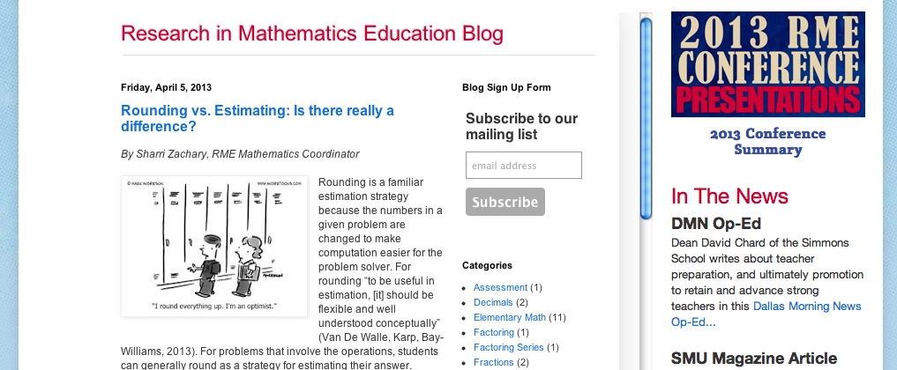
Interested in Learning More?
http://www.smu.edu/Simmons/Research/RME

