Slide 1
The New Science of Learning: How Research is Changing the Way We Teach
Southern Methodist University
23rd Annual Teaching Effectiveness Symposium
August 21, 2015
Todd Zakrajsek, Associate Professor
Department of Family Medicine
University of North Carolina at Chapel Hill
919-636-8170
TODDZ@UNC.EDU

Slide 2
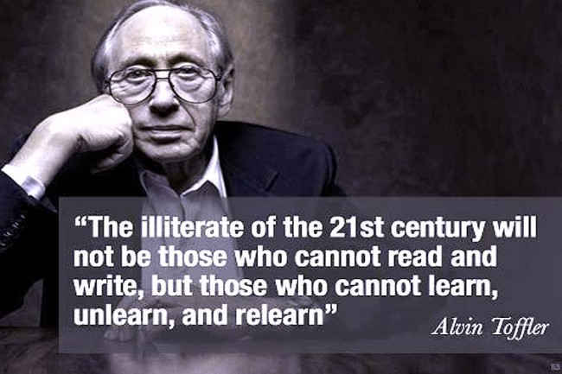

Slide 3
Icebreaker
We improve on a task by working at specific aspect of a task, not by repeating the same behavior over and over...

Slide 4
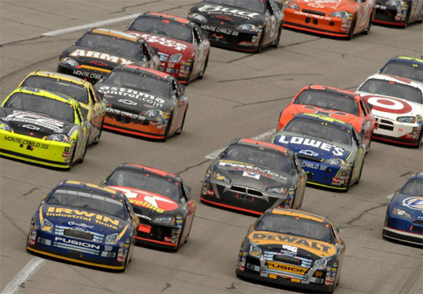
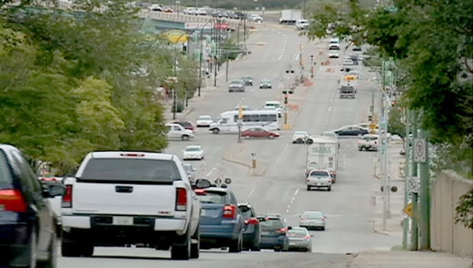

Slide 5
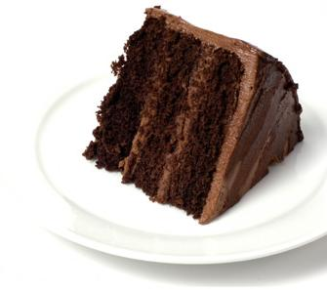
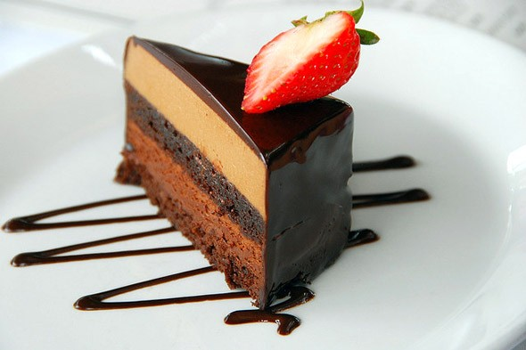
Notes:
This is a good idea of how teachers may follow something that “sounds good.” We can elaborate and have fun.

Slide 6
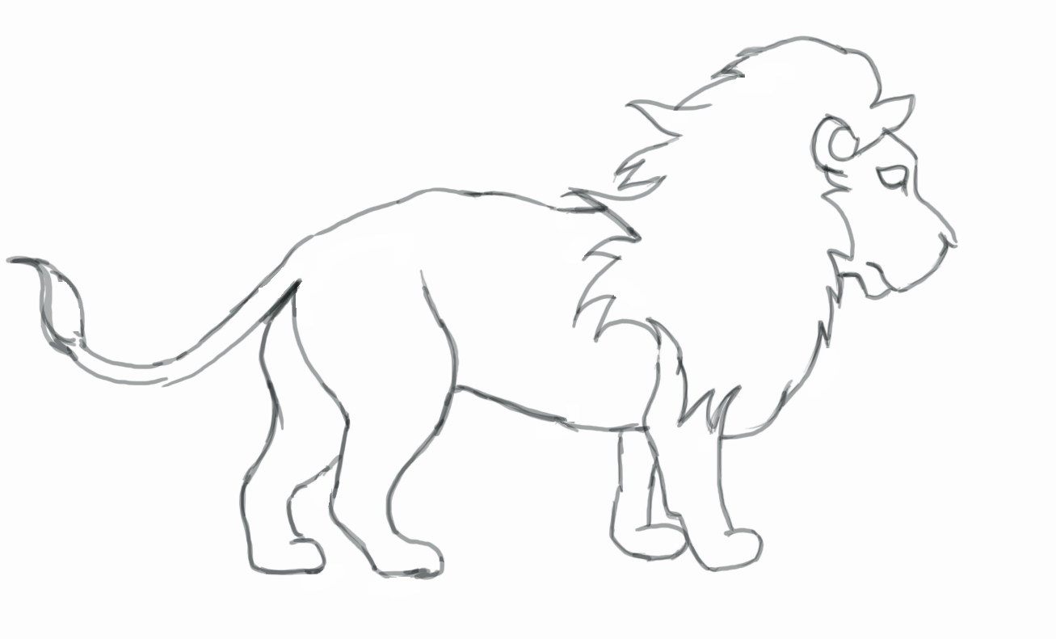
Notes:
This is a good idea of how teachers may follow something that “sounds good.” We can elaborate and have fun.

Slide 7
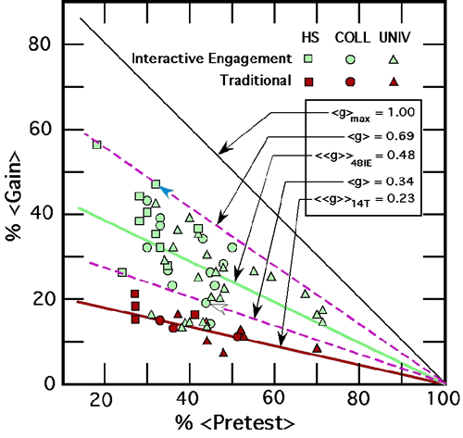
Hake (1998)
http://scitation.aip.org/getpdf/servlet/GetPDFServlet?filetype=pdf&id=AJPIAS000066000001000064000001&idtype=cvips&doi=10.1119/1.18809&prog=normal

Slide 8
Lecture vs Active Learning
50
Lecture
Active learning
# of Students
25
0
1
2
3
4
5
6
7
8
9
10
11
12
Score on Test
Deslauriers et al. Science, 2011: Improved Learning in a Large-Enrollment Physics Class
http://www.sciencemag.org/content/332/6031/862.full.pdf

Slide 9
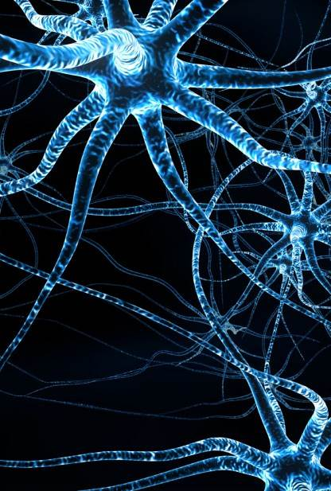
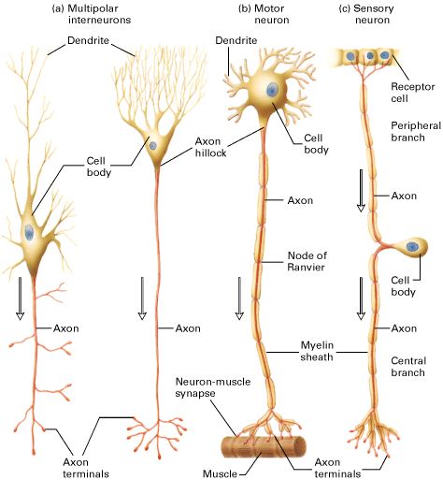
Retrieval Dependent on Encoding
Strength of Elaborations
Memory Trace
NOTE: Attention necessary to encode information.
Notes:
This is a good idea of how teachers may follow something that “sounds good.” We can elaborate and have fun.

Slide 10
Thinking vs Recall
It takes more time and energy to think than to recall.
When it is better to not think?

Slide 11
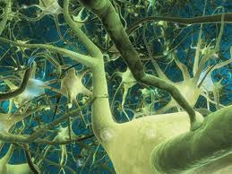
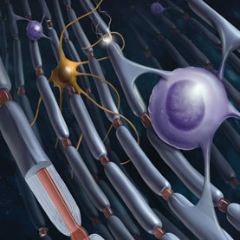
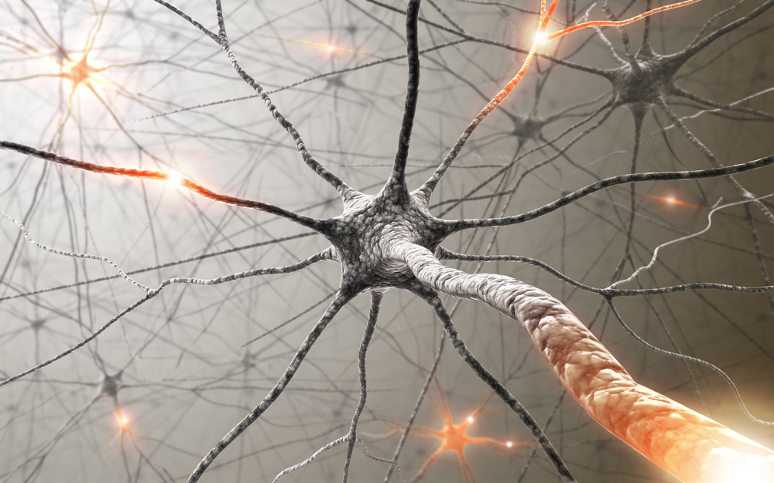
We are what we repeatedly do. Excellence then, is not an act, but a habit --Aristotle Long-term potentiation

Slide 12
Teaching Strategies

Slide 13
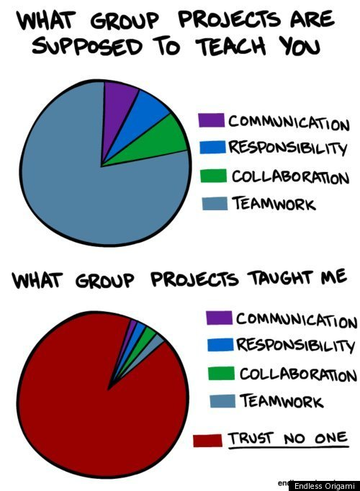
Teaching Strategies

Slide 14
Teaching Strategies

Slide 15
(From Nickerson & Adams, 1979)

Slide 16
Reward for Learning
Dopamine is there to reward your brain for learning new information, or engaging in new experiences.
Without dopamine, you would not be interested in learning or trying new things.

Slide 17
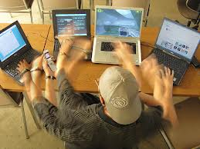
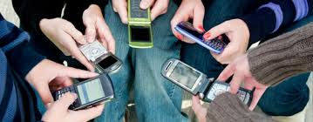
Multitasking
86% of students report texting throughout entire class periods. (McCoy, 2013)
Clifford Nass (Stanford), studies social and psychological impacts of media. His research shows that chronic multitasking were terrible at ignoring irrelevant information; they’re terrible at keeping information in their head nicely and neatly organized; and they’re terrible at switching from one task to another…..yet they think they are great multitaskers.
(Ophir, Nass, & Wagner, 2009. Proceedings of the National Academy of Sciences)

Slide 18
Multitasking
Placed in font of a computer with internet and a television for 30 minutes. Estimate how many time switch attention from one to the other.
Following study session participants asked how many time they had “shifted” attention.
Estimated Average 15 times….
Actual……120 times.
Computer average was 6 seconds and TV average was 2 seconds.
(Brasel & Gips, 2011. Boston College)

Slide 19
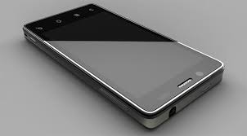
Multitasking
The mere presence of a cell phone has been shown diminish attention and reduce performance on cognitively complex tasks.
(Thornton, Faires, Robbins, & Rollins, 2014)

Slide 20
Photo credit: Auto Repair Match

Slide 21
Learning Styles: Concepts and Evidence
-- vision and olfactory very important
Pashler, McDaniel, Rohrer, & Bjork, 2009
Notes:
This is a good idea of how teachers may follow something that “sounds good.” We can elaborate and have fun.

Slide 22
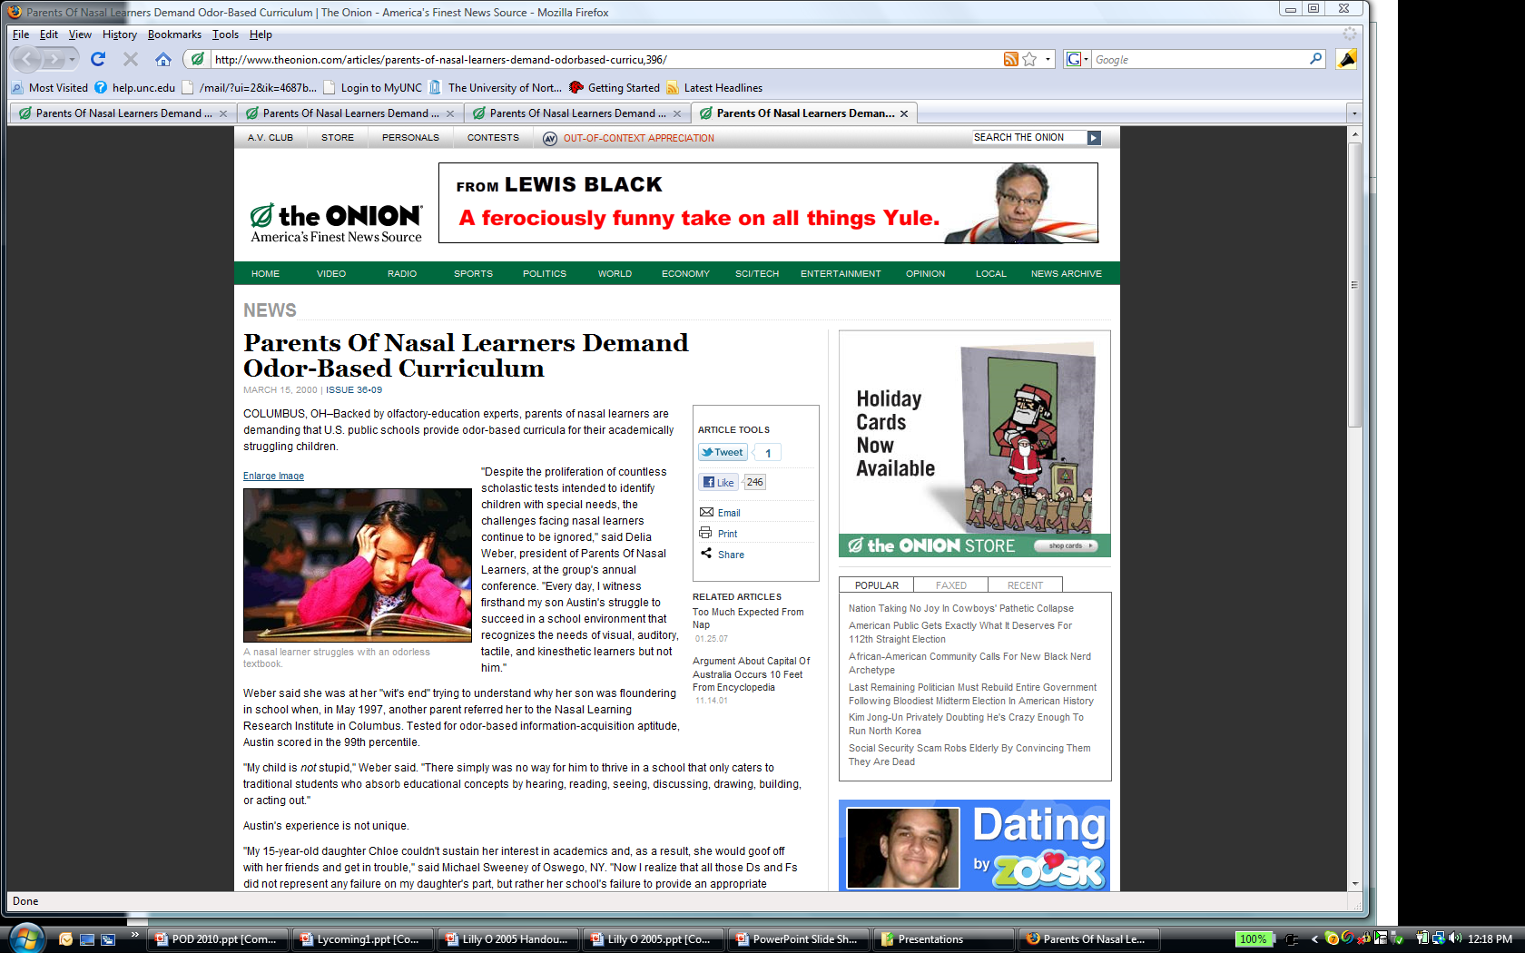
Basketball….

Slide 23
One-Minute Preceptor (Furney, et al., 2001)
Ask for a Commitment
Probe for Underlying Reasoning
Provide Positive Feedback
Correct Errors (if needed)
Teach General Rule

Slide 24
Learners must be taught to take a metacognitive approach.
How can you know when your learner knows?
Bransford, et al., How People Learn, 1999
http://www.nap.edu/openbook.php?record_id=6160

Slide 25
Types of CATs
Minute Paper (check understanding at end of class session)
Muddiest Point (check understanding at end of class session)
One-Sentence Summary (check understanding at end of class session)
Directed Paraphrasing (check understanding of a concept)
Lecture Checks (Mazur’s Technique)
Card Passing (very good for sensitive topics)

Slide 26
Karpicke & Roediger, 2007
SSSS
SSST
STTT
.80
.70
Proportion of ideas recalled
.60
.50
.40
5 Minutes
1 Week
Retention Interval For Final Test
Notes:
This is the study that has been circulating recently. I have been having the worse luck….. I have used this study for about 2 years and really like to use it as an example, then it gets popular. Not as bad as the gorilla basketball video, but close ;)

Slide 27
Exercise
Ratey (2008) has shown that exercise increases the production of vital neurotransmitters important for:
Focusing and Attention
Motivation
Patience
Mood

Slide 28
Exercise Stimulates Synaptic Growth
Exercise stimulates the production of new synapses, whose capacity and efficiency underlie superior intelligence.
(Art Kramer of the University of Illinois at Urbana-Champaign)
“It thus provides more generalizable benefits “

Slide 29
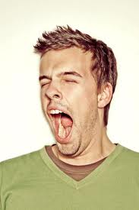
Awake, but NOT Learning
Corelli, 2011 notes that when a person’s brain is sleep deprived the person may actually feel fully awake and yet the neurons needed for learning and memory shut down. Essentially, basic functions operate, but complex tasks are not encoded.

Slide 30
Awake, but NOT Learning
Dangers of blue light and melatonin. Proceedings for the National Academy of Sciences (Nov 2014) found that screen time before bed can be detrimental. In addition to poor cognitive functioning, lack of sleep related to obesity, diabetes, and cardiovascular disease. Chronic suppression of melatonin is even related to certain cancers.

Slide 31
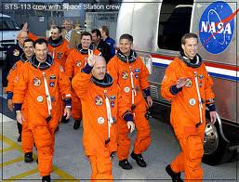
Sleep and Rest
Sleep and Rest – Researchers at the NYU’s Department of Psychology and Center for Neural Science have found that rest directly after learning increases retention
A NASA study found astronauts who napped
for 27 minutes in the
afternoon improved their
cognitive functioning on
later day tasks by 34% over
nonnapping astronauts(Medina, 2008).

Slide 32
Memories are made during Sleep
Most sleep researchers now agree that sleep plays an important role in the formation of long term memories . (Stickgold, 2005).

Slide 33
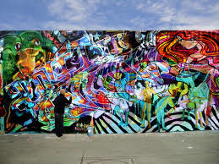
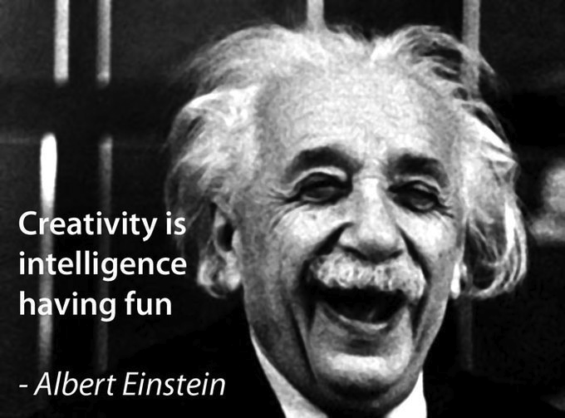
Sleep and Creativity
Sleep also seems to reorganize memories, extracting the emotional details and reconfiguring the memory to help us produce new and creative ideas.
(Wagner, U., Gais, S., Haider, H., Verleger, R., & Born, J. (2004).
D

Slide 34
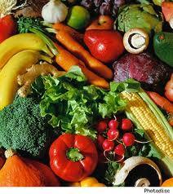
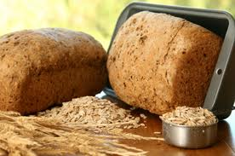
Food/Hydration
Food (glucose) --- Complex carbohydrates (vegetables and whole grains) MUCH better than simple sugars

Slide 35
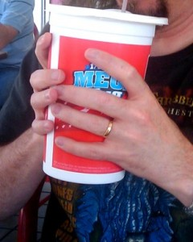
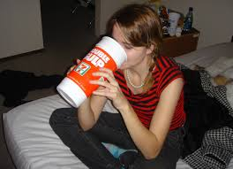
Hydration
Mild dehydration can result in cognitive declines of 10%.
(Norman, 2012)

Slide 36
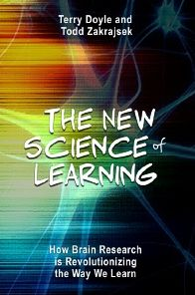

Slide 37
http://scholarlyteacher.com/

Slide 38
Thank you !!!

