Slide 1
When We Say Predictive Analytics,
What Do We Mean?
Professor Tom Fomby
Director of the Richard B. Johnson
Center for Economic Studies
SMU
http://www.smu.edu/Dedman/Academics/InstitutesCenters/RBJCenter
Dallas Tech Execs Forum
IBM Innovation Center
Coppell, TX
September 17, 2013

Slide 2
Some General Observations
Most Computer Scientists and Engineers are not trained in Statistics
Most Statisticians and Econometricians are not trained in Data Warehousing Techniques
Most Offices of Information Technology are not using statistical methods to be forward-looking or proactive with respect to their customers and business operations
Properly Reporting Predictive Analytics Results to a Lay Audience is crucial in getting buy-in and utilization of analytics results in company operations
Many Technical People are not well schooled in presentation skills

Slide 3
Successful Implementation of Predictive Analytics into company operations requires a combination of three Basic Core Competencies
Predictive Analytics
Reporting
Data Warehousing

Slide 4
To Operate Core Competencies
Data Warehousing: D-base, Oracle, etc.
Predictive Analytics: SPSS Modeler and Other Statistical Packages
Reporting – Cognos for Dashboards and Microsoft PowerPoint

Slide 5
Prerequisite Skills for a Skilled Analytics Person
Essential Tools
for
Predictive Analytics
GLM
Time Series Analysis
Applied Multivariate Analysis
Machine Learning Tools
Computational Skills
Multiple
Regression

Slide 6
Some Specifics on Skills
Multiple Linear Regression (OLS, WLS, Time Series Regressions)
Generalized Linear Modeling (Probit, Logit, Multinomial Logit/Probit, Count, Cox Proportional Hazard models)
Time Series Modeling Expertise (Seasonal Adjustment, Box-Jenkins, Exponential Smoothing, Vector Autoregressions)
Applied Multivariate Statistical Analysis (Clustering, Principal Components, Discriminant Analysis)
Training in Machine Learning Tools (CART, CHAID, SVM, ANN, K-Nearest-Neighbors, Association Rules)
Computer Usage and Programming Skills (SPSS Modeler, SAS Enterprise Miner, Matlab, Mathematica, R, STATA, EVIEWS)

Slide 7
Core Tasks of Predictive Analytics
EDA
Univariate Plots
Box-Plots
Matrix Plots
Heat and Spatial Maps
Unsupervised
Learning
Treatment of Missing Observations
Treatment of Outliers
Data Segmentation
Reduction of Dimension of Input Space
Supervised
Learning
Prediction of Numeric Targets
Prediction of Categorical Targets
Scoring of New Data
Continual Supervision of Model Performance

Slide 8
A Bond Rating Problem
In this problem imagine yourself as a Bond Rating Analyst working for BondRate, Inc., a National Bond Rating Company. Given the financials of a company that is about to issue a corporate bond, you are to rate its bond with a rating of AAA (highest rating), AA, A, BBB, BB, B, or C (lowest rating) depending on the probability that the company will not be “financially stressed” in the next 12 months. In our rating system, if the company has a probability between 0.0 and 0.05 of being distressed in the next 12 months, the firm’s bond is rated AAA. If the company has a probability between 0.05 and 0.10 of being distressed in the next 12 months, the firm’s bond is rated AA. The ranges for the other ratings are A = (0.10 – 0.15), BBB = (0.15 – 0.20), BB = (0.20 – 0.25), B = (0.25 – 0.30), and C = (0.30 and above).
Target Variable: Y = 0 if firm does not become “distressed” in the next 12 months, Y = 1 if firm becomes distressed in the next 12 months
Input Variables include (next slide)

Slide 9
Input Variables
Measured 12 Months Prior
tdta = "Debt to Assets"
gempl = "Employee Growth Rate"
opita = "Op. Income to Assets"
invsls = "Inventory to Sales"
lsls = "Log of Sales"
lta = "Log of Assets"
nwcta = "Net Working Cap to Assets"
cacl = "Current Assets to Current Liab"
qacl = "Quick Assets to Current Liab"
ebita = "EBIT to Assets"
reta = "Retained Earnings to Assets"
ltdta = "LongTerm Debt to TotAssets"
mveltd = "Mkt Value Eqty to LTD"
fata = "Fixed Assets to Assets";

Slide 10
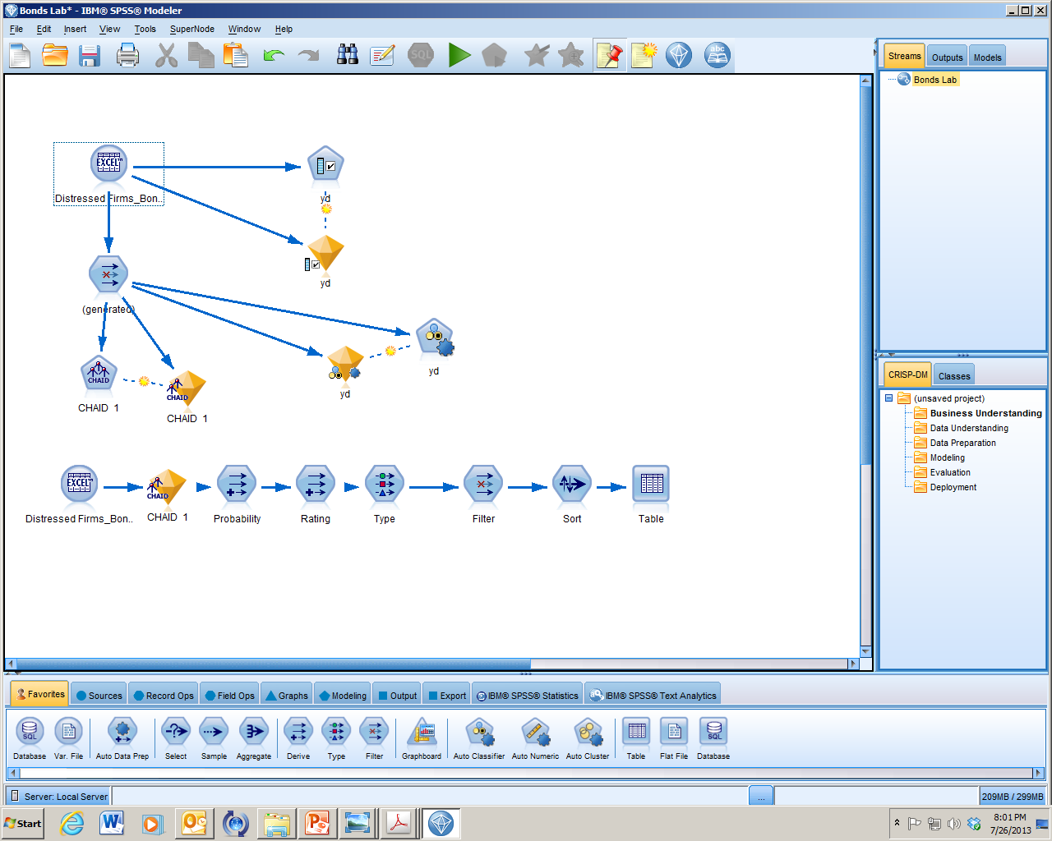
A Typical SPSS Modeler Stream

Slide 11
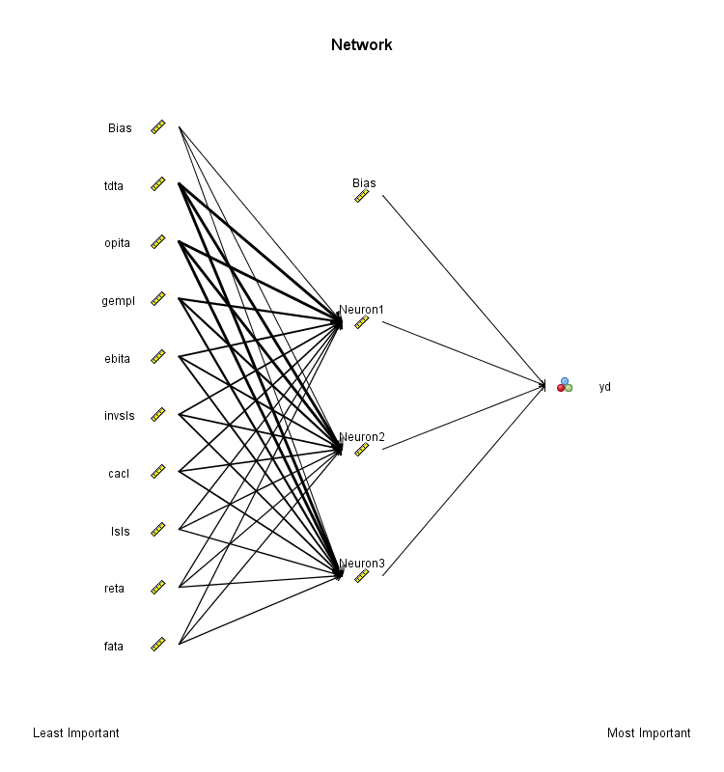
An Artificial Neural Network

Slide 12
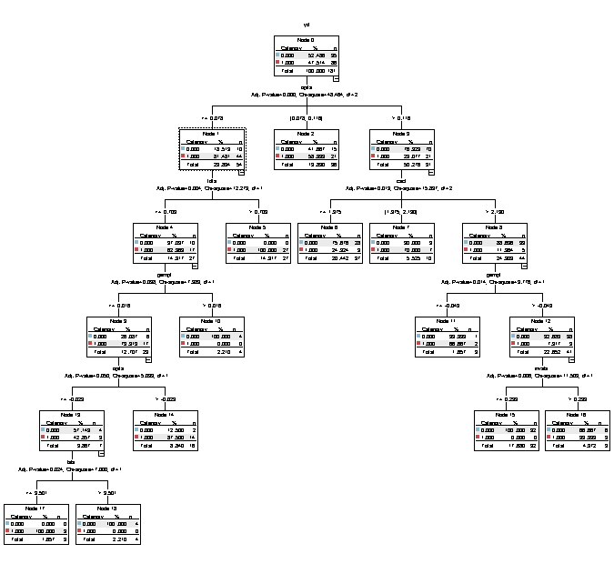
A CHAID Tree

Slide 13
SMU Degrees in
Analytics
Department of Economics – MS in Applied Economics and Predictive Analytics (MSAEPA)
Department of Statistics – MS in Applied Statistics and Data Analytics (MASDA)
Cox School of Business – MS in Business Analytics (MSBA)
They Each Have Slightly Different Emphases

Slide 14
Recent PA Activities in
Economics Department
Two National Champions and One Silver Medal in the SAS Data Mining Shootout. In the TOP 3 teams out of 60 teams entered from Universities and Colleges across the country in this year’s competition. We find out order of finish at SAS Analytics Conference on October 22 in Orlando, Florida. Will soon be competing in the Capital One Data Mining Competition.
Participation in two IBM SMART programs – Andrews Distributing Company and EXTERREN Corp.
In partnership with Dallas IBM Innovation Center, we put on first PA workshop for STEM High School Students in the Nation. It was held from July 22 through 25, 2013 on SMU and IBM campuses. 20 Dallas Town View Magnet STEM students.
One of the Core Missions of the Richard B. Johnson Center for Economic Studies is advancing Predictive Analytics and Big Data in the DFW area including the placement and interning of our students.

Slide 16
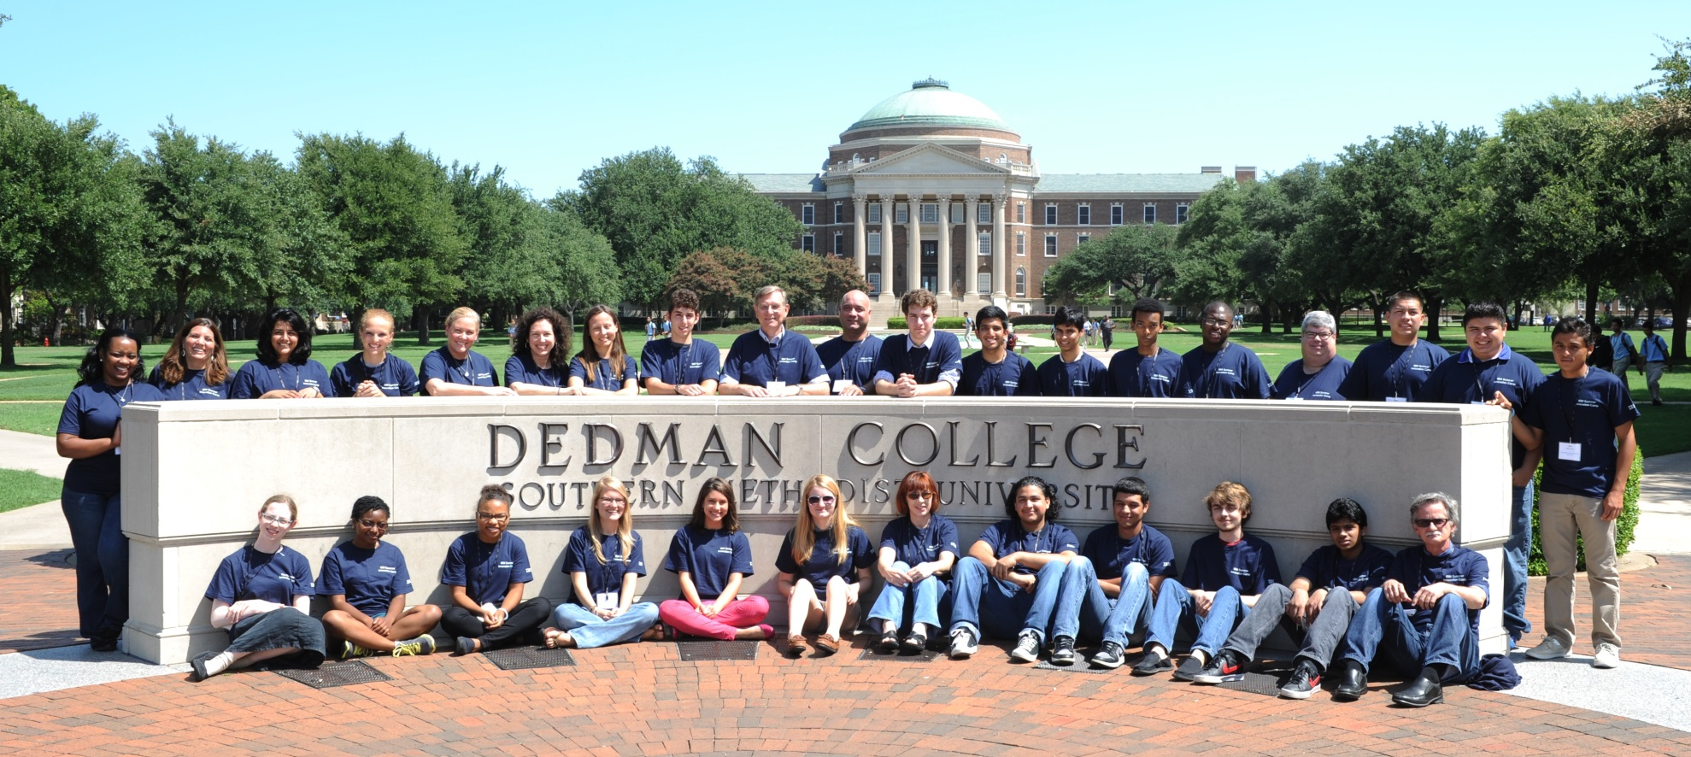
Town View STEM Students

Slide 17
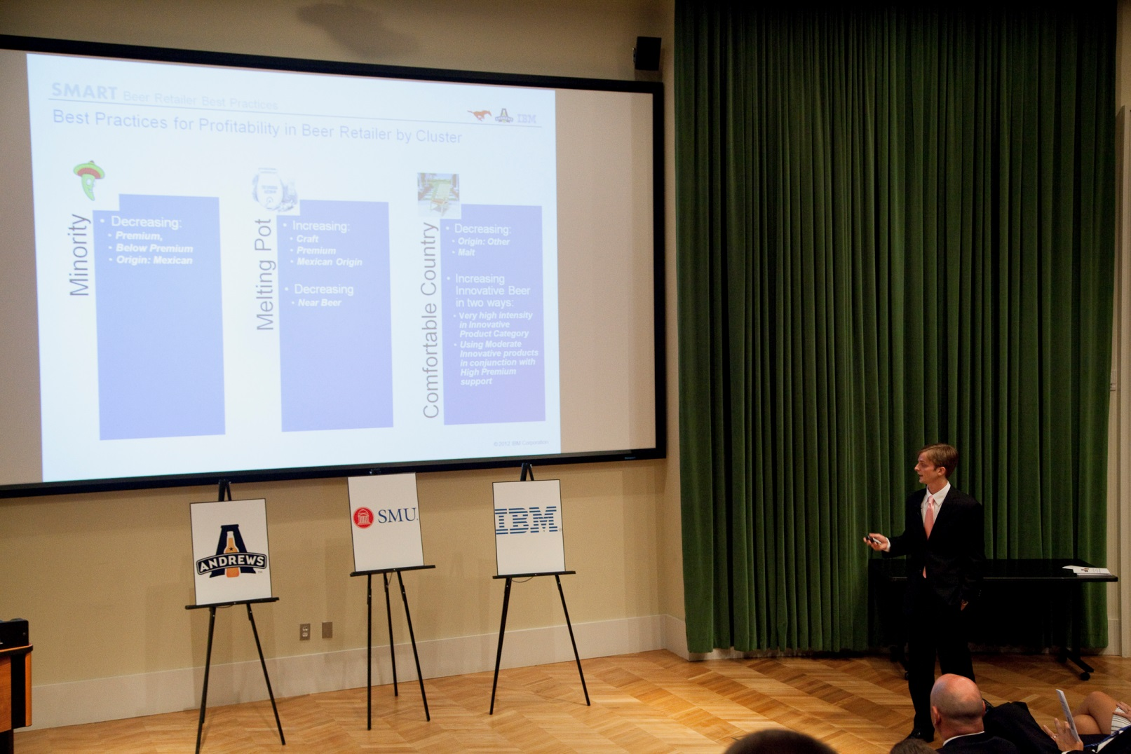
IBM/SMU SMART Program # 1 with Andrews Distributing

Slide 18
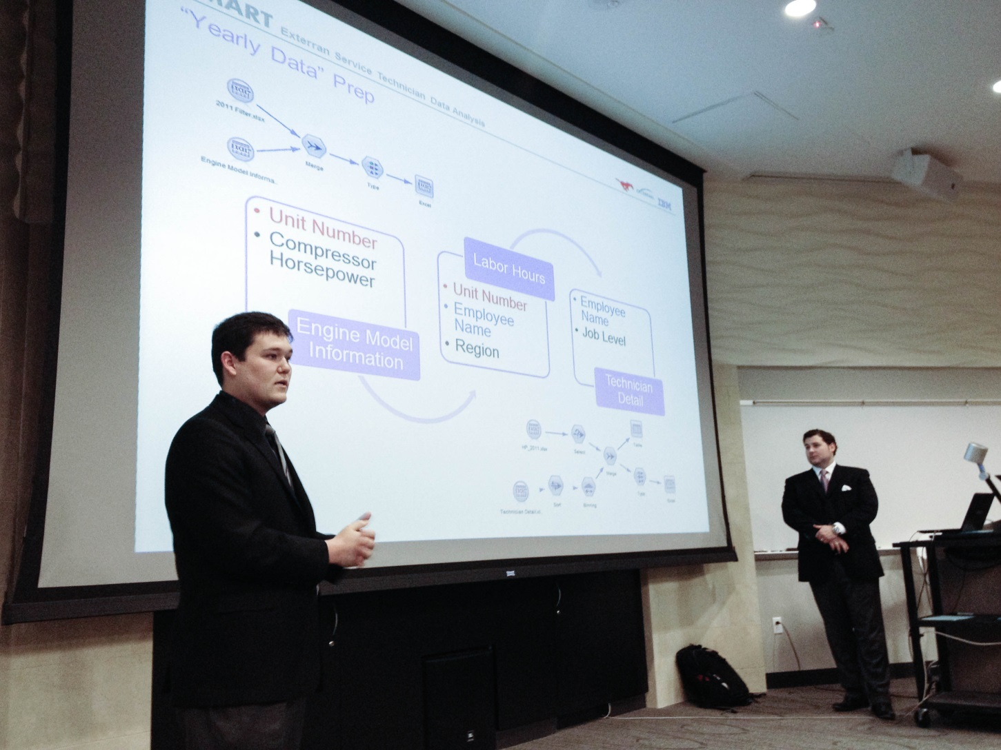
IBM/SMU SMART Program # 2
With EXTERRAN Corporation

Slide 19
How to Create a
High Performance Analytics Team
http://www.analyticsvidhya.com/blog/2013/09/high-performance-analytics/
Blog on Analytics Vidhya by Kunal Jain, September 12, 2013

Slide 20
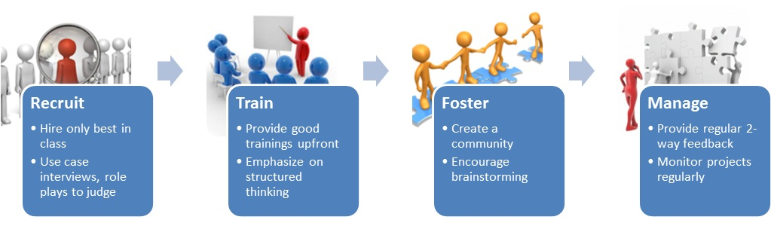
Diagram by Kunal Jain on Analytics Vidhya

