Slide 1
Using the RTI process in Mathematics
Yassmin Lee, Principal
Diamond Hill-Jarvis High School
Yassmin.Lee@fwisd.org
Dr. Erica Lembke
University of Missouri
lembkee@missouri.edu

Slide 2
Overview
RTI in mathematics—how does it look?
Overview of Curriculum-Based Measurement (CBM) in mathematics
Connecting pieces of assessment
Evidence-based interventions in mathematics
Strengthening Core Instruction in Math and Deepening Content Knowledge– Disciplinary Literacy
Many slides taken or adapted from the National Center on Student Progress Monitoring, www.student.progress.org

Slide 3
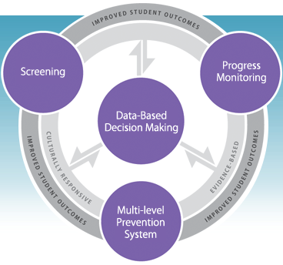
Critical elements—National Center on RTI

Slide 4
Basic steps in depth

Slide 5
Basic steps in the RTI process
#1—Implementation of evidence-based core instruction for all students, including differentiated instruction
Notes:
Evidence based interventions/instruction are those that have been directly studied. Use of evidence-based core program is key in the RTI model. We don’t want to provide a multitude of interventions if the system is actually ‘broken’ for students at the universal level.
Need to consider whether a class wide supplement like Peer Assisted Learning Strategies (PALS) is needed to help increase performance. One of the key items is monitoring fidelity. Create or utilize an existing fidelity checklist on a frequent basis. Have teachers do self checks, peer checks, or administrator checks.

Slide 6
Most important part of instruction/intervention?
The teaching!
  Need to be deliberate and intentional about your teaching
  MAXIMIZE every instructional minute
  What are the elements of effective teaching practice?

Slide 7
Effective teaching components
Evidence-based teaching practices are the key to high quality instruction/intervention
  Objective for the lesson (concrete and measurable), including a rationale
  Motivational activities to get students interested in and excited about the lesson
  Modeling
  Guided practice
  Independent practice
  Assessment

Slide 8
Treatment fidelity
One of the key components of RtI is lack of response to validated instruction, implemented with integrity
  Need to check on fidelity of implementation. How can this be done?
  Checklists, observation, discussion, video
The purpose of fidelity checks is to create open dialogue regarding what is effective and what needs to be altered
  Should be an OPEN process—no surprises here!

Slide 9
Fidelity of implementation—critical to intervention success!
How is this monitored in schools that you are working with? Or is it monitored?
How can this become a routine part of a school environment?
How can this lead to more open dialogue and better instructional methods?
How would the example work in your building?

Slide 10
Basic steps in the RTI process
#2—Schoolwide screening/benchmarking
All students screened (3 times per year is most prevalent) to determine which students are suspected to be at risk.
I would suggest a Curriculum-Based Measurement (CBM) tool. More about this in a minute…
These CBM data systems give you one data source to help determine students that fall into Tiered levels (based on national norms)
Notes:
Students are screened at the beginning of the year to determine which students are suspected to be at risk. Suspected at-risk students are identified by a percentile cutoff on a screening measure: a norm-referenced test or a cutoff point on a curriculum-based measurement (CBM) test. The suspected at-risk students are assessed using progress monitoring (PM). Students unresponsive to primary prevention move to the next tier.
Consider whether you want to provide some weekly progress monitoring to confirm/disconfirm placement in a tiered intervention group.
Use a validated screening system that has reliable and valid measures. Consider the benchmarking tools chart on rti4success.org as you are choosing a screening/progress monitoring system. Examples include dibels, aimsweb, STAR, easyCBM.

Slide 11
Basic steps in the RTI process—and considerations!
#3—Progress monitoring for students at risk
Students receiving Tier 2 (supplemental) or Tier 3 (intensive) supports are progress monitored on a frequent basis, goals are set, data is graphed, and decisions are made based upon the data
  Considerations—how often, what tool is used
  Guidelines—Students in Tier 2 are progress monitored every other week. Students in Tier 3 are monitored weekly.
  More frequent data=better decisions made more frequently.
Notes:
Progress monitoring and subsequent teacher-use of the data is perhaps one of the most powerful pieces of RTI. Teachers need to administer weekly or every other week measures to students in Tiers 2 and 3 (and perhaps students in the bubble of Tier 1) and then graph that data. Most importantly, teachers compare progress to goals that are set to determine when intervention changes are necessary.

Slide 12
How do assessments fit together?
1 to 3 times per year
Outcome tests
District test
CBM Benchmarking
? answered—how is this student
doing compared to peers or
benchmarks?
Weekly or monthly
Progress monitoring using CBM
for students deemed at-risk after
triangulation of data
? answered—is the student benefitting
from the instruction being provided?
Weekly or monthly
Diagnostic tests (unit or
chapter tests, teacher-made tests)
? answered—what specific skills are
mastered or do I need to reinforce?
Notes:
This is how we visualize assessments fitting together. 1 to 3 times per year, all students are screened to determine how students are doing compared to state or national benchmarks or norms. Then, as often as weekly, two additional pieces of assessment are in place—progress monitoring using CBM (aimsweb, dibels, star) that tells you whether students are benefiting from instruction and diagnostic tests that tell the teacher what skill needs to be focused on.

Slide 13
CBM—Overall Indicators
Curriculum-Based Measurement (CBM) assessments like Aimsweb, EasyCBM, and DIBELSmath serve as indicators of academic proficiency, just like…
  Temperature in degrees serves as an indicator of overall wellness
  Weight in pounds serves as an indicator of overall health
  A litmus test serves as an indicator of a solution’s acidity
Notes:
Temperature serves as an indicator, just like words read is a good indicator (it isn’t everything!)
Also discuss weight loss as indicator of health.

Slide 14
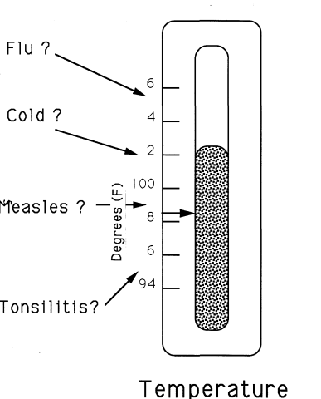
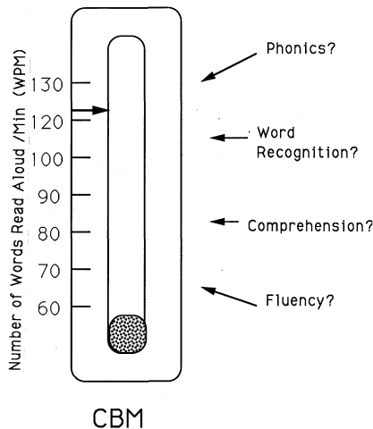
CBM: An Index of
Academic Health
Fact Fluency
Number of Correct Digits
Word Problems
Place value
Conceptual understanding
Notes:
Temperature serves as an indicator, just like words read is a good indicator (it isn’t everything!)
Also discuss weight loss

Slide 15
Measures Used For Monitoring
Math—CBM
Early Numeracy
  Oral Counting, Missing Number, Number Identification, and Quantity Discrimination
Math Computation
Math Concepts & Applications
Notes:
Math—basic fact probes, mixed problem probes

Slide 16
Examples of options for early numeracy indicators
Measures in most systems include things like number identification, quantity discrimination, missing number, mixed numeracy, next number, and how many?
Most measures in early numeracy are individually administered for 1-3 minutes
Teachers score the measures later

Slide 17
Examples of sources for CBM early numeracy measures
Lembke and Foegen measures
Number ID, Quantity Discrim, Missing Number, Mixed Numeracy
Free at www.progressmonitoring.org. Click on research and early numeracy
Both screening and progress monitoring measures

Slide 18
Examples of sources for CBM K-8 measures
Aimsweb (aimsweb.com)—TEN, Tests of Early Numeracy; Computation (M-COMP); Concepts and Applications (M-CAP)
  TEN--Oral counting, number id, QD, MN
  Individually administered
  For math only, $4 per student per year ($200 min)

Slide 19
Examples of sources for CBM K-8 measures
EasyCBM (easycbm.com)
  Geometry, Measurement, Numbers and Operations
  Group administered
  Free for ‘lite’ version (limited forms)
  $4 per student plus $200 first time training fee

Slide 20
Examples of sources for CBM K-8 measures
DIBELS math
  In pilot testing right now (are any of you part of the pilot?)
  Aligned with the common core standards
  Individually administered
  Free

Slide 21
The/ DIBELS matht Measures
 | Beginning Quantity Discrimination | Number Identification | Next Number Fluency | Advanced Quantity Discrimination | Missing Number Fluency | Computation
K
1st
2nd
3rd
4th
5th
We are also in the process of developing a problem solving component
© 2012 Dynamic Measurement Group

Slide 22
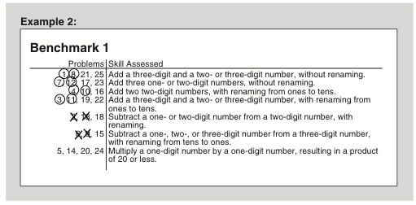
DIBELS math
DIBELS® Math key points:
The problem types are tightly constrained by grade, but also allow for several problems from the grade level before.
We include an optional error patterns analysis
© 2012 Dynamic Measurement Group

Slide 23
Algebra progress monitoring measures
Project AAIMS, Dr. Anne Foegen, Iowa State University
http://www.education.iastate.edu/c_i/aaims/
Resources for Algebra Progress Monitoring:
Algebra Basic Skills
Algebra Foundations
Algebra Content Analysis
Translations

Slide 24
Questions for discussion
Which math measures will we use or are we using?
When will we implement math screening and progress monitoring?

Slide 25
Basic steps in the RTI process—and considerations!
#4--Discussion and decision-making about the data with grade level, content-specific, or school-wide teams
Consideration--Decision-making rules established. For instance:
  After 6 data points are collected over 6 weeks, use the trend line or 4-point rule to make a decision about current plan
Notes:
To make decisions about progress or lack of progress, the trend or individual data points are compared to the goal line every 4 to 6 weeks. If the trend of performance or last 4 data points are below the goal line, an instructional change is made. If trend or last 4 data points are the same as the goal line, the current plan is continued. If the trend or last 4 data points are above the goal line, the goal may need to be increased.

Slide 26
Decision-making--Progress Monitoring data
Every 4 to 6 weeks, examine trend of data compared to goal line or 4 most recent consecutive data points
  If trend or 4 points are below the goal line, make an instructional change
  If trend or 4 points are above the goal line, consider past data to determine if the student can be moved to a lower tier or goal can be raised
  If trend or 4 points are the same as the goal, stay the course
Notes:
One of the ways that you can incorporate the decision making rules into a rubric follows. The three guiding questions that we can ask are above.

Slide 27
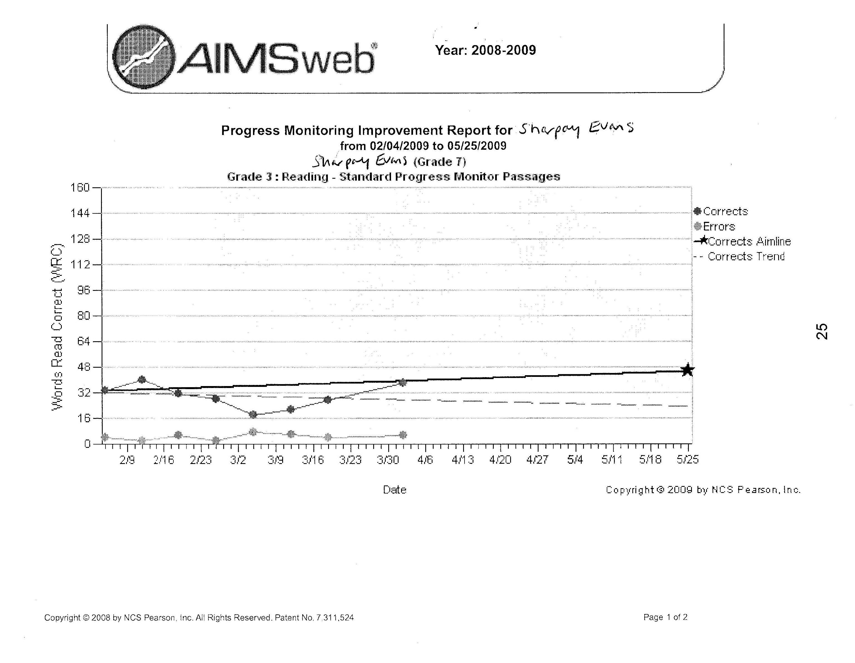
Aimline (goal line)
Trend line

Slide 28
Four-Point Method
most recent 4 points
X
goal-line
Notes:
On this graph, the four most recent scores are above the goal-line. Therefore, the student’s end-of-year performance goal needs to be adjusted. The teacher increases the desired rate (or goal) to boost the actual rate of student progress.
The point of the goal increase is notated on the graph as a dotted vertical line. This allows teachers to visually note when the student’s goal was changed. The teacher reevaluates the student graph in another seven to eight data points.

Slide 29
Four-Point Method
X
goal-line
most recent 4 points
Notes:
On this graph, the four most recent scores are below the goal-line. Therefore, the teacher needs to change the student’s instructional program. The end-of-year performance goal and goal-line never decrease; they can only increase. The instructional program should be tailored to bring a student’s scores up so they match or surpass the goal-line.
The teacher draws a dotted vertical line when making an instructional change. This allows teachers to visually note when changes to the student’s instructional program were made. The teacher reevaluates the student graph in another seven to eight data points to determine whether the change was effective.

Slide 30
Discussion of data and decision making
Use decision-making rules
Use guiding questions in your handout packet to discuss data with your team

Slide 31
Basic steps in the RTI process—and considerations!
#5—Implementation of evidence-based interventions for students at-risk
Consideration—how will fidelity be monitored?
Logistical considerations—how will interventions be scheduled? How will they be chosen?
Diagnostic consideration—how will skills be targeted?
Notes:
Consider the characteristics of the interventions that you are choosing. How will you assess whether the interventions are evidence/research based? Consider examining the instructional tools chart on the National Center for RTI website: rti4success.org. Interventions can be individualized and developed for each student, or can be a specific program used for many students (standard treatment protocol).

Slide 32
Diagnostics
Aligning instruction and intervention to common core (see handouts)
Examining results from your common assessments
Mathematics interviews?
Error analysis
Unit tests
‘Mad Minute’ assessments
Can use DIBELS math diagnostic information

Slide 33
Mathematics Interventions

Slide 34
Recommendations for resources
Lesson plans from NCTM http://illuminations.nctm.org/
Mathematics intervention briefs—
http://ebi.missouri.edu/?page_id=983

Slide 35
Intervention Plan
What will you be doing for Tiers 1, 2, and 3?
  How will you check fidelity on your plan?
What are the critical areas of need for our students in math?
How can we address these needs or how are we addressing these needs?

Slide 36
Response to Intervention in Math: Supporting all Students
Strengthening Core Instruction in Math and Deepening Content Knowledge– Disciplinary Literacy

Slide 37
RtI in Math
Tier I | On-level and standards based Math instruction Frequent practice of skills and activities that strengthen core knowledge Pyramid of skill levels progression from basic to complex computation Problem-Solving tasks offered in different context Hovering during independent practice with feedback Daily independent practice with progress check Homework Literacy in the Content Area
Tier 2 | Additional time allotted for pre-teach, tutoring, or acceleration Small group or one-to-one instruction Individualized correction in specified skill area Progress monitoring of daily work or progress checks with incentive
Tier 3 | Additional course in Math or Extended learning environment Targeted skills development Contract with student to commit to certain amount of work completed in Math daily Increase amount of time in guided practice with daily corrective feedback Daily progress monitoring of scaffolded skill development or skill continuum After school tutoring intervention, Saturday school, or Intensive Math Camp

Slide 38
Tier I – Working on Strengthening Core Instruction and Deepening Content Knowledge – Disciplinary Literacy
What does Disciplinary Literacy do for Core Instruction?
DL applies literacy skills in the math content area to increase the amount of thought devoted to content
DL starts at the basic literacy level coupled with math content and progresses towards the deep content knowledge level
The goal of DL in math is to have students demonstrate their knowledge of the content through explanation; the understanding is demonstrated as the students are challenged by putting the math in their own words

Slide 39
Professional Development in DL
Identify literacy teachers who can work with math teachers in developing DL in math
Provide time during the 40 hour week to allow teams to collaborate on literacy-based math operations
Provide literacy tools and demonstrate how to use them – improve the use of tools through collaborative talks between the literacy teacher and the math teacher
Provide coaching – if possible- or provide feedback to the math teacher on the application of DL strategies
Plan on-going professional development on school-wide DL which should include the studying of student work where literacy practice is embedded in math
Incorporate learning walks that focus on strengthening core instruction and using DL within math (and the content areas)

Slide 40
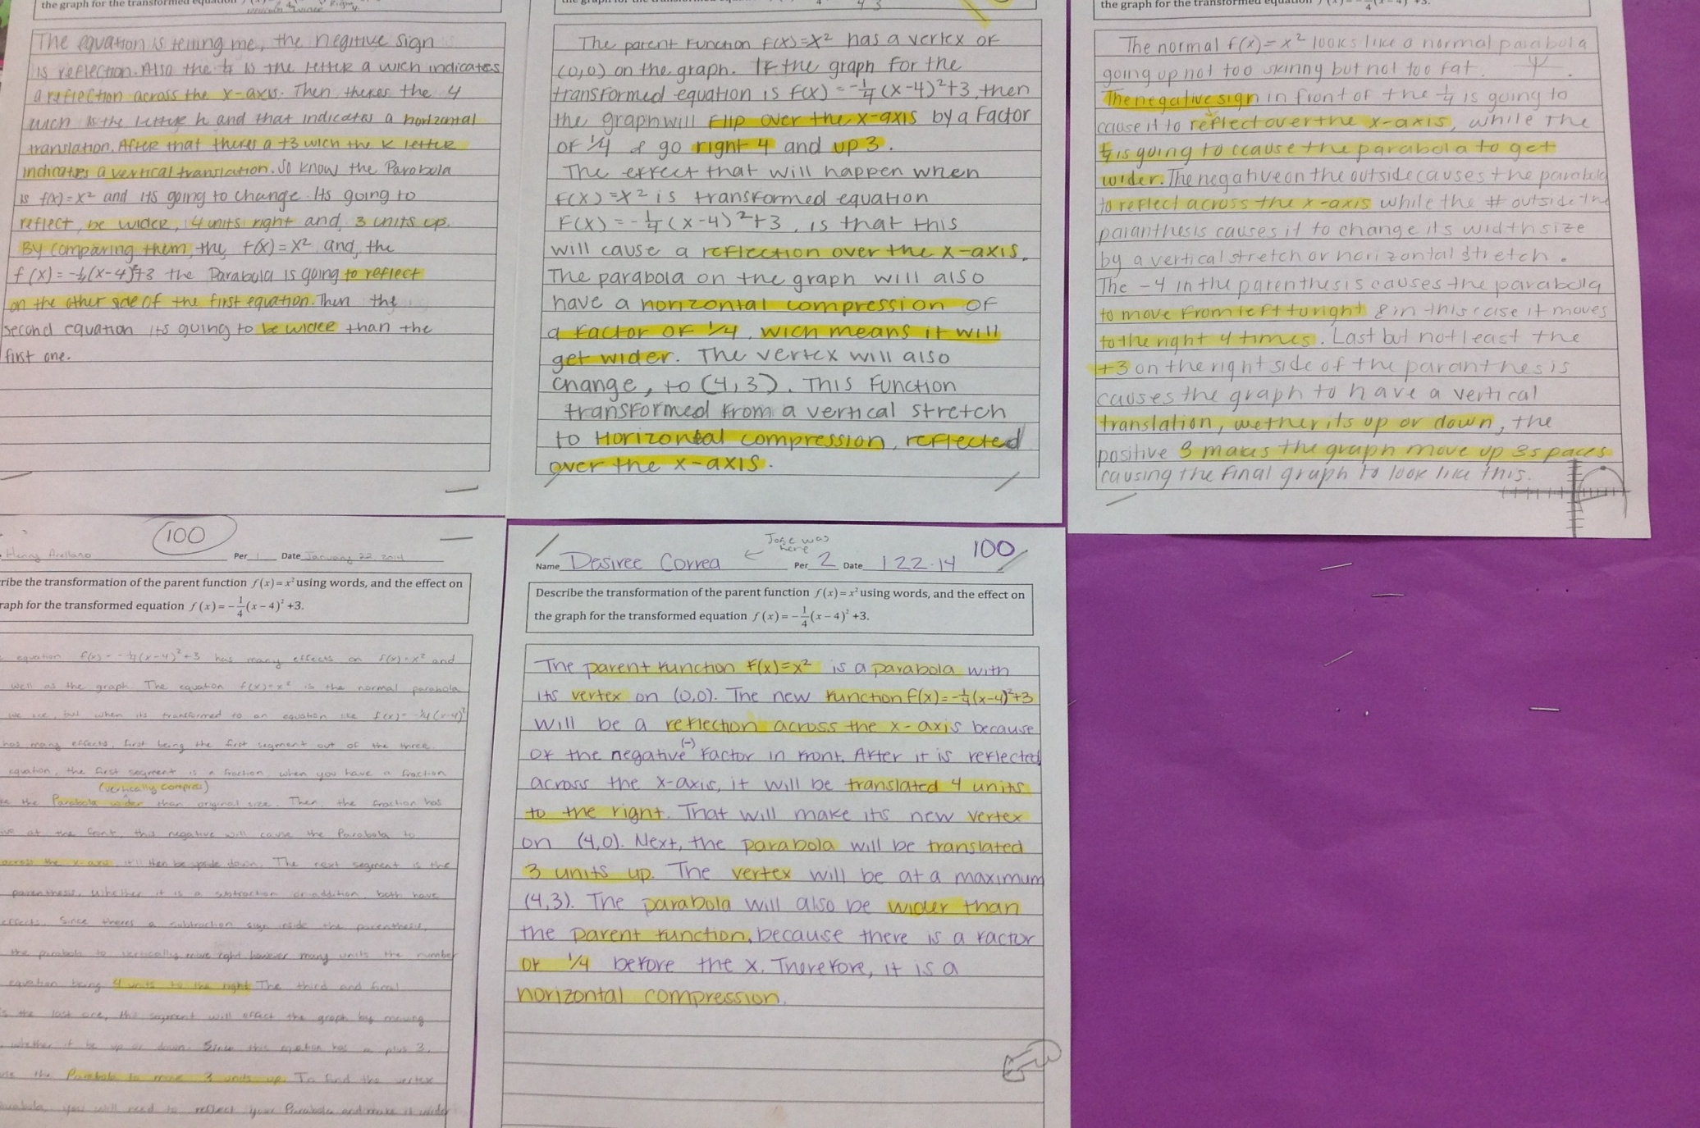
Toolbox

Slide 41
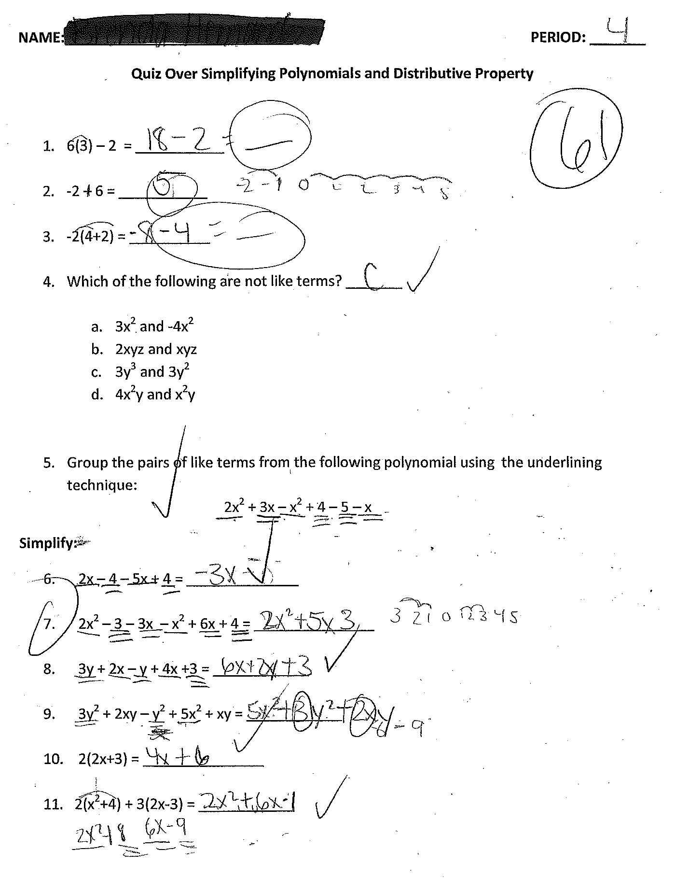
Samples of Student Work

Slide 42
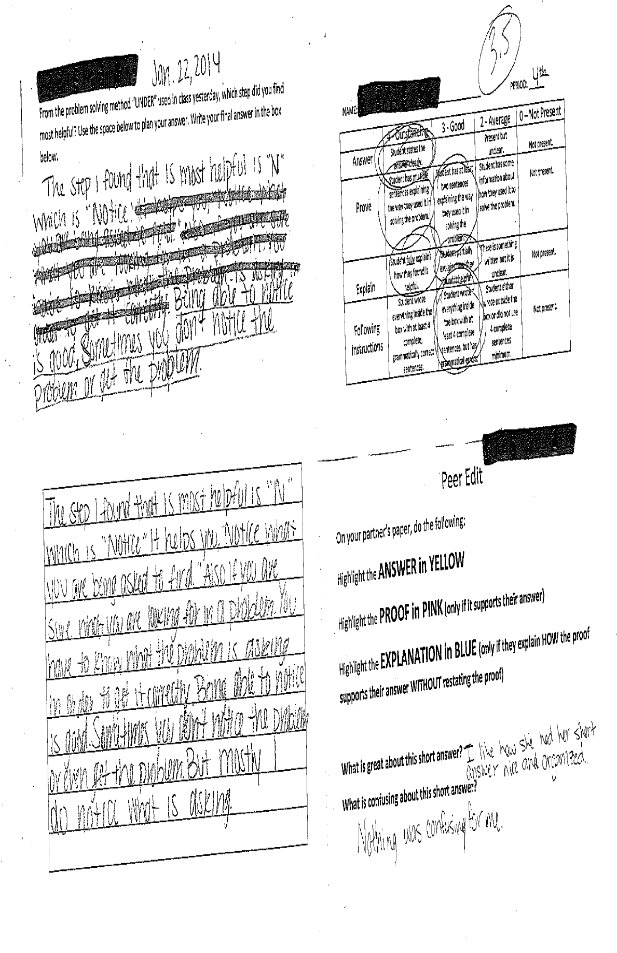
Short Answer Response

Slide 43
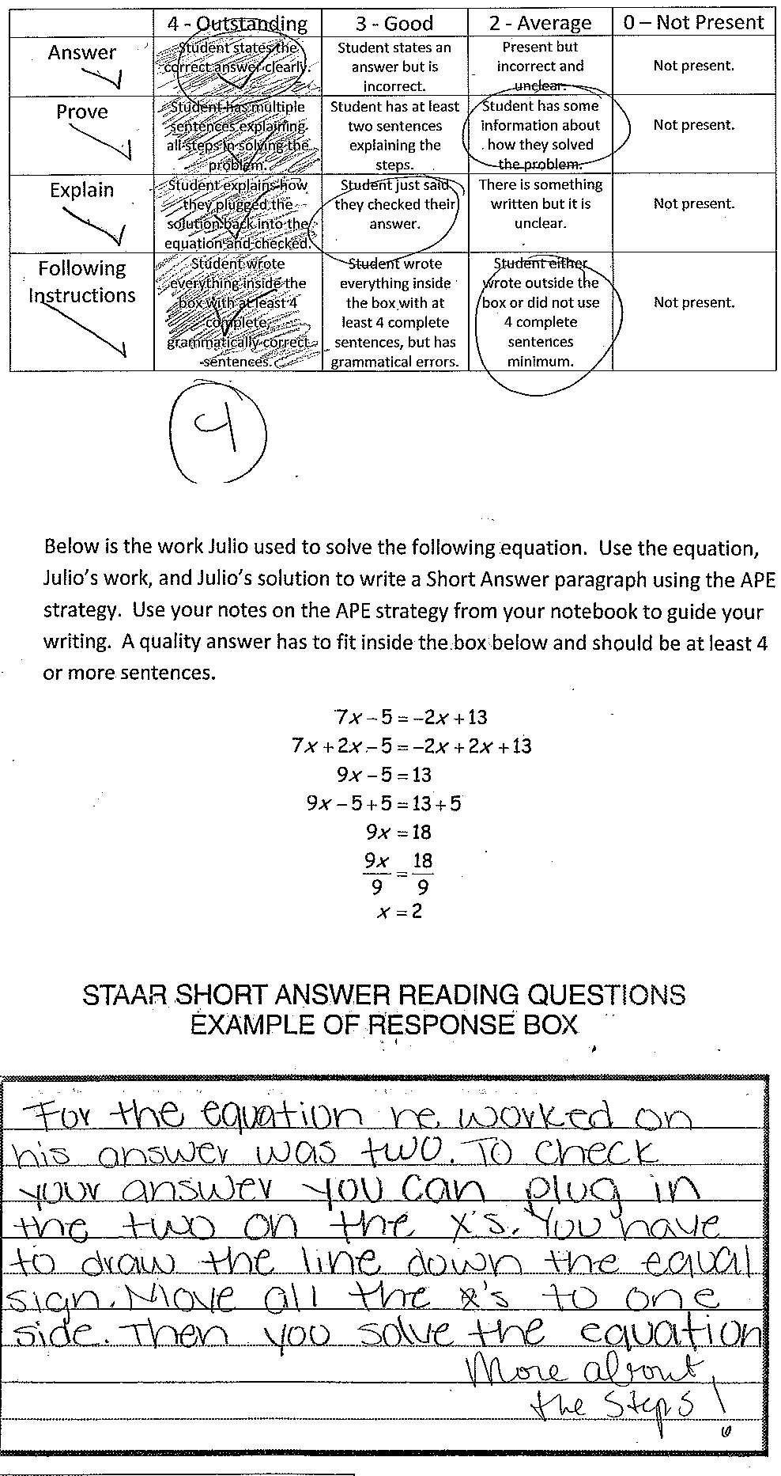
Short Answer Response

Slide 44
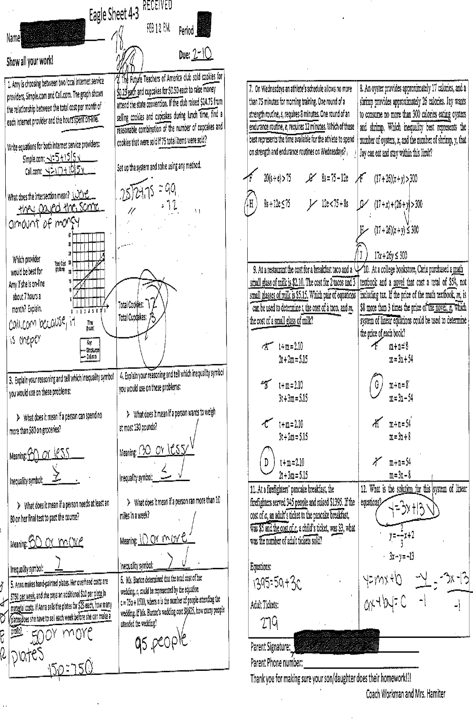
Literacy-rich Summaries of Math

Slide 45
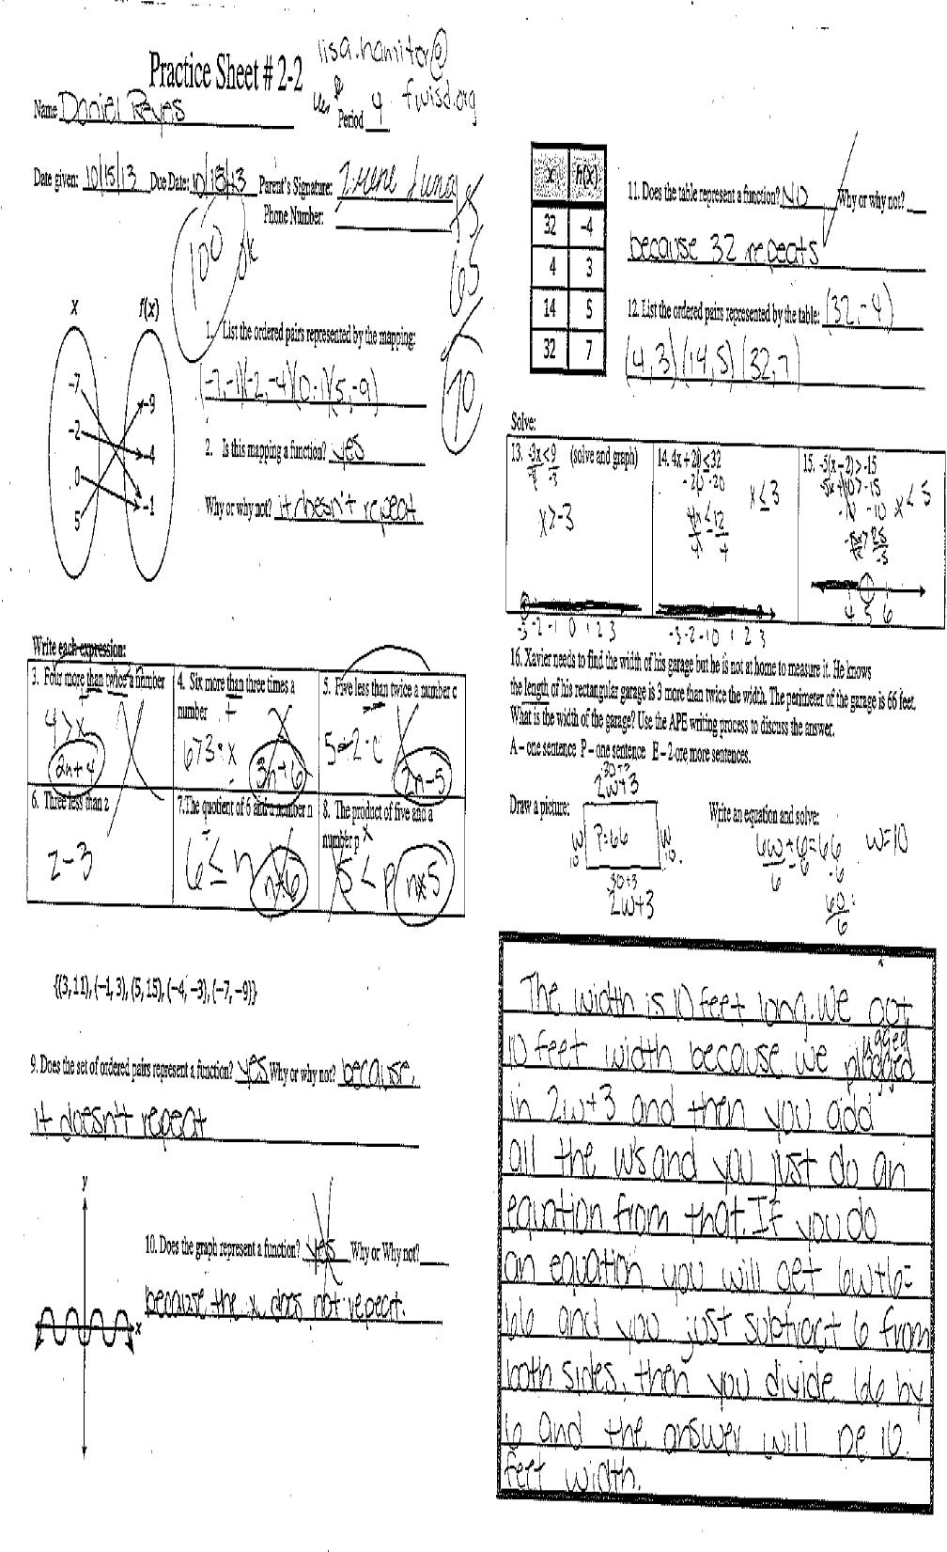
Literacy-based Practice in Math

Slide 46
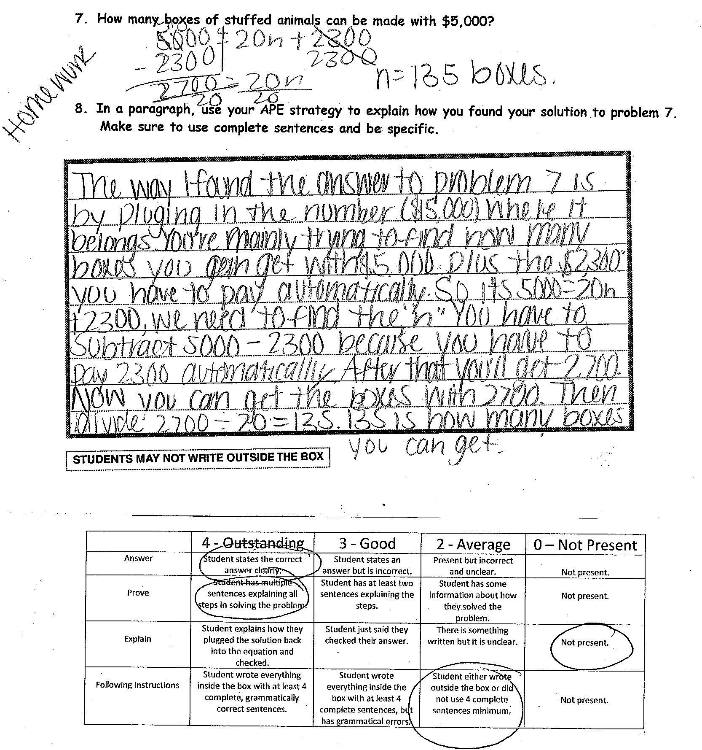
Literacy Homework in Math

Slide 47
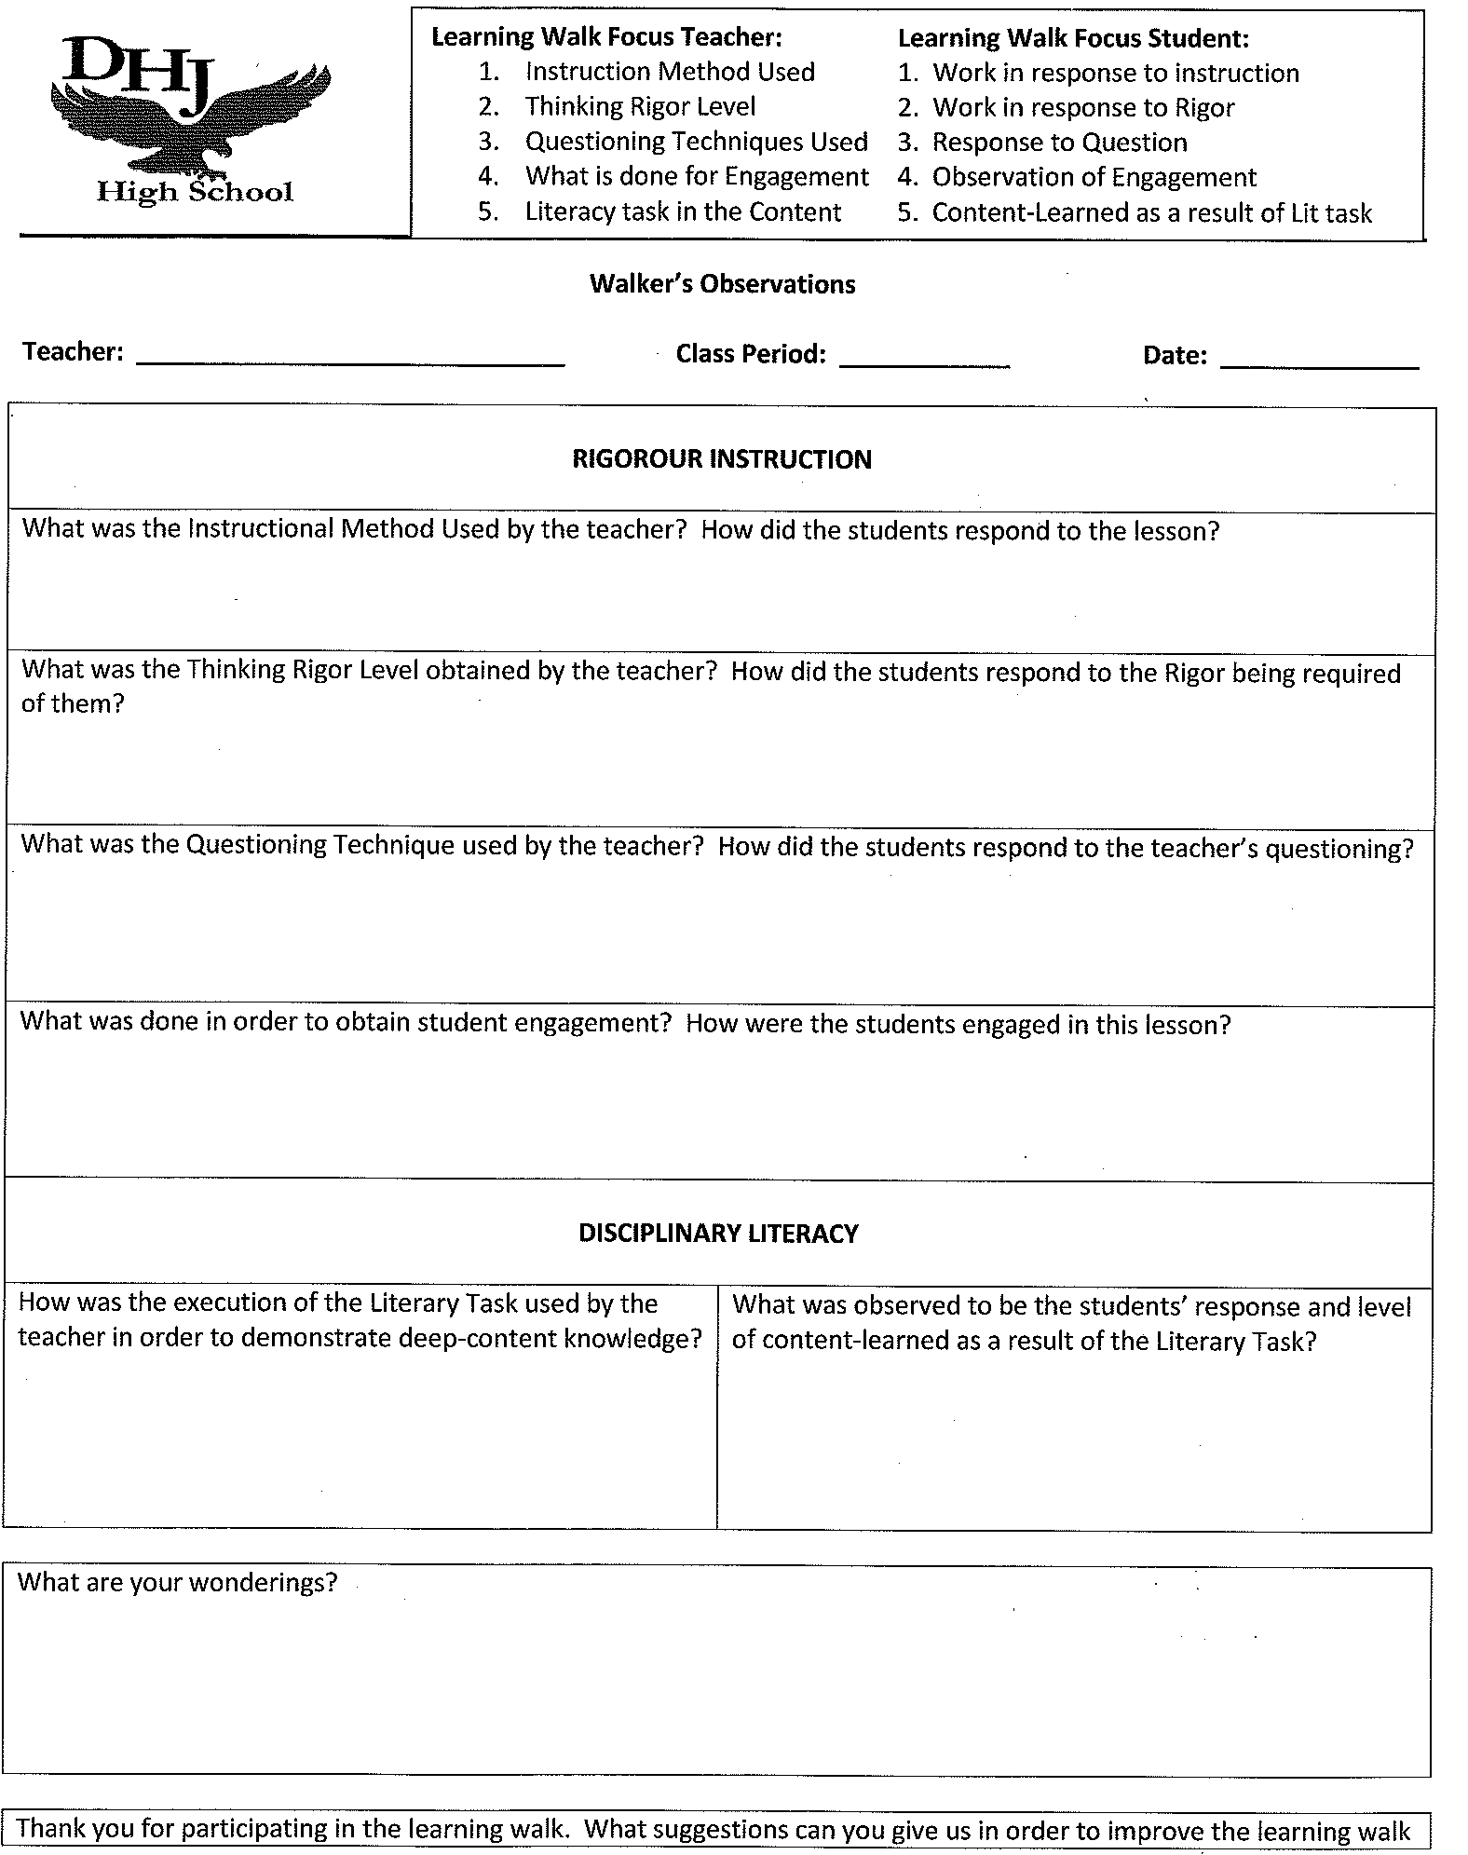
Learning Walks in Content Areas

Slide 48
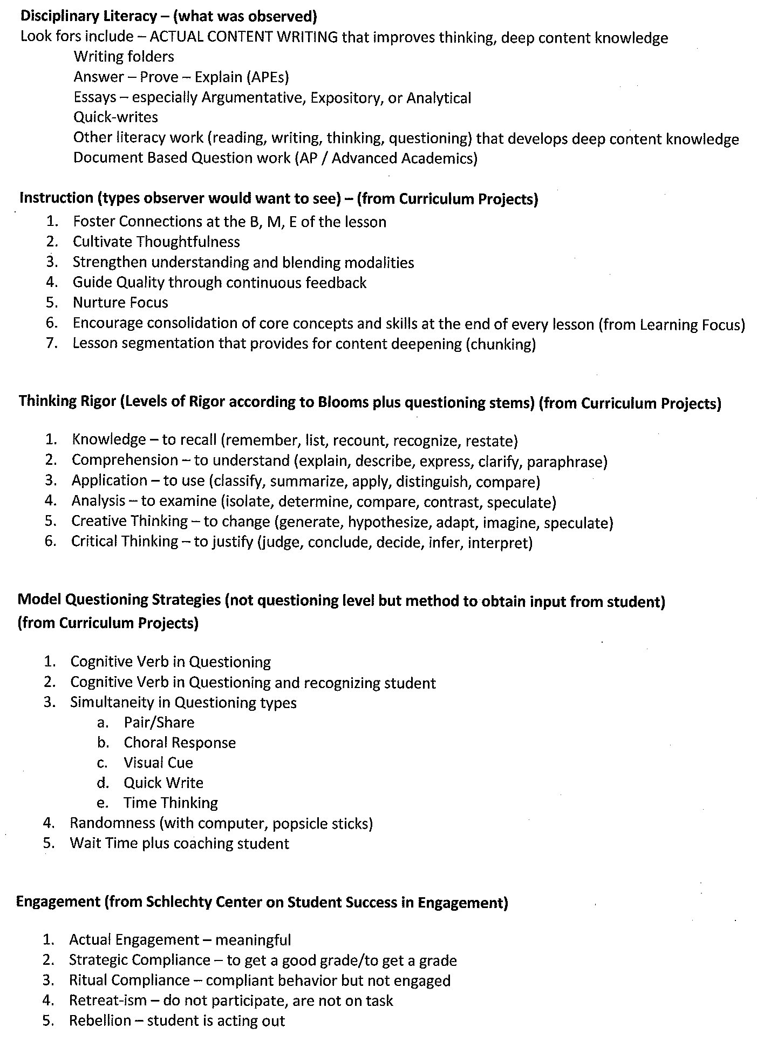
Look-For’s in Math

Slide 49
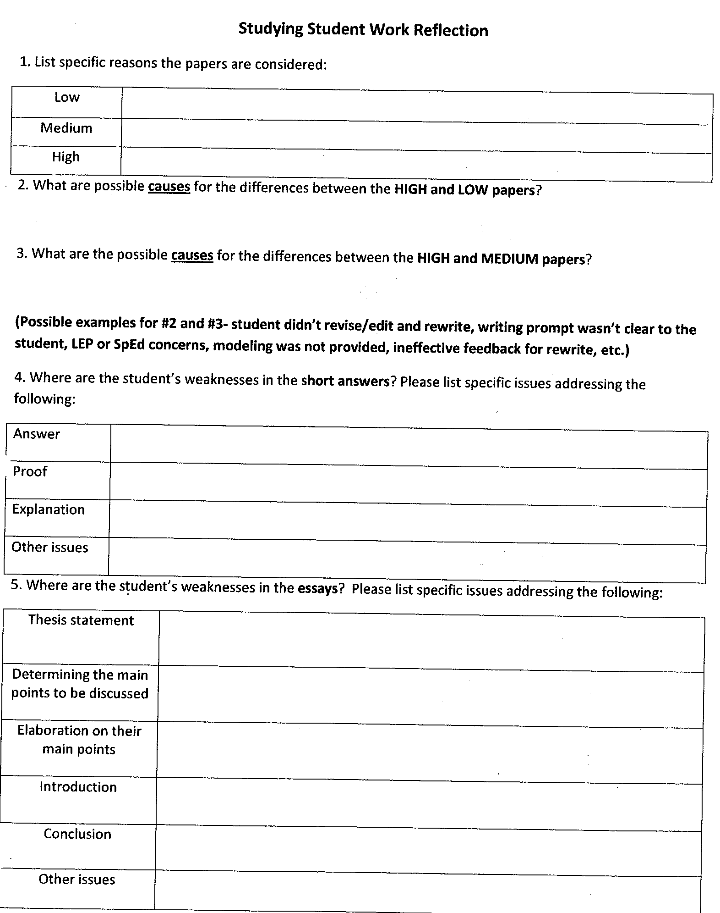
Studying Student Work

Slide 50
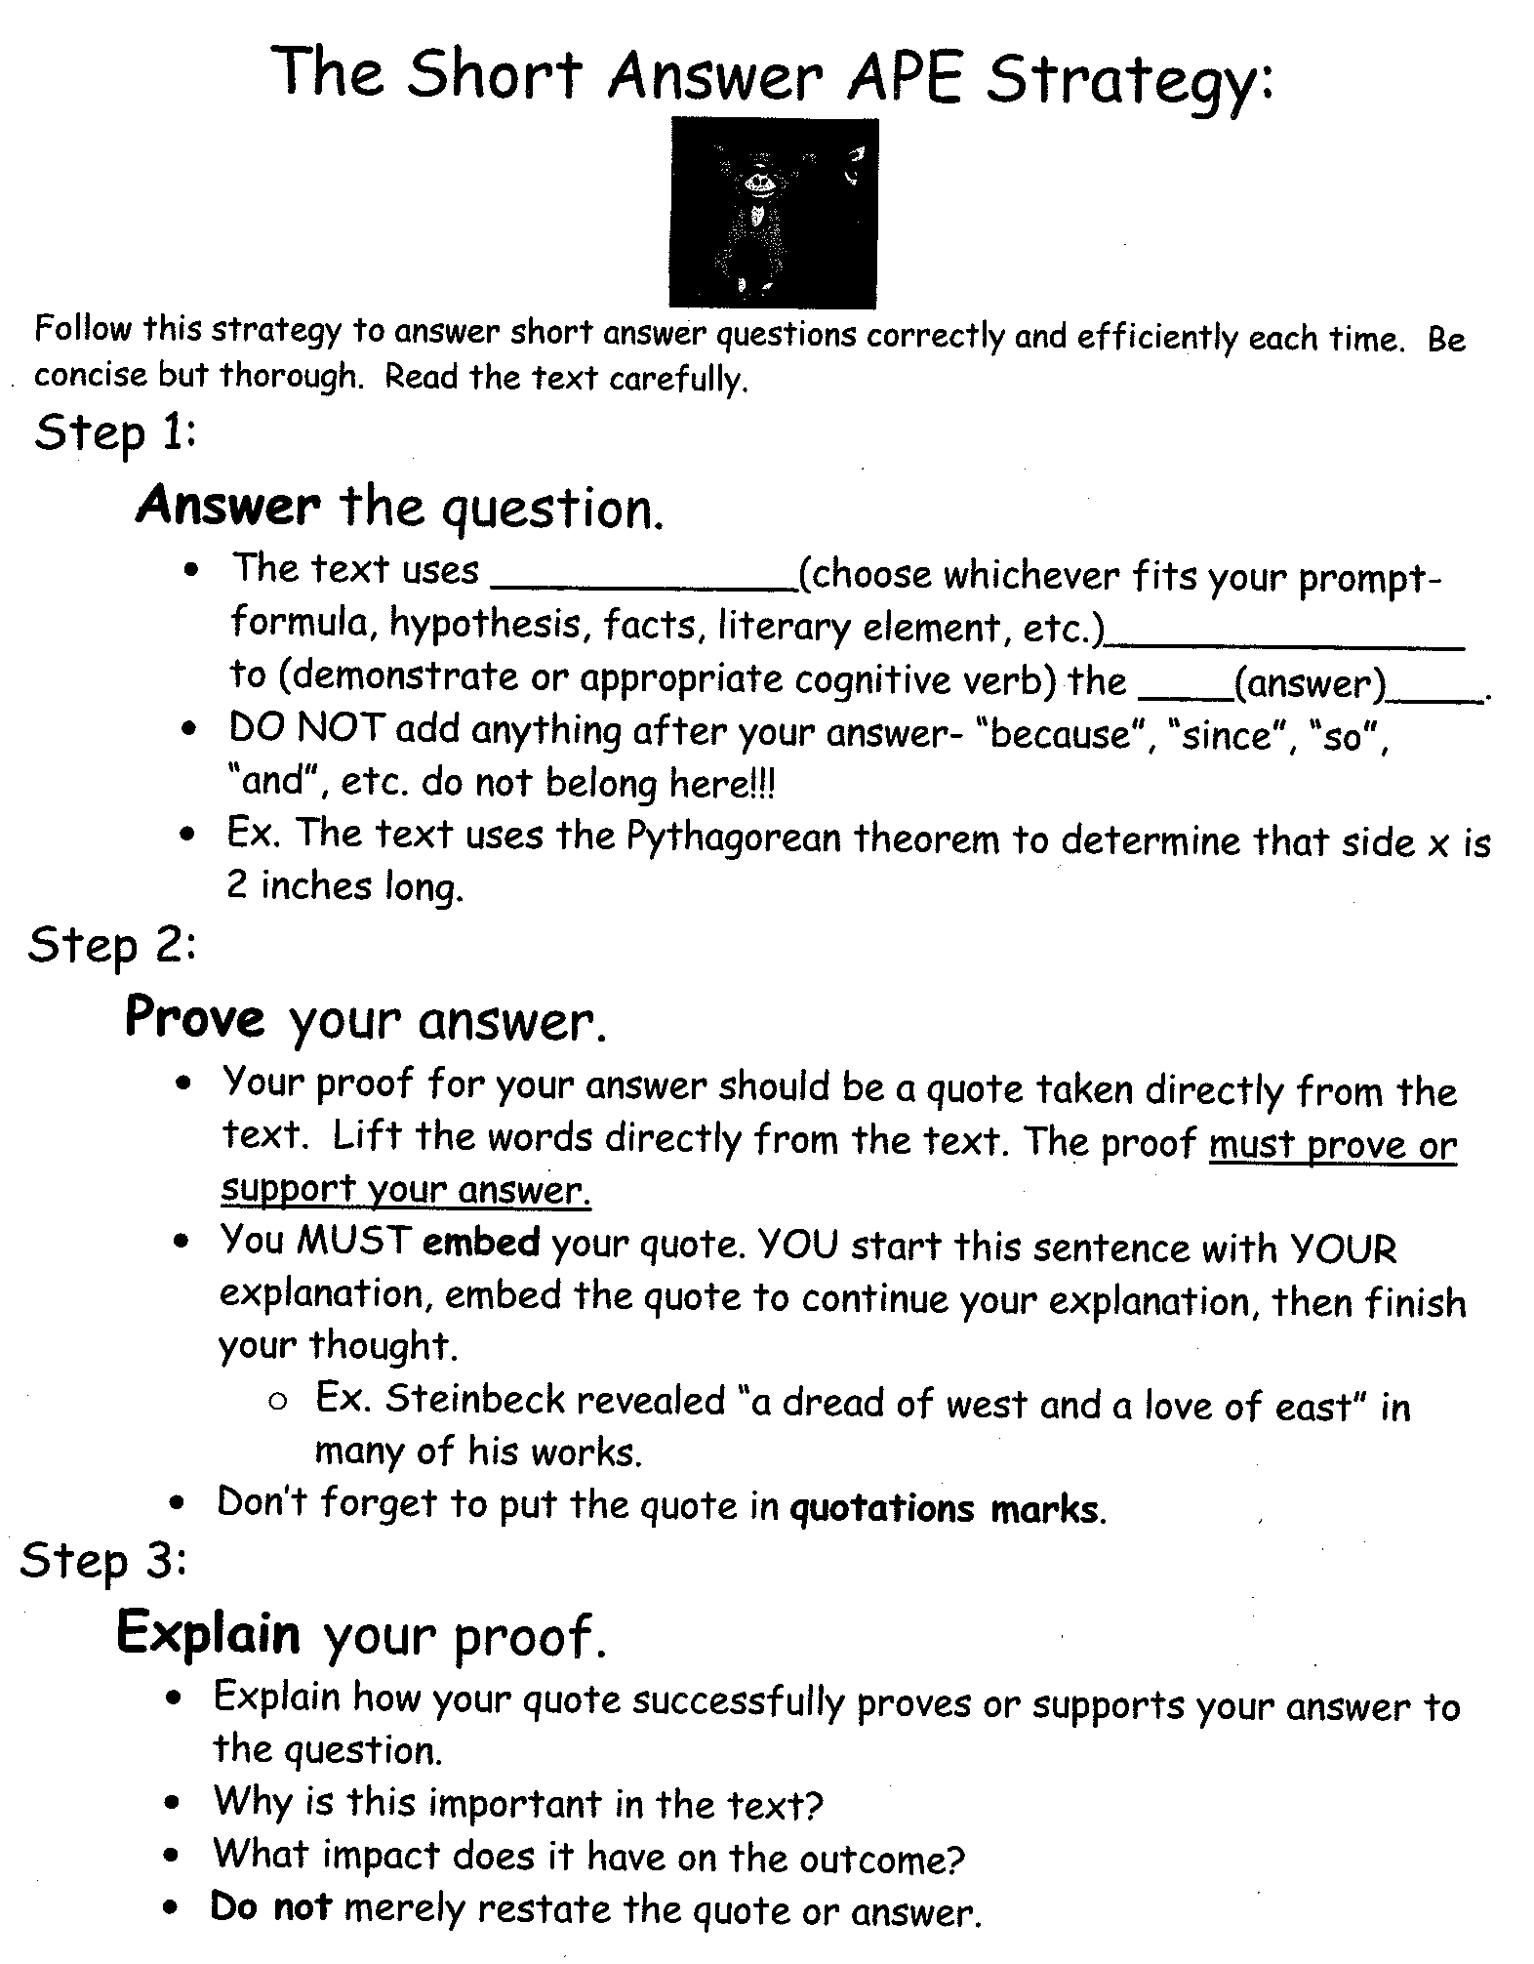
The Short Answer Response Strategy

Slide 51
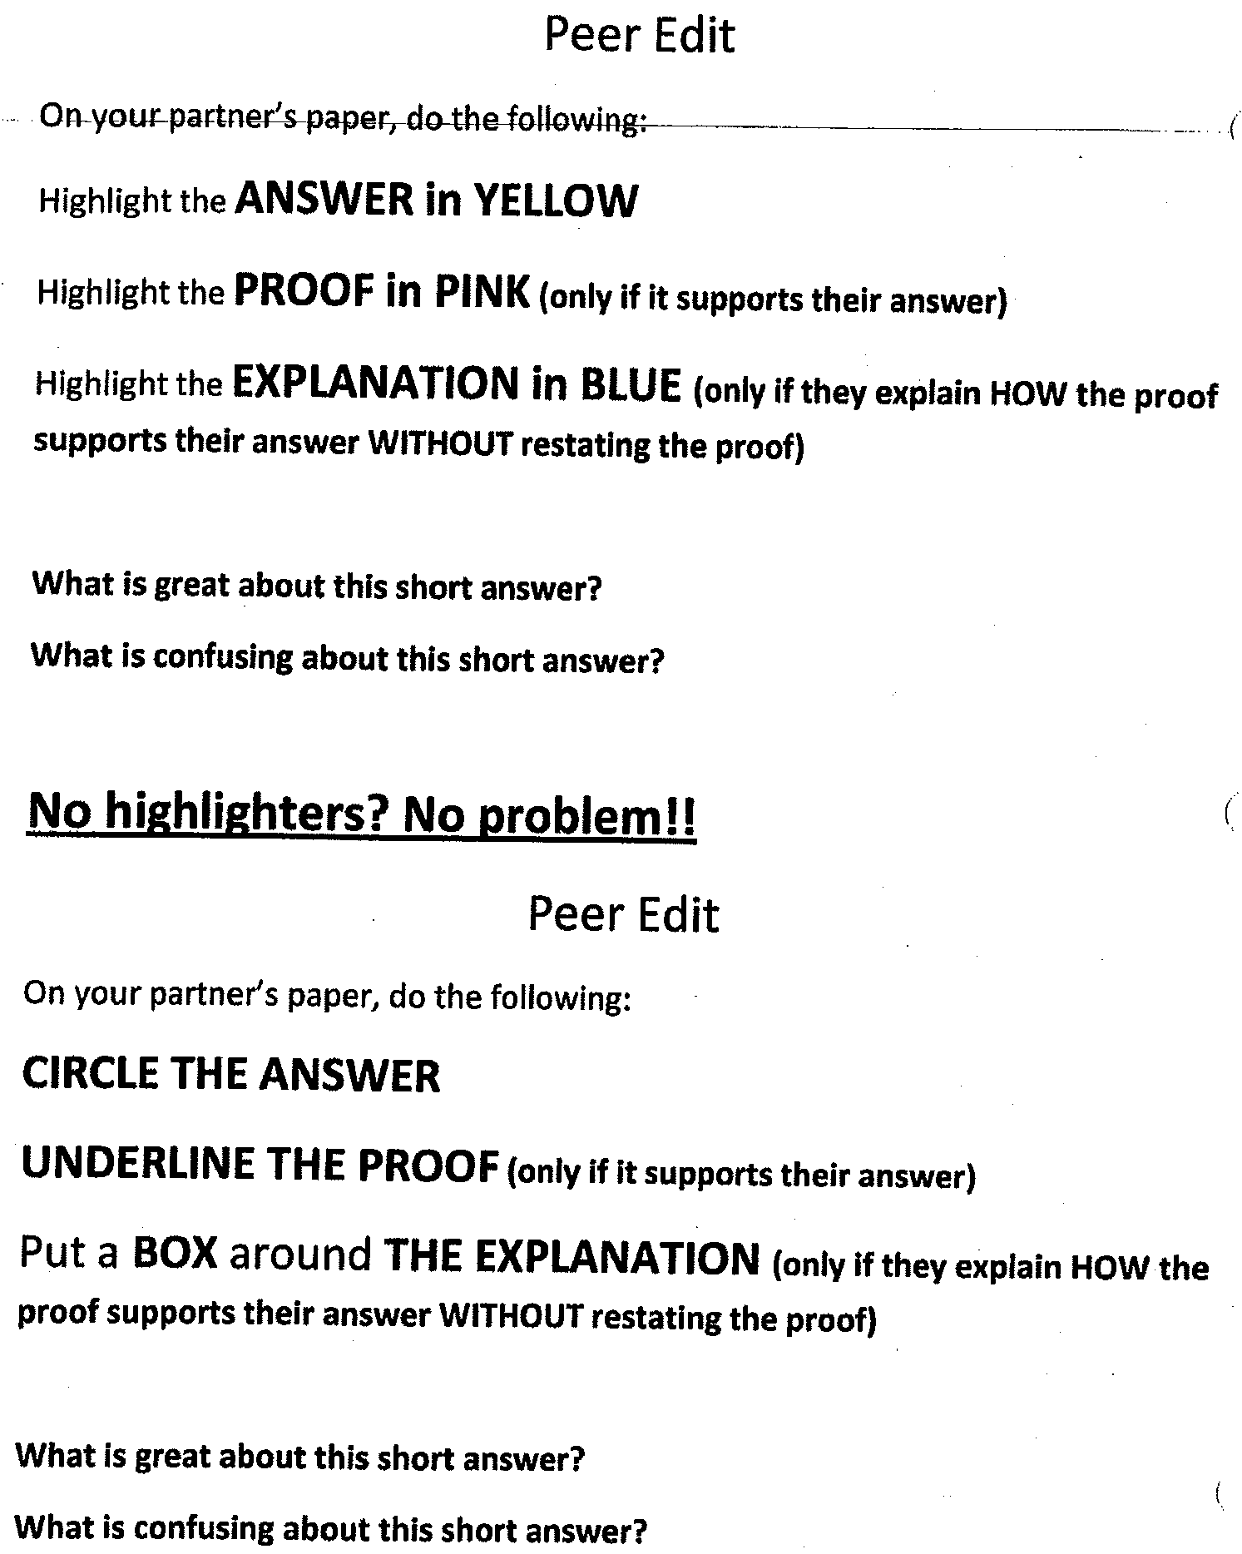
Students Peer Editing Tool

Slide 52
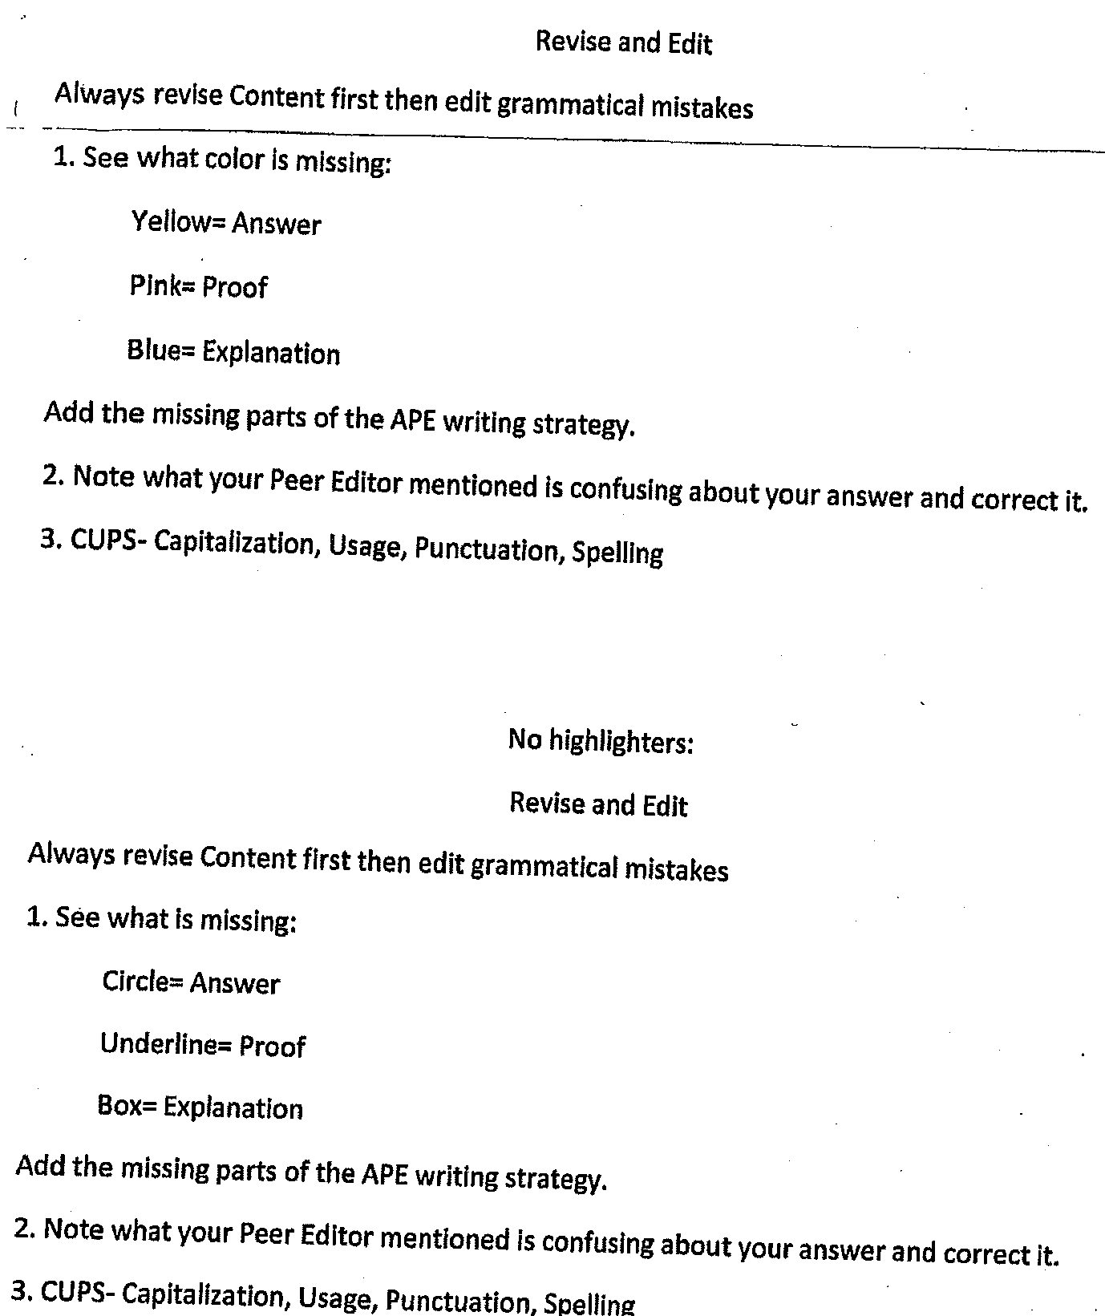
Revising and Editing a Math Essay

Slide 53
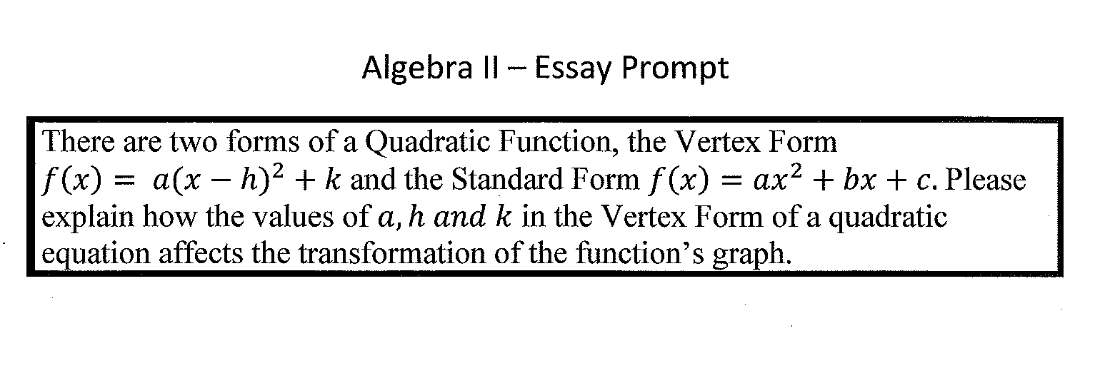
Algebra II Essay Sample

Slide 54
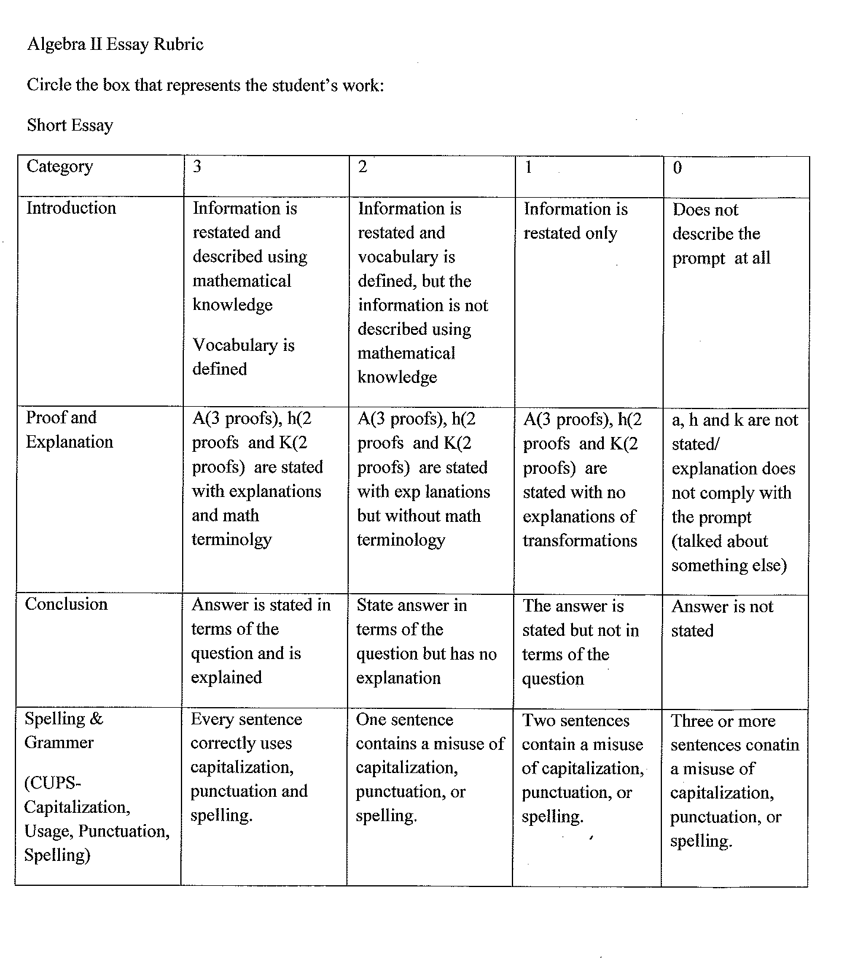
Algebra II Rubric

Slide 55
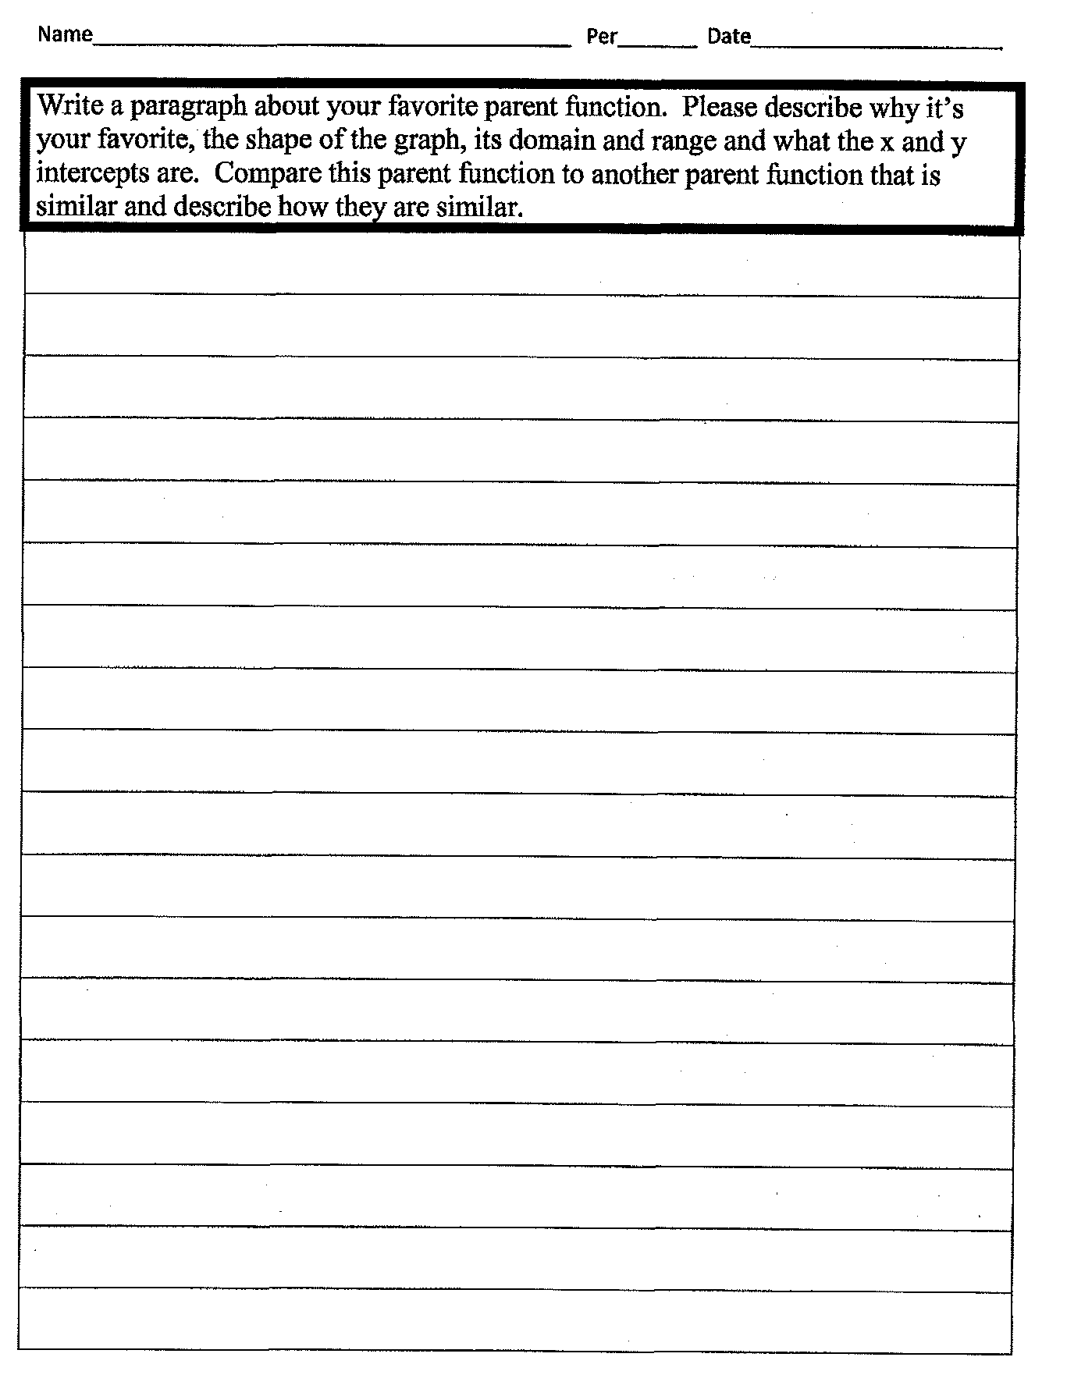
Math Short Essay Response

Slide 56
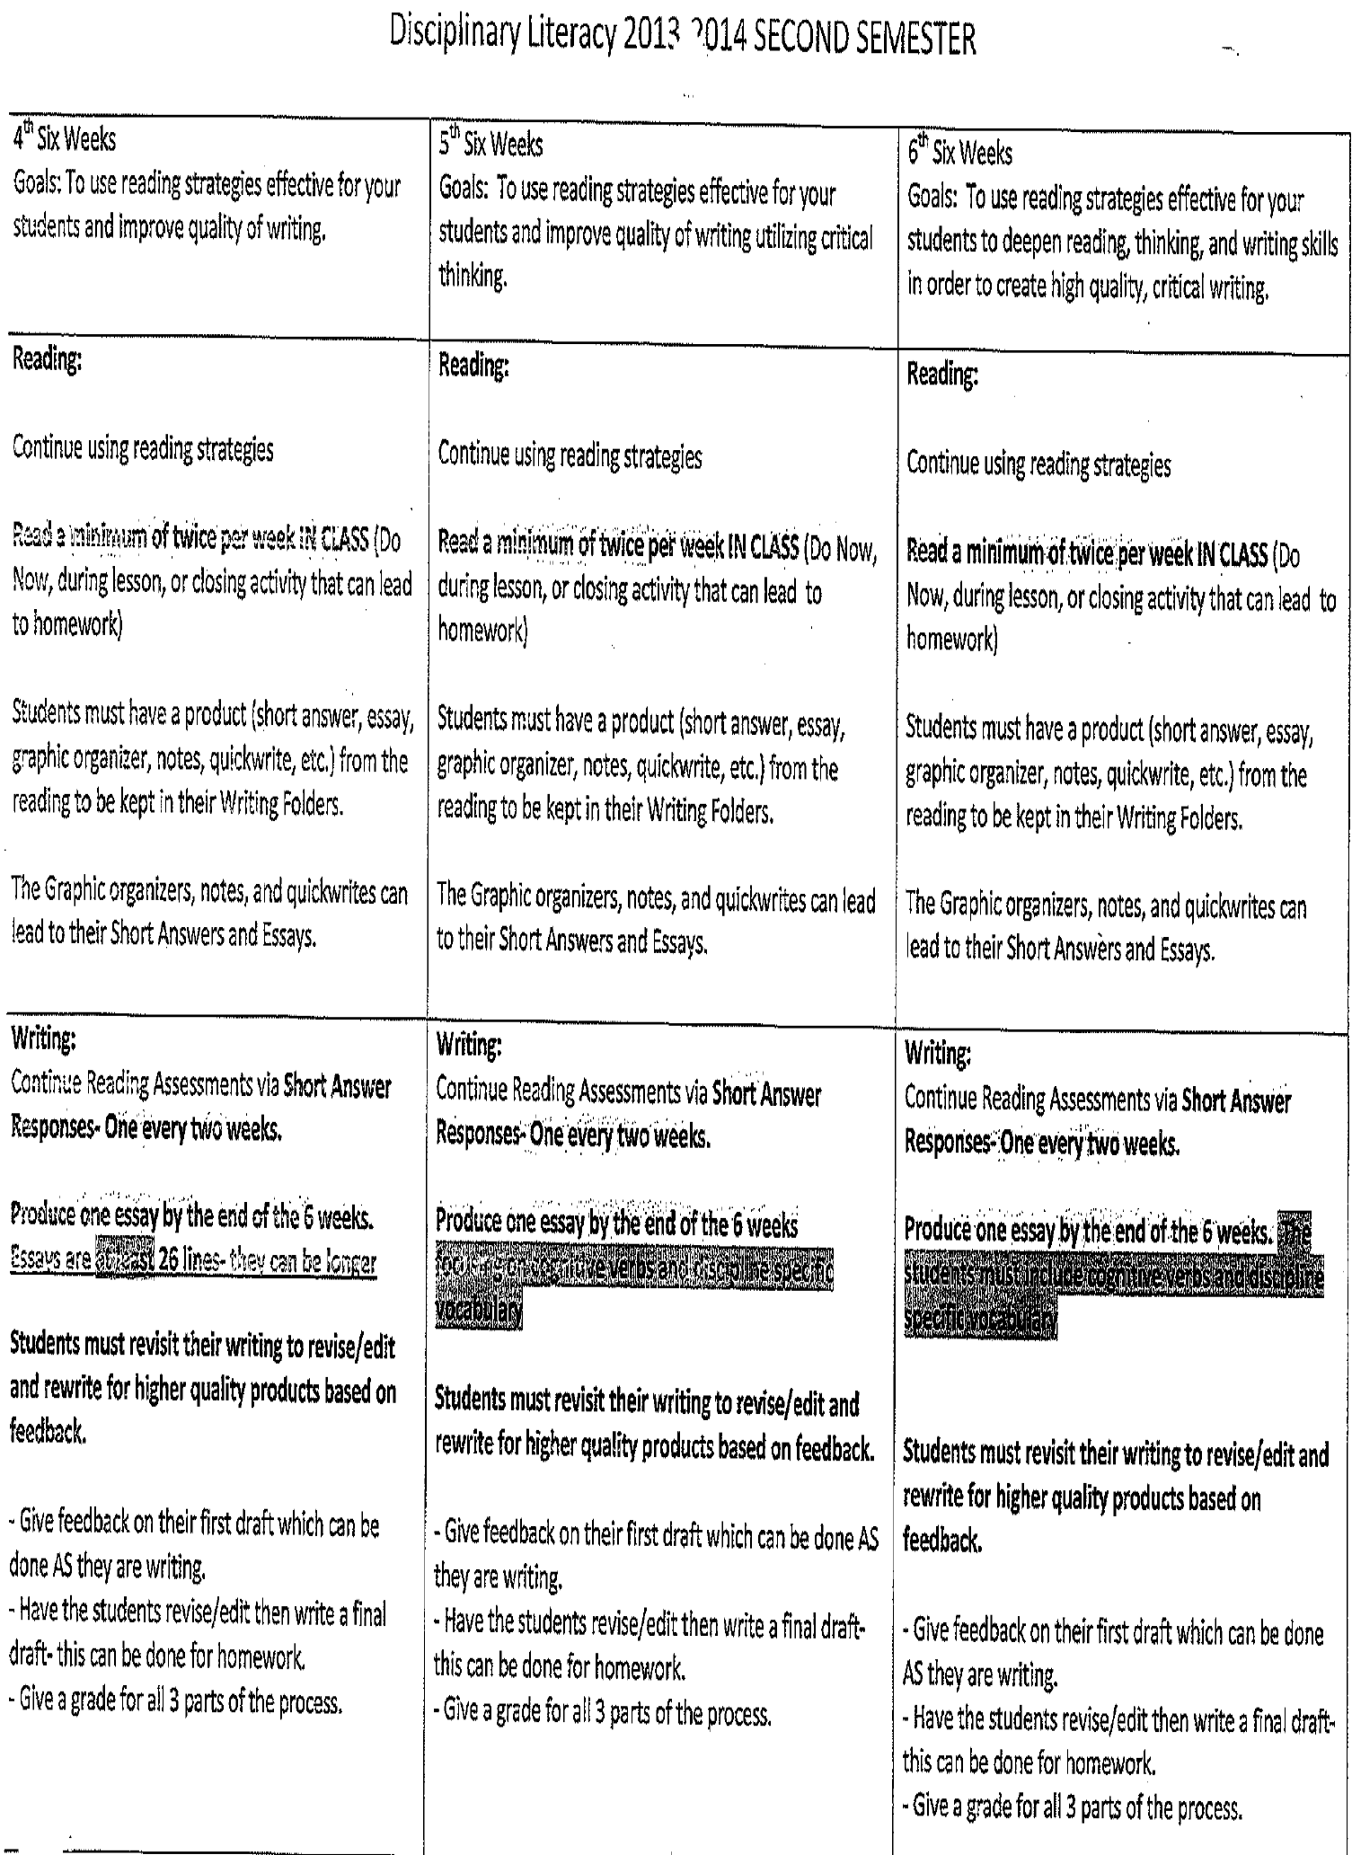
Create a Plan for Disciplinary Literacy

Slide 57
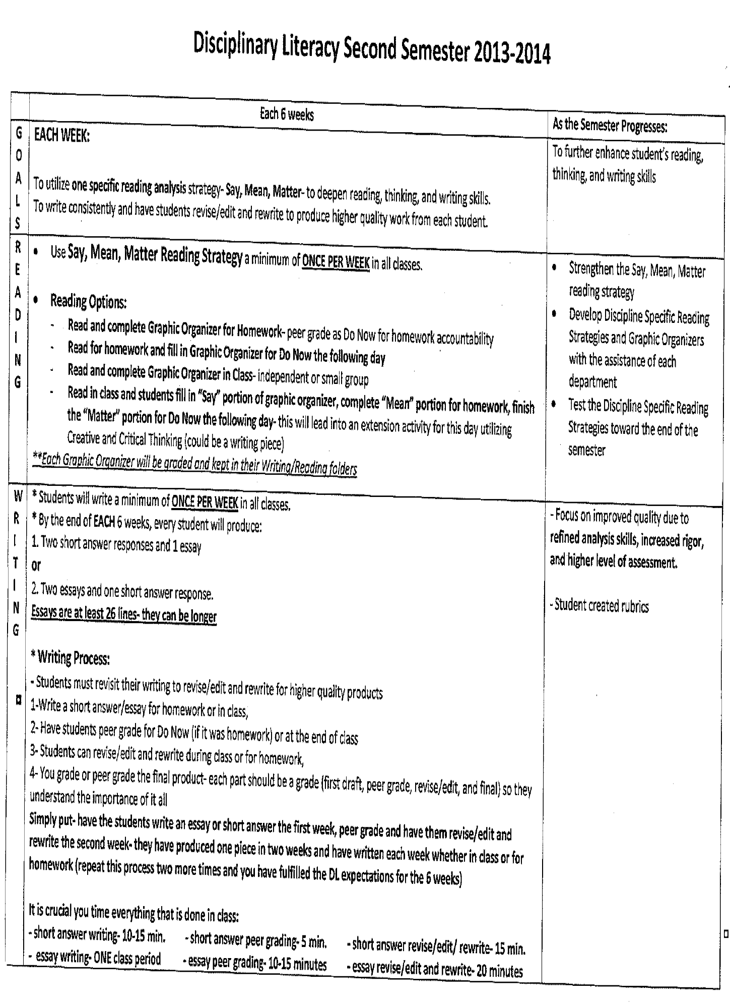
Include Literacy in Weekly Math Plans

Slide 58
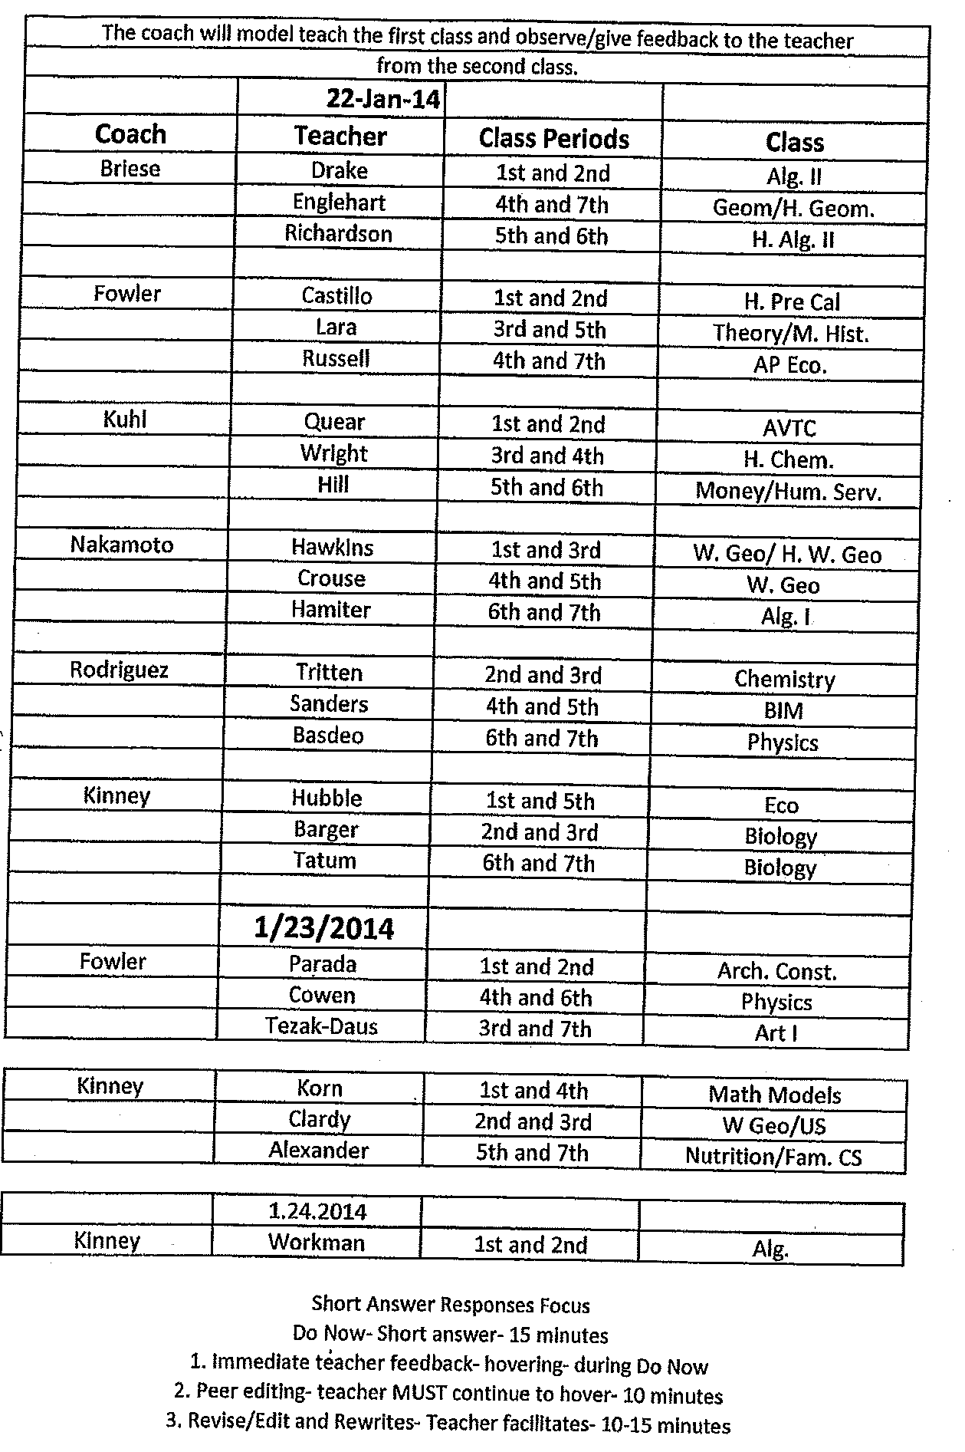
Create Literacy and Content Teams

Slide 59
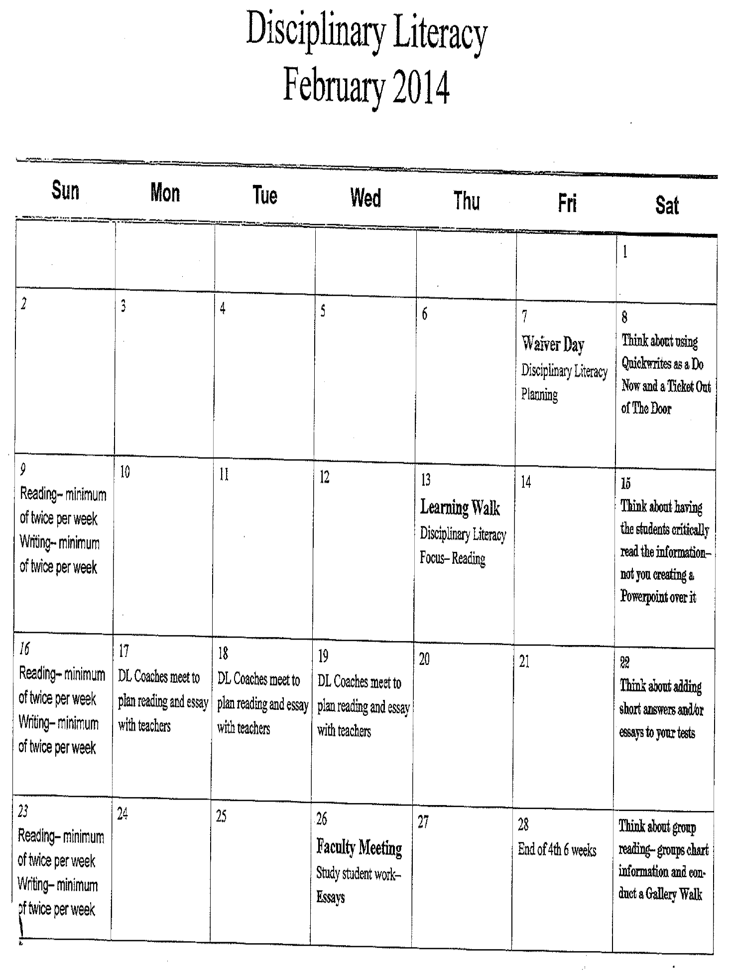
Make Literacy and Content Work a part of the School-wide Calendar

Slide 60
Contact Information
Yassmin Lee, Principal
Diamond Hill-Jarvis High School
Yassmin.Lee@fwisd.org
817-815-0010

Slide 61
Wrap Up, Discussion
Final Questions
Next steps in your classroom or school?

