Slide 1

The STEM Challenge: Are Demography and Geography Destiny?
William Tate
SMU
Simmons School of Education & Human Development
April 2018

Slide 2
Acknowledgements
National Science Foundation
Washington University in St. Louis, Public Health Institute (2009). Linking Genetically Informative Addiction Data Sets to Objectively-Measured Environmental Data via Geo-Coding.
Andrew Plunk
Richard Grucza
Laura Bierut
Mark Hogrebe
Brian Cohen
Erin Daugherty
NO CONFLICTS OF INTEREST

Slide 3
Acknowledgements
Brittni Jones
Kelly Harris
Christopher Hamilton
William Brett Robertson
Elizabeth Thorne Wallington
Lyndsie M. Schultz
Ashley Macrander
NO CONFLICTS OF INTEREST

Slide 4
Acknowledgements
Jason Purnell
Gabriela Camberos
For the Sake of All Team
NO CONFLICTS OF INTEREST

Slide 5
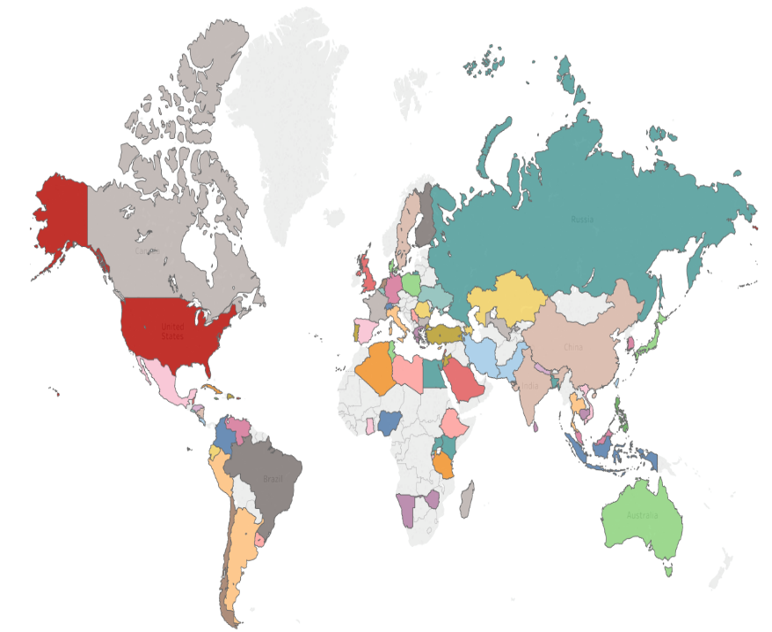
In 2017, the Graduate School received more than
3,300
applications,
from over
130 different countries
Notes:
3,342 and 133, respectively. This includes Masters and PhD applications in the Natural Sciences (including DBBS), Social Sciences, and Humanities. Not including PhDs in Business, Public Health, or Engineering.

Slide 6


Slide 7

Play on Words
Discovery
Diversity
Destiny
Is Geography Destiny in STEM?
Is Poverty Destiny in STEM?
Is Race Destiny in STEM?

Slide 8
Guiding Questions
What is the first law of geography?
Does the first law of geography inform our understanding of the ecology of opportunity to learn in algebra and biology?
If so, what are the important lessons for social scientists and educational reformers?

Slide 9
Tobler’s First Law of Geography
Nearby things are more similar than
distant things.

Slide 10
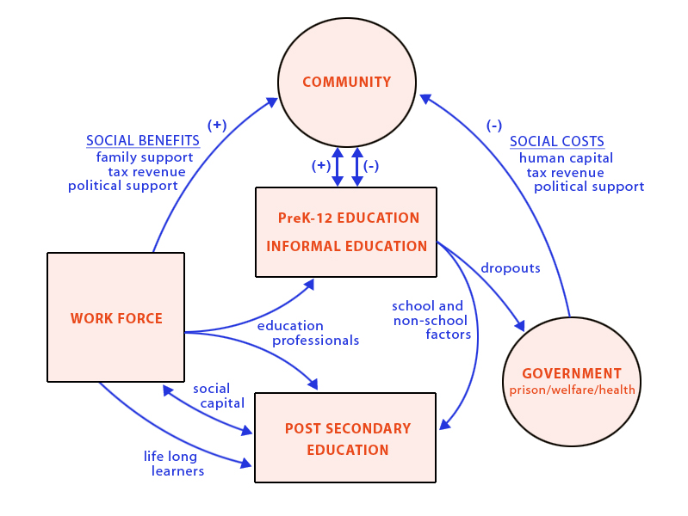


Slide 11
R.I.P.
Retrospective
Intrastate
Policy

Slide 12

Education Outcomes
Educational Researcher, 2014

Slide 13
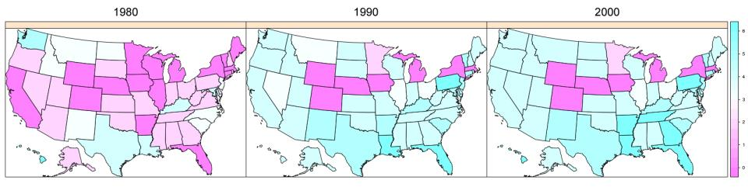
Figure 1
State mathematics and science course graduation requirements, combined, for the years 1980, 1990 and 2000. The dark purple represents no mandated statewide requirement, while the darkest blue denotes a requirement of 6 courses; those states without a requirement by 2000 were excluded from our analyses.

Slide 14
Outcome Variables
“High school dropout"
“College enrollment"
“Any college degree"

Slide 15
Dropout Rate Varied by Demographic Group

Slide 16
Large Impact on Dropout
Highest requirements were associated with a 1.07 point increase in the dropout rate for all likely non-movers (p < 0.001)
Greatest increases observed for Black and Hispanic men
  1.88 point increase for Black Men (p = 0.018)
  2.58 point increase for Hispanic Men (p < 0.001)

Slide 17
Cost to Society
One percent reduction in the national high school dropout rate is equated with 400 fewer murders and 8,000 fewer assaults.
One percent reduction for all men ages 20-60 would save the United States as much as $1.4 billion per year in reduced costs from crime incurred by victims and society at large.
Lochner and Moretti (2001)

Slide 18
Educational Attainment and Societal Benefit
Benefits per high school graduate range from $53,000 (fiscal benefits to state and local government) to $392,000 (total economic benefits to California).
Source: California Dropout Research Project

Slide 19
College Enrollment Not Affected as Expected
No significant findings until subgroup analyses were performed
Some subgroups were less likely to go on to college when exposed to higher requirements
  5.21 percentage point decrease for Hispanic Men (p = 0.008)
  3.32 point decrease for Hispanic Women (p = 0.022)

Slide 20
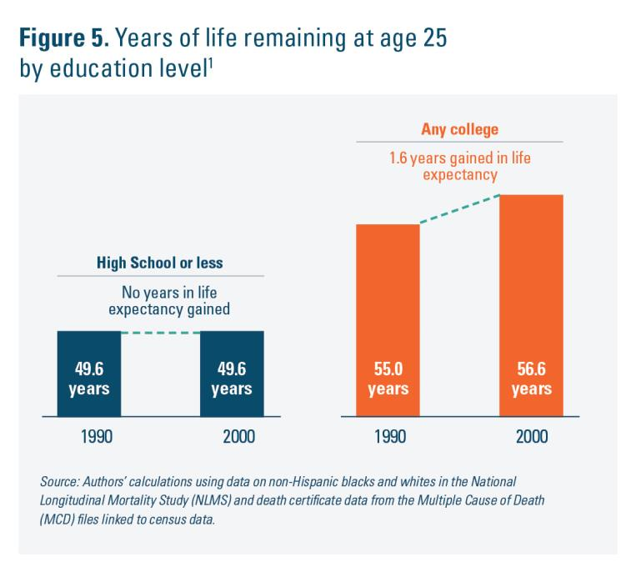

Slide 21
Some Benefit Seen for College Completion
Probability of completing a degree increased by 0.42 percentage points for the full sample (p = 0.047)
Conditional analyses varied by likely migration status
  2.87 point increase for likely non-mover Black women (p = 0.037)
  6.36 increase for likely non-mover Hispanic men (p = 0.031).

Slide 22
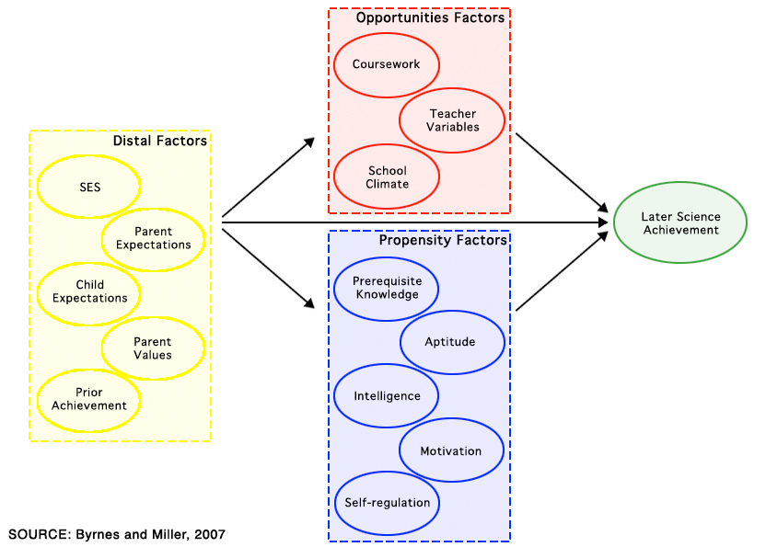
AN OPPORTUNITY-PROPENSITY MODEL

Slide 23
Geographically Weighted Regression (GWR)
GWR runs a regression for each location, instead of a sole regression for the entire study area. GWR is a useful regression model to work with non-stationary data. The term stationarity refers to relationships in which the influences of the independent variables remain constant over the dependent variable throughout time and space.
On the other hand, local or non-stationary models (e.g. GWR) account for different responses in different parts of the study region that the independent variables produce over the dependent variable.

Slide 24
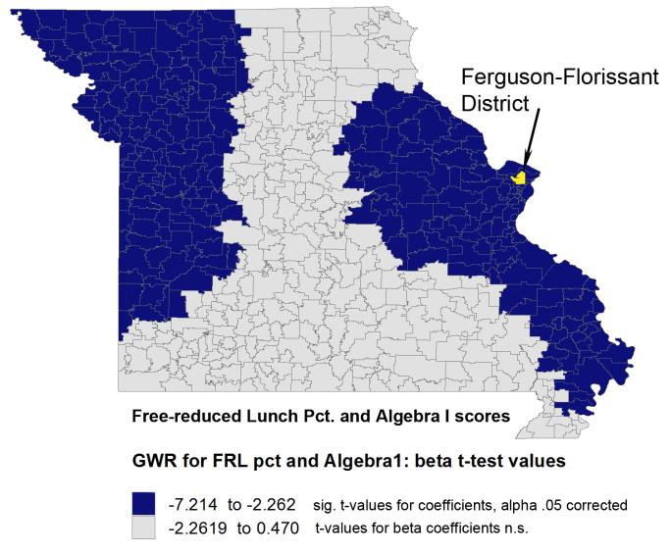

Slide 25
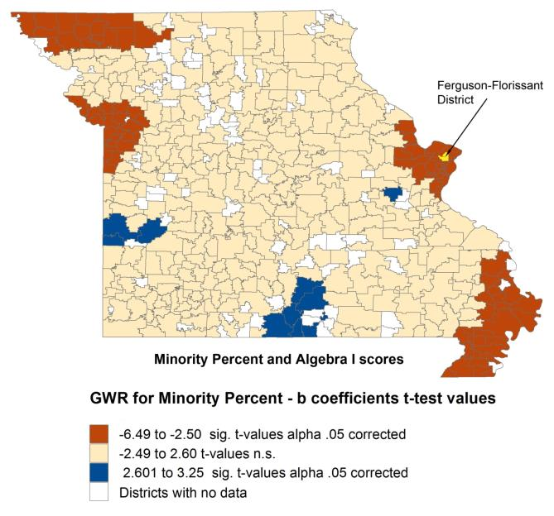

Slide 26
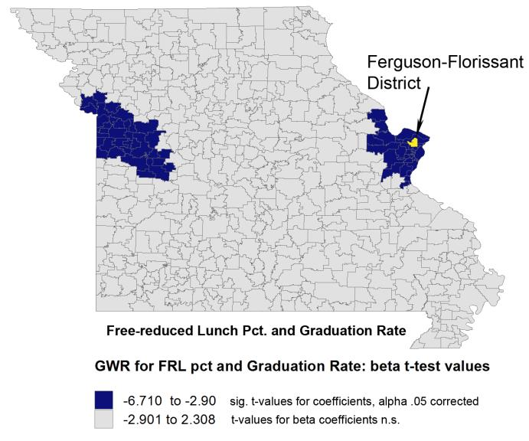

Slide 27
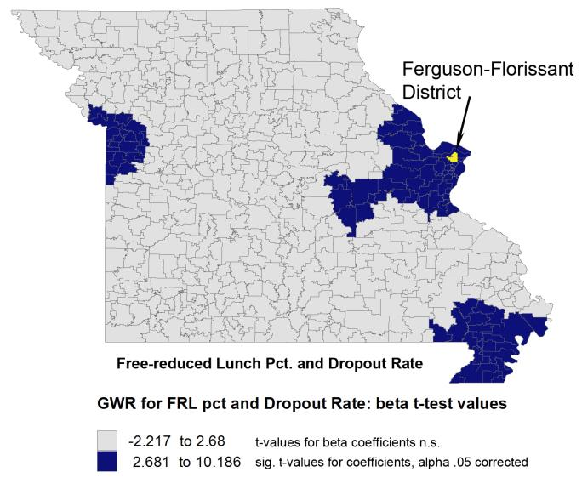

Slide 28
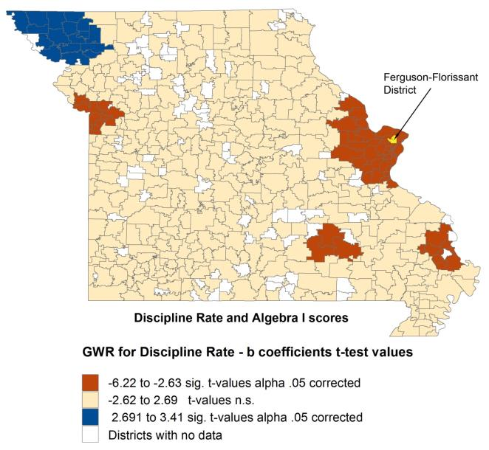

Slide 31
Reason for suspensions
In 2014, nearly one out of five of the 3,989 total suspensions in the St. Louis Public Schools was for “insubordination/disrepect,” a category that relies on the subjectivity of a teacher or administrator.
1,422 elementary students
200 kindergartners
8 preschoolers
Source: St. Louis Dispatch, March 22, 2015

Slide 32
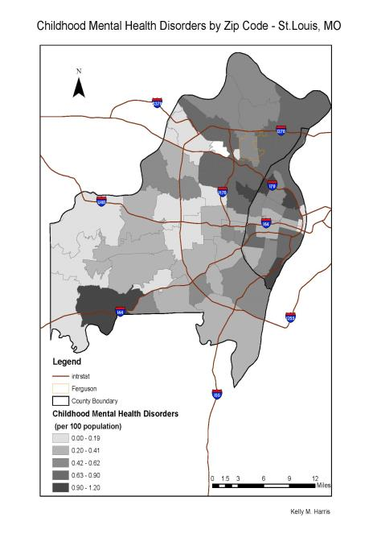

Slide 33
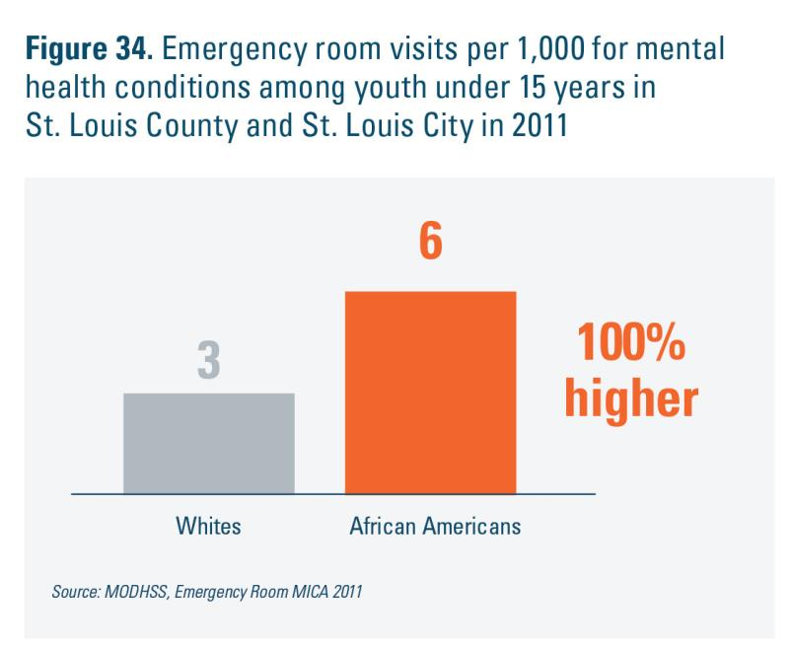

Slide 34


Slide 35
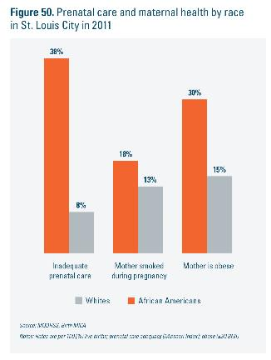
Building a Brain Regime

Slide 36
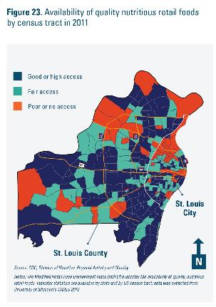
Building a Brain Regime

Slide 37
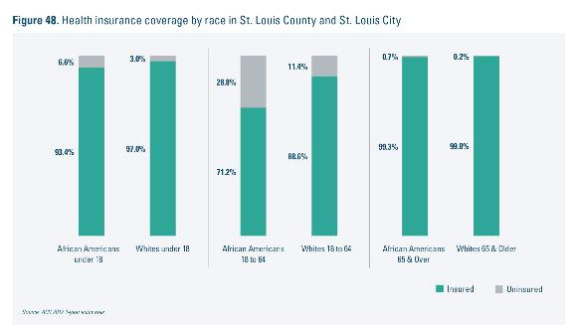
Building a Brain Regime

Slide 38
The Case of North St. Louis
There is a general shortage of healthcare professionals in North St. Louis. Although approximately one-third of St. Louis city’s total population resides in North St. Louis, only 13% of the city’s physicians have practices located in the area.
There are approximately 25 physicians per 10,000 North St. Louis residents, 70% fewer physicians per 10,000 residents than the rest of St. Louis City.
Most areas in North St. Louis have fewer than 8 physicians per 10,000 residents. When physicians affiliated with community health centers are excluded, there are fewer than 5 physicians per 10,000 residents in most areas, supporting and underscoring the finding that relatively few private practices are located in the area.
Building a Brain Regime

Slide 39
Geographically Weighted Regression (GWR)
GWR runs a regression for each location, instead of a sole regression for the entire study area. GWR is a useful regression model to work with non-stationary data. The term stationarity refers to relationships in which the influences of the independent variables remain constant over the dependent variable throughout time and space.
On the other hand, local or non-stationary models (e.g. GWR) account for different responses in different parts of the study region that the independent variables produce over the dependent variable.

Slide 40
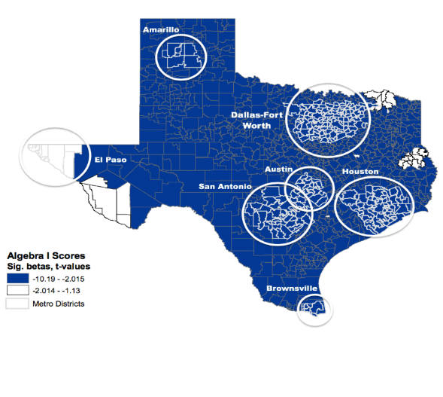
Algebra 1 and Poverty

Slide 41
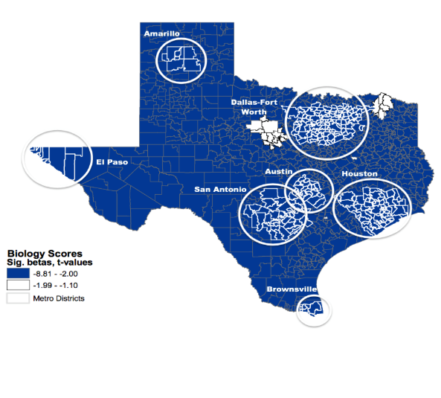
Biology and Poverty

Slide 42
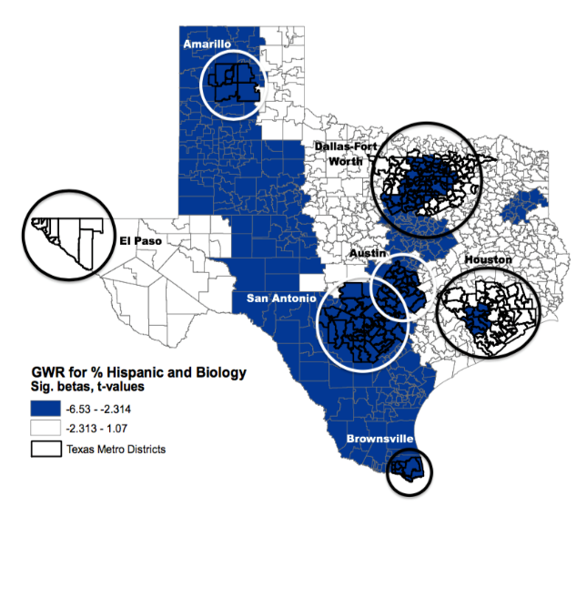

Slide 43
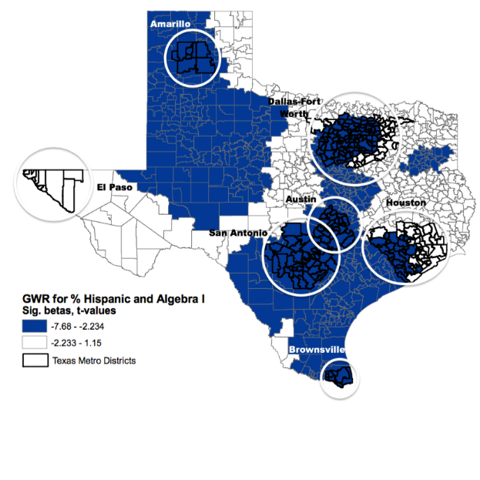

Slide 44
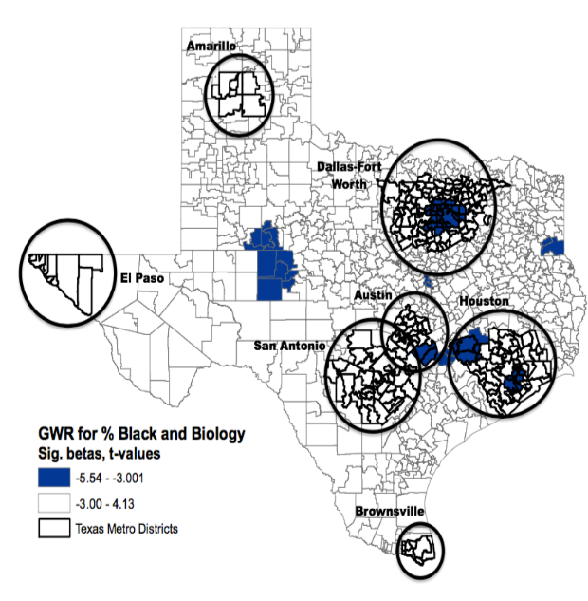

Slide 45
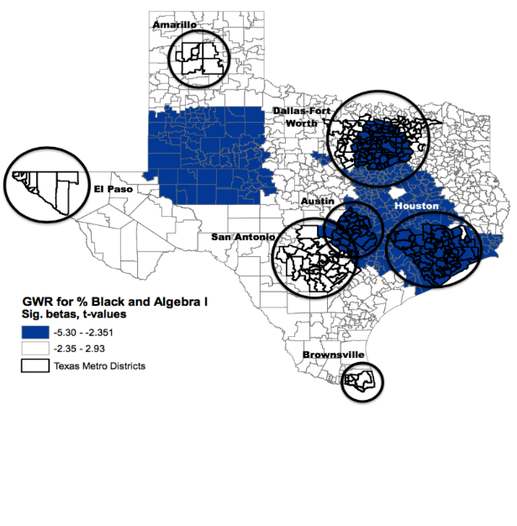

Slide 46
Brain Regimes: Developmentally Sound Policy
Prenatal Care at Scale
Consumer Report on Preschool Quality
Expansion of Health Insurance to Families
Teacher Quality Disparities [Teacher Effects > School Effects]

Slide 47
Brain Regimes: Developmentally Sound Policy
Robust PreK-8th grade Science and Mathematics
Massive Funding Disparities in Education
Reclaim Adult “school push outs”
Food Deserts

Slide 48
References and Resources
Hogrebe, M., & Tate, W. F. (2015). Poverty and algebra performance: A comparative spatial analysis of a border south state. Peabody Journal of Education, 90(3), 380-403.
Hogrebe, M., & Tate, W F. (2015). Poverty, place, and biological proficiency: A
comparative statewide analysis. In W. E. Tierney (Ed.), Rethinking education and
poverty (pp. 97-116). Baltimore, MD: Johns Hopkins University Press.
Plunk, A. D., Tate, W. F., Bierut, L. J., & Grucza, R. A. (2014). Intended and unintended effects of state-mandated high school science and mathematics course graduation requirements on educational attainment. Educational Researcher, 43, 230-241. Retrieve supplemental tables at http://edr.sagepub.com/content/43/5/230/suppl/DC1.
Hogrebe, M., & Tate, W. F. (2012). Place, poverty, and algebra: A statewide comparative spatial analysis of variable relationship. Journal of Mathematics Education at Teachers College, 3, 12-24.
Tate, W. F., Jones, B., Thorne-Wallington, E., & Hogrebe, M. (2012). Science and the city: Thinking geospatially about opportunity to learn. Urban Education, 47(2), 399-433.
Hogrebe, M., & Tate, W. F. (2010). School composition and context factors that moderate and predict tenth-grade science proficiency. Teachers College Record. Available on-line at http://www.tcrecord.org/Content.asp?ContentId=15661.
https://forthesakeofall.files.wordpress.com/2014/05/for-the-sake-of-all-report.pdf
http://pages.wustl.edu/scienceandtechnology/publications/articles

