Slide 1
NEVER LOVED US
MAKING HIGHER EDUCATION WORK FOR THOSE IT WAS NEVER MEANT TO SERVE
PAVING THE WAY TO INCLUSION: VISUALIZING EQUITY IN EDUCATION
SMU SIMMONS SCHOOL OF EDUCATION + HUMAN DEVELOPMENT, MARCH 27, 2018
CHRIS DOWDY
VP OF ACADEMIC AFFAIRS
PAUL QUINN COLLEGE
DALLAS, TEXAS

Slide 3
THE WE Over Me Farm:
Size 4 acres
Yearly yield 6,000-8,000 lbs.
Yearly donation 3,000 lbs.
Yearly gross $40,000
Largest vendor Legends Hospitality

Slide 4
What were we thinking?

Slide 5
CHOICE 1:
TURN THE FOOTBALL FIELD INTO A FARM

Slide 6
OUR STUDENTS DESERVE BETTER THAN FOOD DESERT CONDITIONS

Slide 8
ALSO THE FOOTBALL TEAM WAS TERRIBLE

Slide 9
CHOICE 2:
TURN THE SUMMER PROGRAM INTO A PROTEST MOVEMENT

Slide 11
WE ARE NOT TRASH: THE CAMPAIGN AGAINST FLOW CONTROL

Slide 12
What were we thinking?

Slide 13
STUDENTS DESERVE BETTER THAN TRASH BLOWING ACROSS CAMPUS

Slide 14
THEY THOUGHT NO ONE WOULD LISTEN

Slide 15
CHOICE 3:
BECOME THE FIRST URBAN WORK COLLEGE

Slide 17
What were we thinking?

Slide 18
STUDENTS DESERVE TO GO TO SCHOOL FREE OF FINANCIAL STRESS

Slide 19
THEY WORK REALLY HARD AT DISTRACTING JOBS

Slide 20
WHAT ARE WE THINKING?

Slide 21
WE EDUCATE BY EQUIPPING STUDENTS TO SOLVE THE MOST SERIOUS PROBLEMS THEIR CITIES FACE

Slide 22
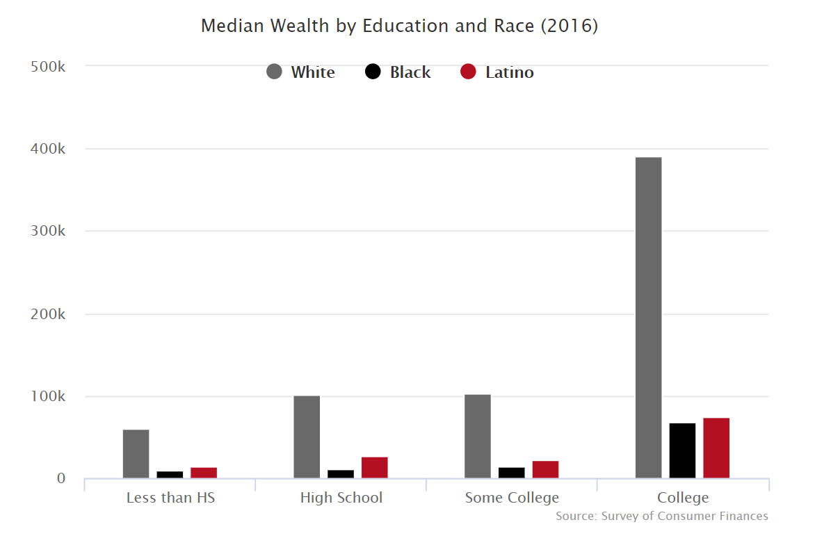
WEALTH
BY ED.
AND
RACE

Slide 23
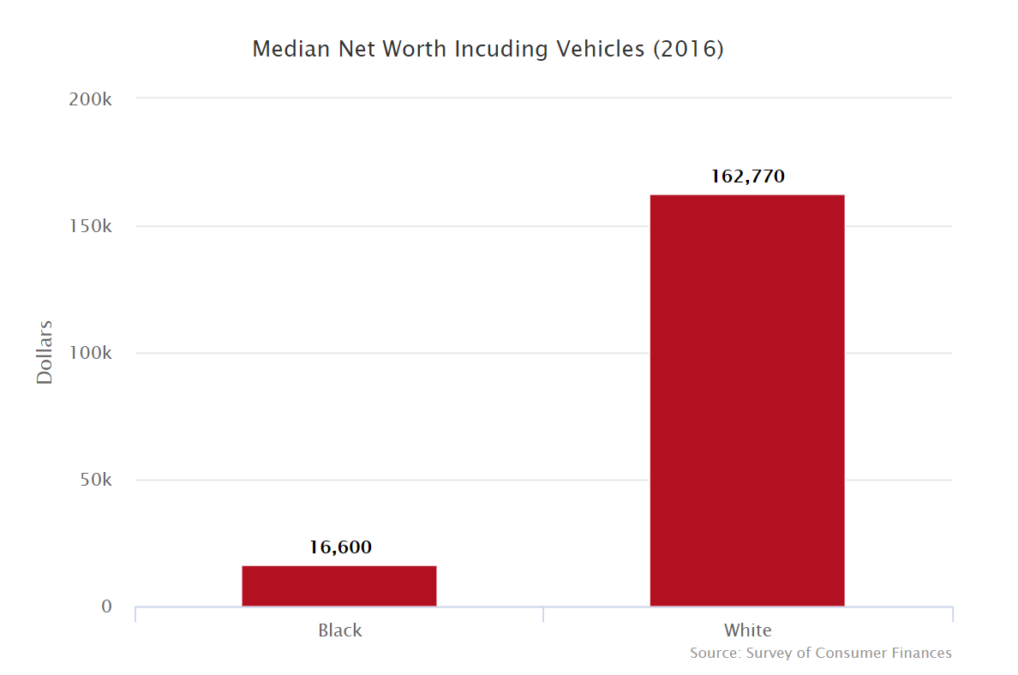
BLACK WEALTH V. WHITE WEALTH

Slide 24
THIS WAS BY DESIGN

Slide 25
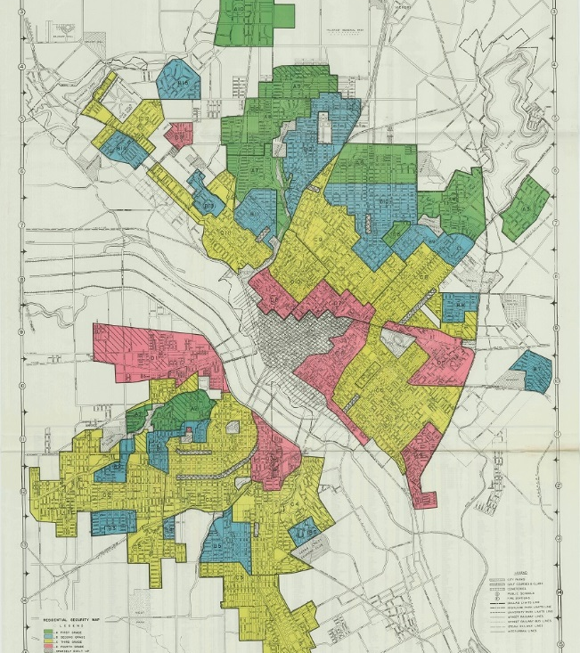
DALLAS HOME OWNERS LOAN CORPORATION MAP, 1937

Slide 26
DALLAS HOME OWNERS LOAN CORPORATION ASSESSMENT, 1937

Slide 27
FARM TAUGHT US HOW TO BUILD THREE KINDS OF POWER

Slide 28
CULTURAL
POLITICAL
ECONOMIC

Slide 29
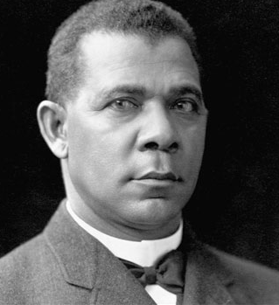
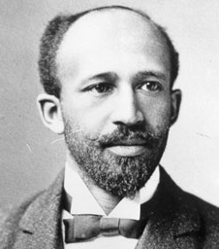
CULTURAL
POLITICAL
ECONOMIC

Slide 30
GROWTH
SINCE
2009

Slide 31
DEBT AFTER TWO YEARS
Notes:
Fiscal mapped discount rate
We were stagnant on our retention rate
We weren’t even collecting the money
Our students worked in tough places

Slide 32
THANK YOU

