Slide 1
EARTHQUAKES AND FLUID DISPOSAL – A historical perspective
North Texas Earthquake Study Group
Acknowledgements:
Cliff Frohlich and the USGS Earthquake Hazards Program
Notes:
.

Slide 2
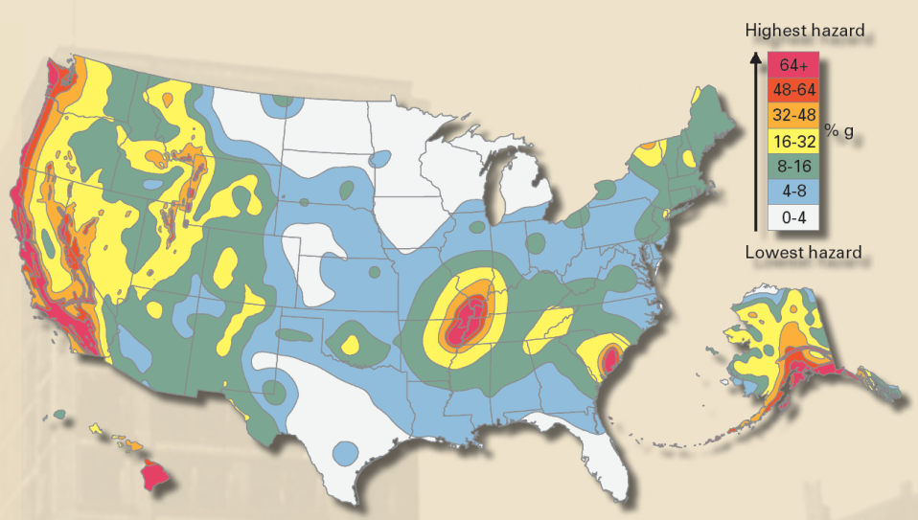





Earthquakes are a national hazard
USGS National Seismic Hazard Map
M6.8
M4.9
M5.2
M5.6
M5.1
M4.0
M6.8
M5.7
M4.0
M3.8
M6.5
M6.0
M4.3
M4.4
M3.8
M4.2
M3.8
M5.6
M5.8
M6.0
M3.9
M5.4
M5.3
M4.3
M6.6
M4.3
M5.0
M4.2
M5.6
M4.7
M7.9
M4.4
M4.9
M4.1
M4.2
M7.2
M4.1
M4.4
M4.4
M4.1
M4.3
M6.0
M4.8
M4.4
M7.2
M6.7
M3.9
M4.8
M5.3
M3.9
Notable earthquakes in the past 15 years
national earthquake hazards reduction program
Notes:
2

Slide 3
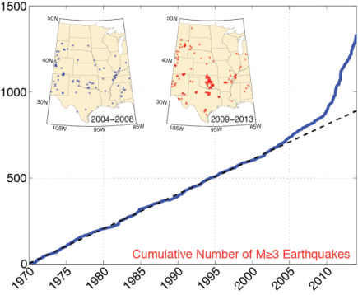
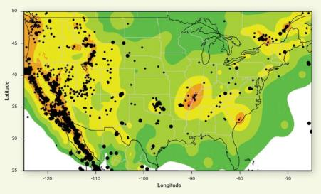
INCREASE IN SEISMICITY IN CENTRAL AND EASTERN US
US seismicity 2009-2013, M>3 displayed on US National Hazard Map
earthquake.usgs.gov/hazards/?source=sitenav
Recent increase in annual seismicity in Central and Eastern US. Ellsworth, 2012.
Updated 6 May 2014
earthquake.usgs.gov/research/induced/

Slide 4
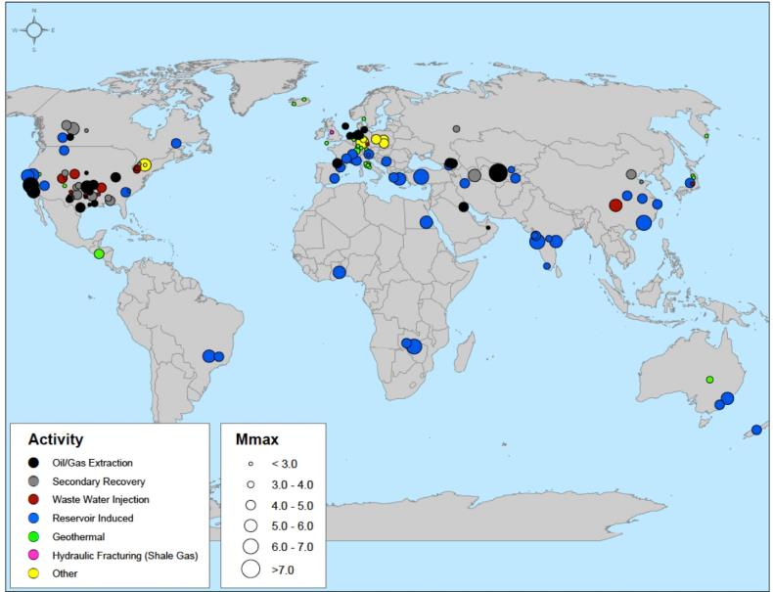
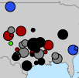
“Seismicity Caused by or Likely Related to Human Activity” NRC, 2013
Possible Linkage to Extraction and Injection of Fluids
www.nap.edu/catalog.php?record_id=13355

Slide 5
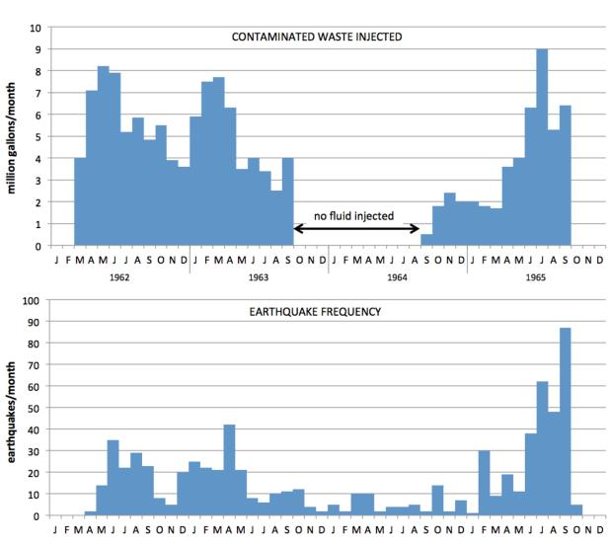
Rocky Mountain Arsenal Waste Water Disposal – 1962-1965
NRC, 2013

Slide 6
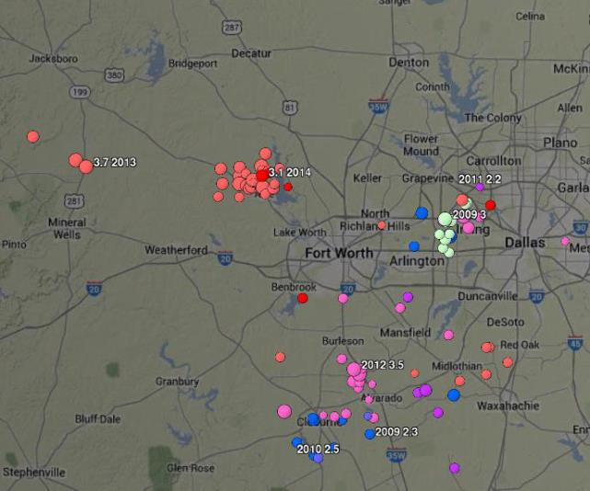
One Earthquake in Fort Worth Basin Prior to 2008 and over 70 Since
May 20, 1950: One felt report, no instrumental data
Azle
DFW Airport
Cleburne
Earthquakes Report by National Earthquake Information Center since 2008 (2.0 – 3.5)

Slide 7
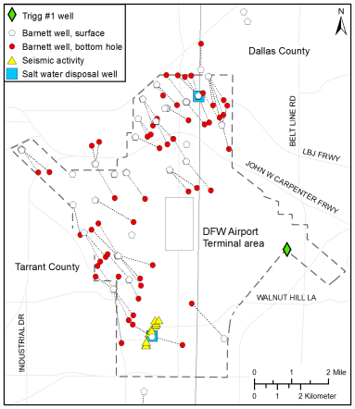
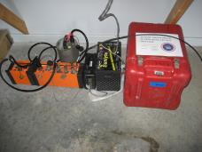
Locations Refined with Local Instruments
DFW Earthquakes 2008-2009
USGS Initial Locations Using
Regional Observations
Earthquake Locations Using Local Instrumentation
Frohlich et al., 2011

Slide 8
Were Earthquakes Induced or Triggered?
Qustions from Davis and Frohlich, 1993 | DFW Answers
1. Are the events the first known earthquakes of this character in the region? | YES
2. Is there a clear correlation between injection and seismicity? | YES
3. Are epicenters within 5 km of wells? | YES
4. Do some earthquakes occur at or near injection depth? | YES
5. Are there known geologic structures that may channel flow to sites of earthquakes? | YES
6. Are changes in fluid pressure at well bottoms sufficient to encourage seismicity? | UNKNOWN
7. Are changes in fluid pressure at hypocentral distances sufficient to encourage seismicity? | UNKNOWN
Little subsurface data to constrain structures, faults and material properties. This type of data needed to produce physical models to assess the cause of earthquakes.

Slide 9
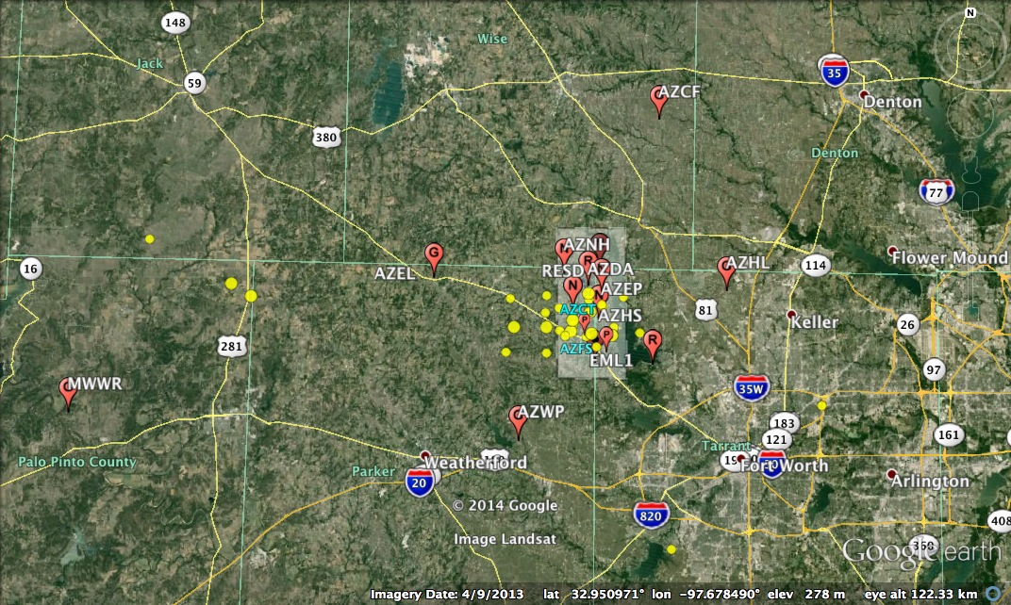
Reno-Azle Earthquake update
Station Map as of May 2014
12 active stations (G,R,N)
USGS NEIC Earthquakes
(11/01/2013 – present)

Slide 10
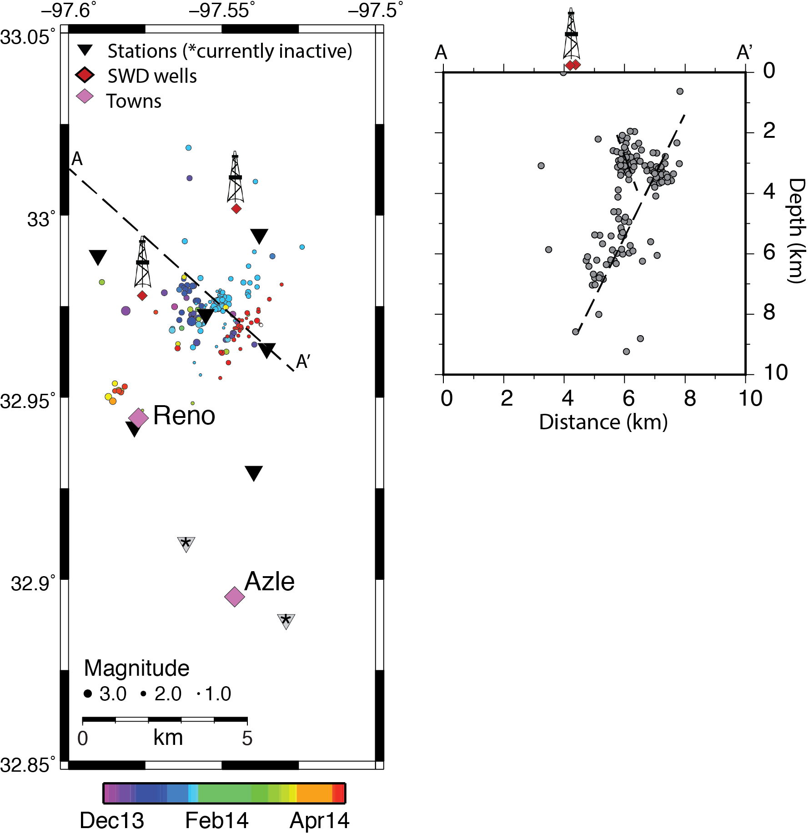
Preliminary Earthquake Locations*
The sequence is continuing, though there have been no felt events since Jan 28th, 2014
Seismicity rate has been highly variable
Faulting appears complex
* These results have not been peer-reviewed and location and magnitude details may change upon further analysis

Slide 11
PATH FORWARD
NRC, 2012
Current models employed to understand the predictability of the size and location of earthquakes through time in response to net fluid injection or withdrawal require calibration from data from field observations.
The success of these models is compromised in large part due to the lack of basic data at most locations on the interactions among rock, faults, and fluid as a complex system.

Slide 12
NEEDS
Seismic instrumentation adequate to establish baseline seismicity
Local instrumentation for detailed fault imaging during an active sequence
Local fault maps – at the surface and at depth
  Vertical and horizontal extent
  Fault Offset and Age
Detailed geological properties
  P and S wave velocities and density
  Permeability and porosity
  3D structure
Timely injector data
  Volumes as function of time
  Pressures, including downhole, as a function of time
  Bleed off tests
  Connectivity with surrounding wells
Regional stress data
  Orientation and strength
Our study team is developing rock mechanics models to understand fluid flow pathways through complex geology, but model results are not available at this time.

Slide 13
CONCLUDING REMARKS
Proof of Induced Seismicity may be difficult to obtain. Absolute proof may not be necessary for consideration of prudent operational changes.
Physical models for linkage between commercial activities and earthquakes exist but need development, testing and refinement. A range of physical models may be in operation depending on individual conditions.
Need for reservoir engineers, geologists and geophysicists to work together to attack these problems. Data sharing provides a step in assessment of these issues. Seismic monitoring is only one part of this assessment.

